Slide 1
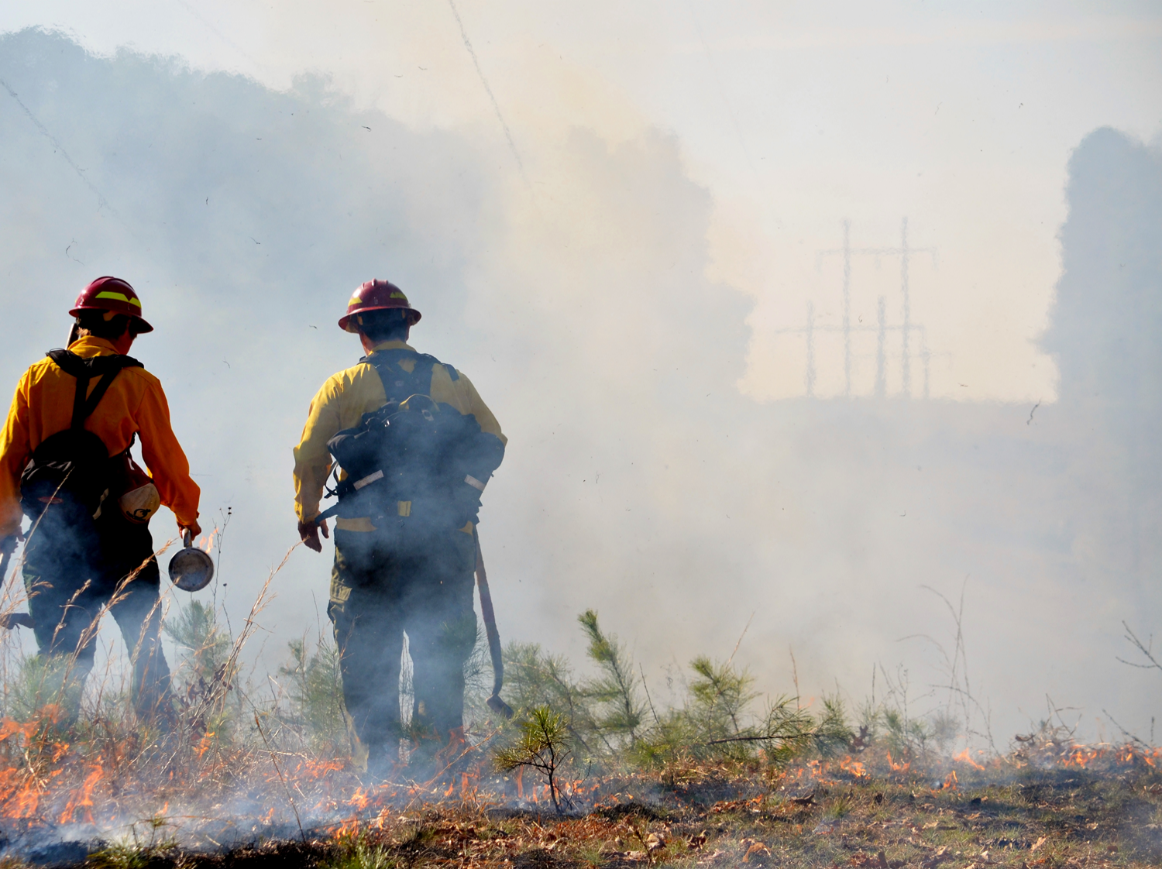
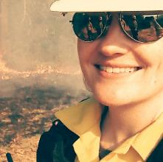
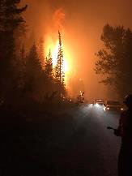
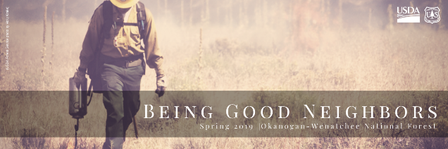
Smoke is the New Fire: Air Resource Lessons Learned
United States Department of Agriculture
Forest Okanogan-Wenatchee
Service National Forest

Slide 2
United States Department of Agriculture
Unit = 4.2M acres spanning 185 miles in Central Washington.
3 major media markets San Francisco, Atlanta or Boston
Acres burned = 648K in the last decade.
2017 = 1,026 days IMTs on unit
2018 = 22,873 unit staff days on incidents + worst air quality in the world + smoke refugee bill in Congress.
(Credit: NOAA NWS photo)
Forest Okanogan-Wenatchee
Service National Forest

Slide 3
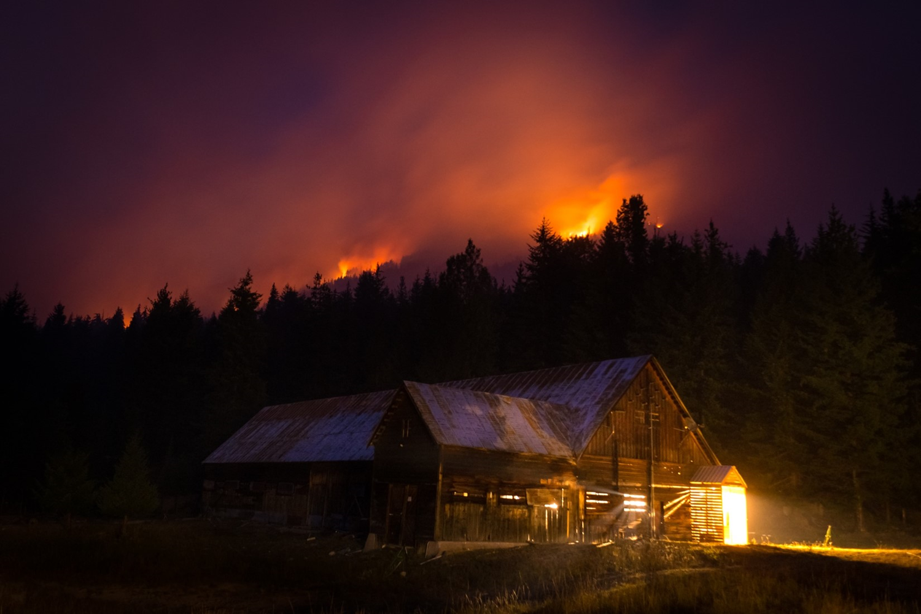
United States Department of Agriculture
Abstract
Wildfire smoke is an increasingly important public health concern for rural communities. The 2017 Diamond Creek wildfire in Washington state was used as a case study to describe the quantity, quality and receipt of wildfire smoke health risk communication information provided to the Methow Valley community. Sixty-four wildfire updates developed and distributed by the U.S. Forest Service incident management team were analyzed to determine presence of wildfire smoke health risk information by air quality each day and compared to the presence of general wildfire risk information (e.g., evacuation). In addition, a sample of Methow Valley community members was surveyed to understand if and how wildfire smoke health risk information was received during the 2017 wildfire season. The content analysis indicates that communication efforts were focused on the physical hazards of the fire and revealed a disconnect between poor air quality and the provision of health risk information. Moreover, only about 50% of survey respondents recalled receiving wildfire smoke health risk information during the 2017 wildfire season and about half would like to receive more information about wildfire smoke and health during future wildfires. Wildfire smoke health risk information should be intentionally communicated during future wildfire events by response agencies.
(Credit: Brandon Matson photo)
Forest Okanogan-Wenatchee
Service National Forest
Notes:
2017 Diamond Creek Fire, asset-based approach = gift of feedback, relationship loop = more thinking about the missing middle = seeing more opportunity

Slide 4
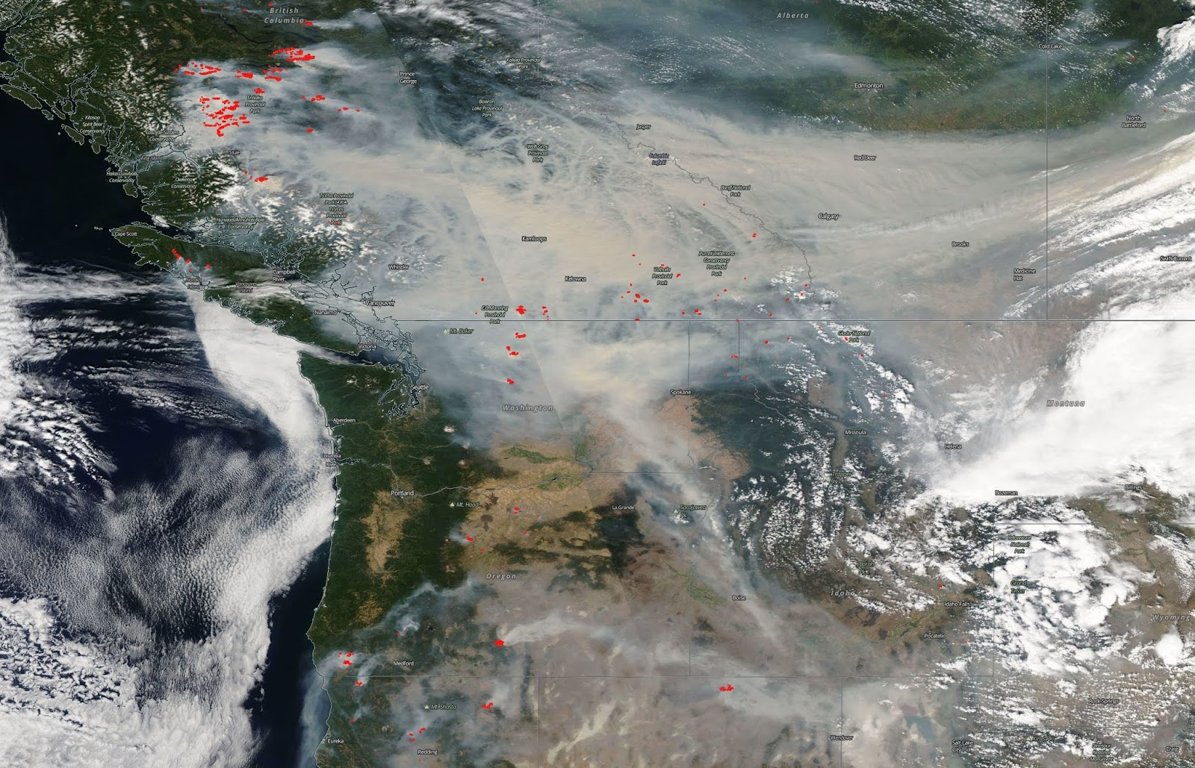
Customer Service Hours
United States Department of Agriculture
2017-2018 Fire Year Preparedness
Do we have organization and process silos around this?
How are we living our values around shared stewardship in regard to air quality?
Who is our missing middle? Are there opportunities to convene folks but not lead them?
Are our approaches relationship driven?
What’s in our Delegation of Authority? What’s in our PIO Plan?
Do I have clear ‘leader’s intent’ with my Agency Administrators for the PIO section around air resources, health risks, etc?
Are Air Resource Advisors on MOMs or an afterthought?
Are ARAs/Public Health PIOs a part of my daily meeting schedule? What about in Rx?
(Credit: WA Interagency Smoke Blog
Forest Okanogan-Wenatchee
Service National Forest

Slide 5
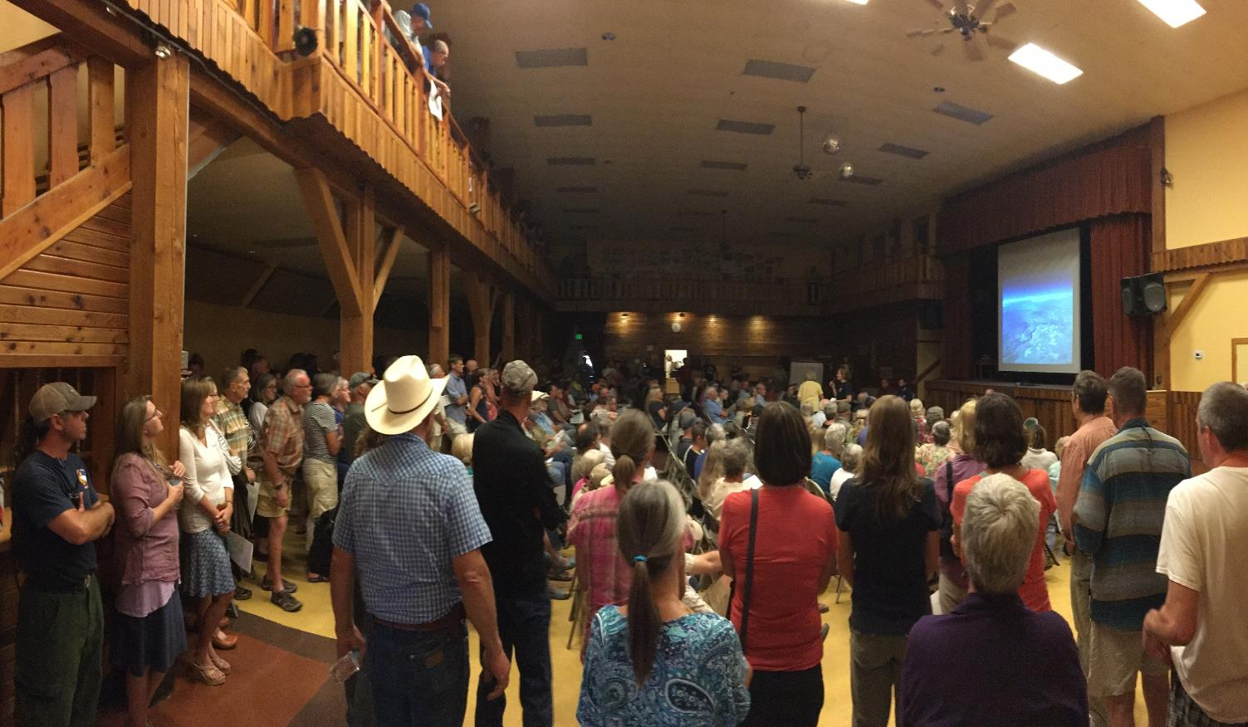
Customer Service Hours
United States Department of Agriculture
2018-2019 Desired Future Condition: We are good neighbors- being in service to the people as trusted communicators by working in collaboration and stewarding the whole. We foster the physical, psychological, and social safety of all- interdependent on our communities and colleagues. We nurture relationships as a core approach to program delivery. We are storytellers- leading with big why’s in the story of fire and smoke in this landscape.
(Credit: USDA Forest Service photo)
Forest Okanogan-Wenatchee
Service National Forest
Notes:
The future condition is a work in progress, but embodies how we value people and places. It’s about living our core values… and asking IMTs to live them as well. After all, we do it all the time when we talk ‘values at risk’. So then we started to reverse engineer from here.

Slide 6
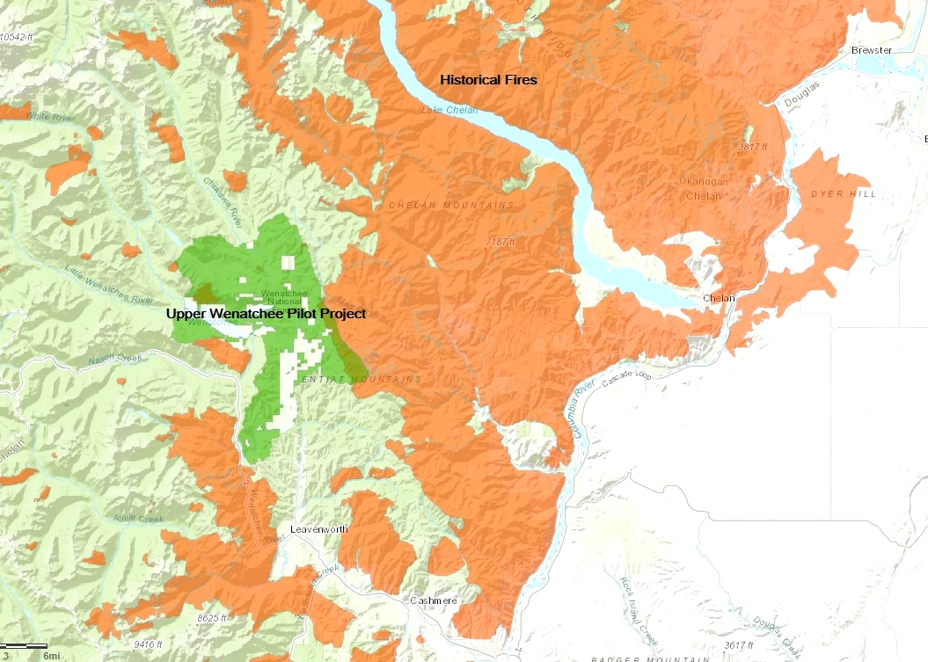
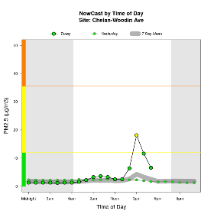
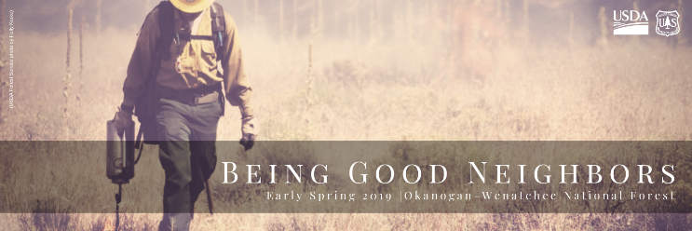
Customer Service Hours
United States Department of Agriculture
2019 Fire Year Preparedness
Core values in our PIO Plan & In-briefs.
In progress of convening, but not leading, county health PIOs around smoke and health.
Readiness with Agency Administrators.
Getting tactical = ARAs, Health PIOs integrated in meetings/products/content.
Prescribed fire integration (map/SM).
NEPA planning integration.
(Credit: USDA Forest Service map)
Forest Okanogan-Wenatchee
Service National Forest

Slide 7
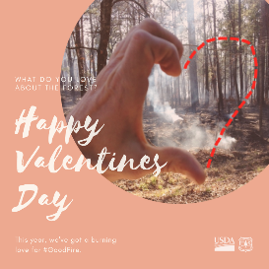
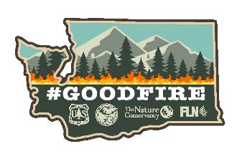
Thank you!
United States Department of Agriculture
Holly Krake, MSEd, PIO2
Public Affairs Officer
USDA Forest Service
Okanogan-Wenatchee National Forest
holly.krake@usda.gov
(Credit: USDA Forest Service photo by Holly Krake)
Forest Okanogan-Wenatchee
Service National Forest

