Slide 1
#FireYear2021 NIFC PIO Webinar

Slide 2
Webinar Topics
Introduction
Ongoing wildland fire response during COVID-19
National fire year themes
NIFC.gov and the PIO Bulletin Board
Biden/Harris Administration priorities
Updates from the NWCG PIO Subcommittee
Incident Management Remote Response
Social media
Information technologies update
Questions and answers

Slide 3
Introduction
Welcome
Zoom Tips
Samantha Storms, BLM

Slide 4
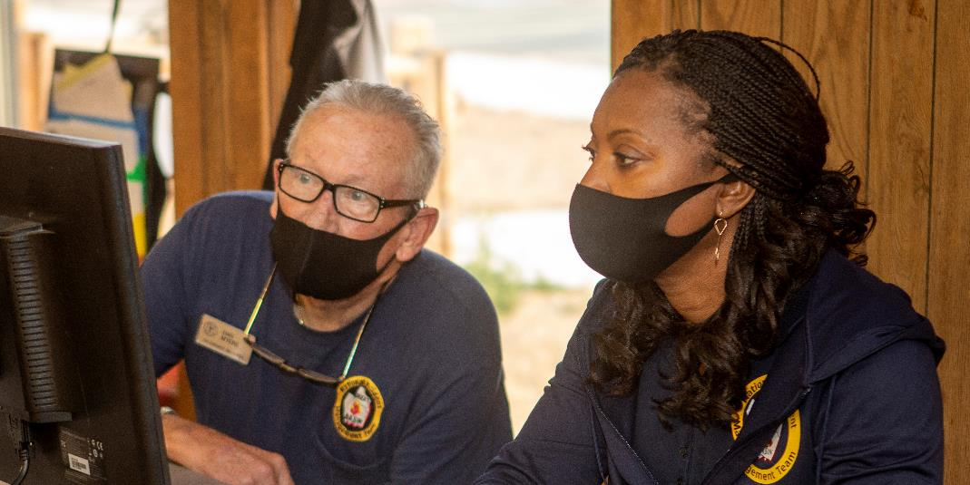
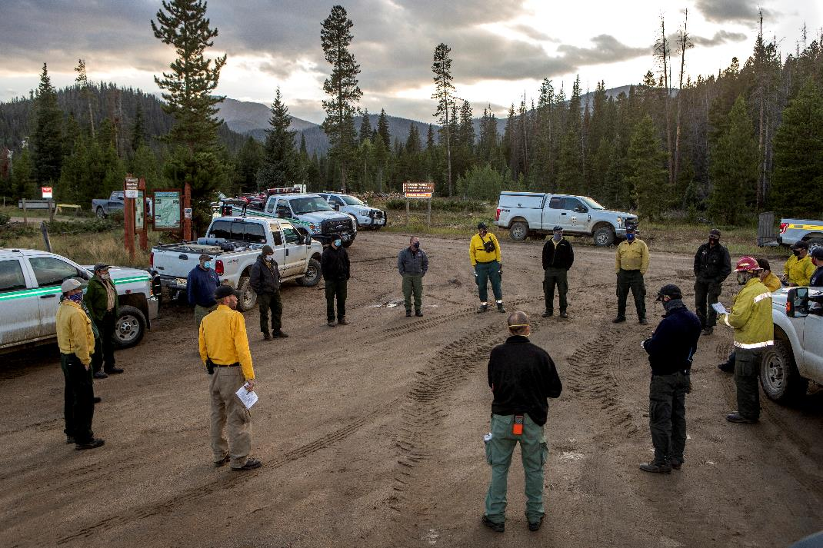
Wildland Fire and COVID-19
Stanton Florea, USFS

Slide 5
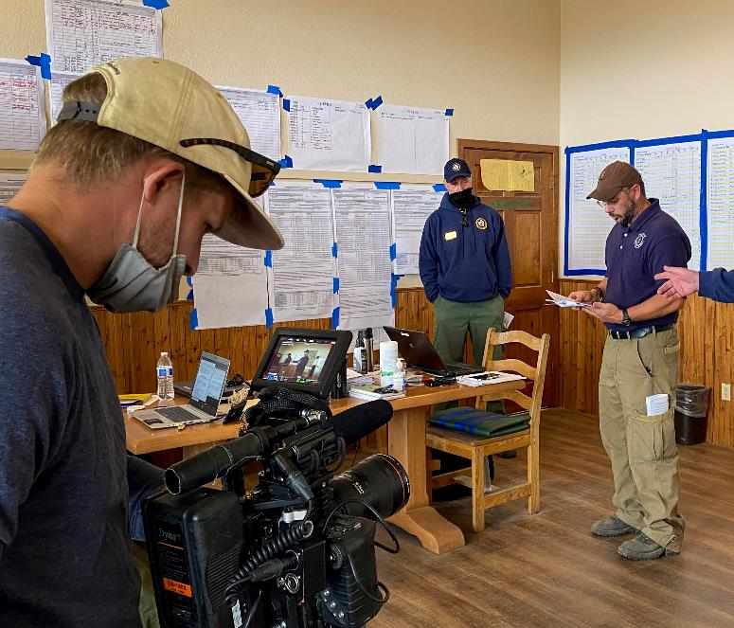
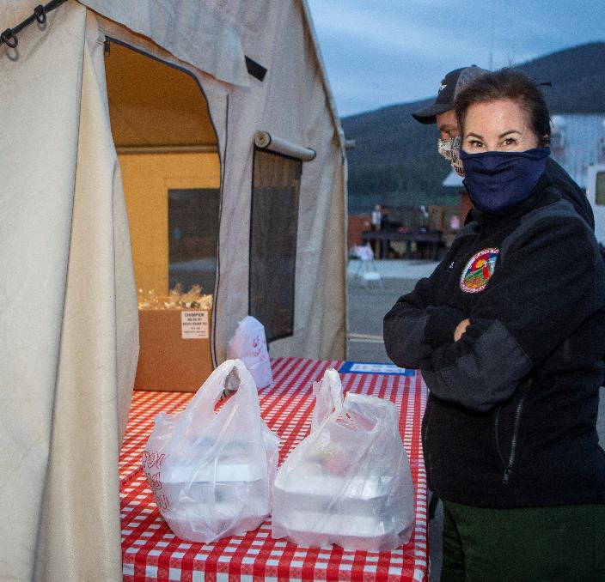
Wildland Fire and COVID-19
Knowns vs. Unknowns
Wildland Fire Response Plans – May, 2020
Agency Policy Differences
Public Trust

Slide 6
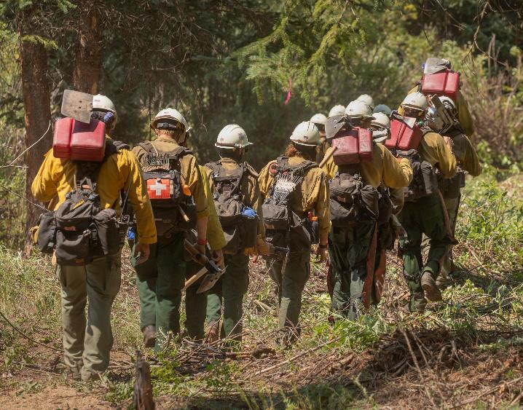
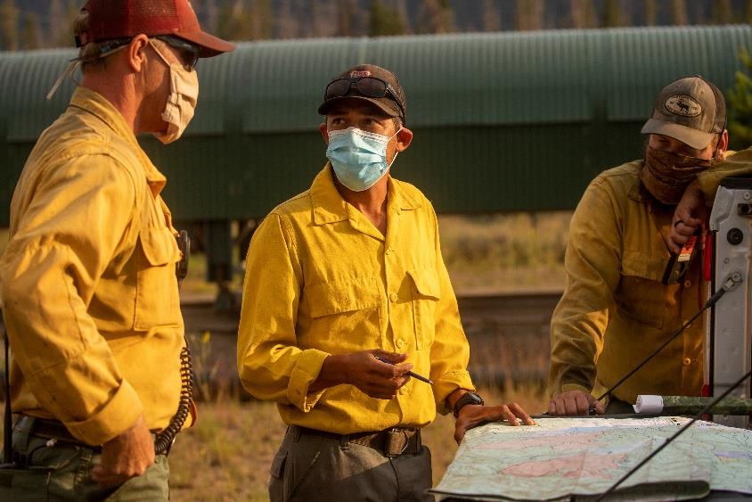
The Path Forward
Continue to use Adapted Fire Information Protocols
Policy Questions to Host Agency
Take Care of Yourself

Slide 7
2021 National Fire Season Themes
Jennifer Myslivy, BLM

Slide 8
Interagency
Highlights important topics
50,000-foot level overview
Notes:
The National Seasonal Themes are a coordinated effort from all agencies that highlights important topics from a variety of subjects. Over the years, the following topics have been addressed: UAS, budget, air tankers, and staffing to name a few.
These themes are developed from a 50,000-foot view but can be easily revised to support local needs.

Slide 9
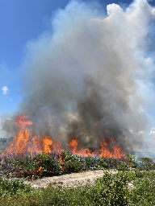
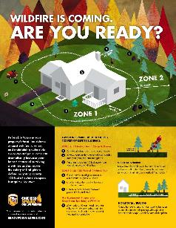
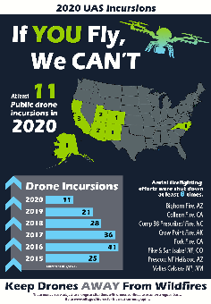
Toolbox of Communication
Notes:
These themes are just a few items that are in the toolbox of communication that we can use during each Fire Year!
Outdoor recreation and fire prevention
RX fire
Creating defensible space
If You Fly, We Can’t
COVID 19 protocols and guidance for both firefighter and public safety
What are other types of themes are out there for #FireYear2021?

Slide 10
NIFC.gov and the PIO Bulletin Board
Sheri Ascherfeld, BLM
Notes:
Hello everyone, I’m Sheri and I work in the external affairs group at NIFC.
And, I’ll quickly talk about the NIFC website and the PIO Bulletin Board

Slide 11
Accessible
Search feature
Automation
Submit photos
Notes:
In February we launched the new NIFC website
Accessible and responsive,
includes a search feature,
Automatically updates statistics
The new site offers a place to submit photos that we can use on our website and our social media accounts.
We welcome your feedback - please submit an email via Contact Us.

Slide 12
PIO Bulletin Board
Tools and guidance
Information updated often
Your suggestions are welcome
Notes:
The PIO bulletin board is a place where PIOs can find tools, documents, and guidance to use on fire assignments.
Working to update this information
Want it to be a useful tool
If you have ideas about documents to add or how to make it more user friendly, contact either Carrie Bilbao or Candice Stevenson with your suggestions.

Slide 13
Biden/Harris Administration Priorities
Jessica Gardetto, BLM

Slide 14
Biden and Harris Administration Priorities
COVID-19
Climate
Racial Equity

Slide 15
Updates from the NWCG PIO Subcommittee
Candice Stevenson, NPS

Slide 16
Submitted revision to the Media Interviews page in the IRPG (p 101)
Topics include Media Visit, Media Interviews, and Social Media
This revision should be in the 2022 version
PIO1 and PIO2 updated IPDs are available for comment.
https://www.nwcg.gov/positions
revision
In 2022
Notes:
The PIOSC has accomplished quite a few things this year despite not being able to have an in-person meeting. We submitted a revision to the “Media Interviews” page in the IRPG (that’s page 101). We kept much of the information, but added social media guidance. The page will be divided into three sections: Media Visit, Media Interviews, and Social Media to allow the user to find information quickly according to their situation. You will see this update in the 2022 revision.
The revised position descriptions for PIO1 and PIO2 are available for comment. The PIOSC updated these position descriptions based on the last feedback received when they were published in 2019. Please submit your comments by using the button on the NWCG page. We encourage comments by the end of July, but will continue to take comments anytime.

Slide 17
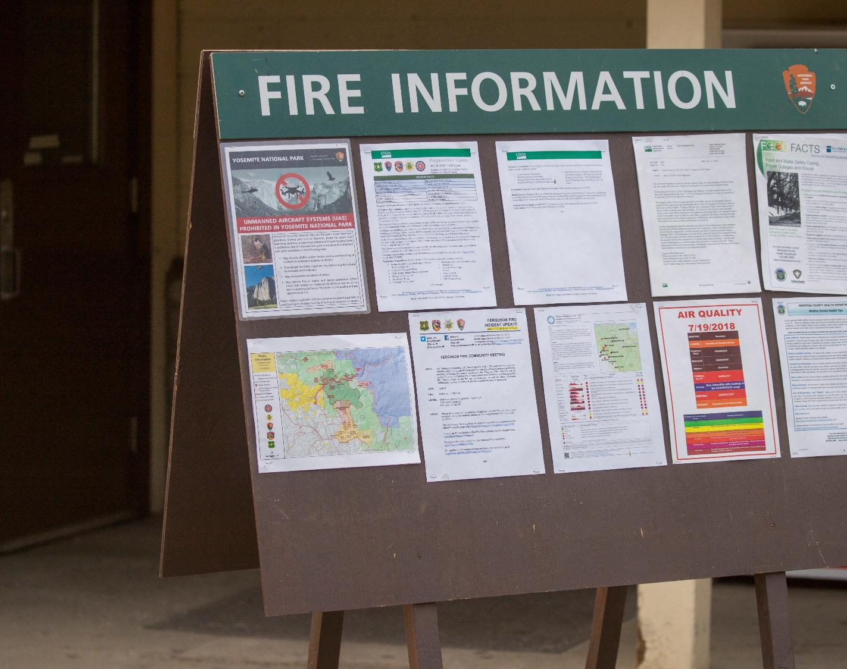
Proposed PIOF standards and qualifications and PIOT (technician) position to be added and available to order in FY 2022. ​
Next year, PIOSC plans to complete revisions to PIOF task book and continue to work with NWCG on training revisions (S-110, S-130, S-203).​
Public Information Officer Subcommittee | NWCG
Notes:
The Incident Standards and Positions Committee is currently reviewing the proposal for the addition of the PIO Technician position and the updates to the PIOF. For the 2021 fiscal year, the PIO3 position will still be named PIOF to prevent confusion with the all-hazard PIO3 position in the ordering system. The updated standards for PIOF will be the same as proposed for the PIO3, but the name will just remain the same. The PIOSC proposed that the PIOT position be added in 2021 and be available to order. The updates and additional training for the “new and improved” PIOF will take effect by October 2022. Those that are currently qualified as PIOF will remain PIOF, those that are working on task books for PIOF will have until October 2022 to complete the qualifications before the new standards are in effect. If you have an open task book after October 2022, you will be required to meet the new requirements.
The next steps for updating the standards is to finish revising the PIOF task book to meet the new position description. This will include leadership development and use of social media platforms. PIOSC will continue to work with NWCG to update to S-110 and S-130 to better meet the needs of PIOs and revise S-203 to ensure better training for today’s PIOs. Topics to consider adding to S-203 include social media platforms, technology, 508 compliance, and supervisory training, among others.
As always, please contact your agency PIOSC representative if you have any questions or feedback. You can find us at our NWCG website.

Slide 18
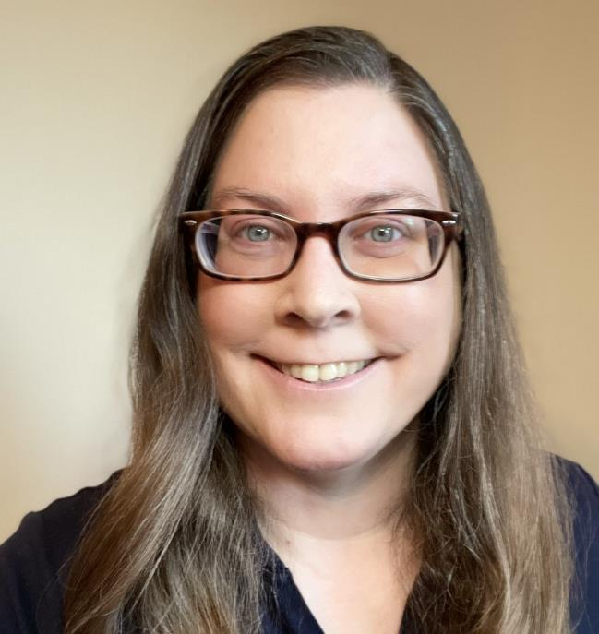
Incident Management Remote Response
Michelle Fiddler, USFS

Slide 19
Incident Management Remote Response (IMRR)
Connecting the Field – Sharing Interagency Incident Innovation – Building Best Practices
Public Information Officers
Wildland Fire Lessons Learned Center wildfirelessons.net > Communities > Incident Management Remote Response (https://tinyurl.com/IMRRinfo)
The purpose of the IMRR community is to provide a single repository for information, best practices, and lessons learned from field practitioners, first responders, IMTs, and agency administrators responding to incidents in a remote environment.
The knowledge collected on this forum will be available for future responses as changes from our "traditional" models are expected.

Slide 20
Incident Management Remote Response (IMRR)
Connecting the Field – Sharing Interagency Incident Innovation – Building Best Practices
Public Information Officers
IMRR PIO calls
Currently bi-monthly on the 1st & 3rd Wed of the month, 10-11 am Pacific Time
Calendar invite reminders with agenda items are currently being sent out a few days before the call
Call notes, recordings, tech talks, and related resources: https://tinyurl.com/IMRRPIOOneNote
Sign up for IMRR PIO call invites on the Wildland Fire Lessons Learned Center at: https://tinyurl.com/IMRRinvite

Slide 21
Social Media
Samantha Storms, BLM

Slide 22
Social Media Goals
Continue to tell the story of wildland fire and other all-hazard incidents to the public.
Highlight:
Wildland firefighting efforts at all levels of the organization
Interagency cooperation
Build long-term relationship with audience to increase trust
Continue online dialog with followers

Slide 23
New partnerships to promote #WildfirePrevention
Growing NIFC photo library on flickr.com/photos/nifc
Ongoing work with employee and contract photographers

Slide 24
Content from the field is ALWAYS welcome
#FireYear2021#WildfirePrevention
#WildfireSafety
#FirefightingResources
#FireName (incident specific)
#NationalFireNews
#WildlandFireOutlook
#WildfireWeatherAWARE
#PreparednessLevel (no “s”)
#FireJob (no “s”) and #NotYourOrdinaryJob
#NeverForgotten
#FireScience
#RxBurn and #RxFire (FWS uses a lot)
#IfYouFlyWeCant and #NoDroneZone
#RecreateResponsibly
Like, follow, tag, and share on social media!

Slide 25
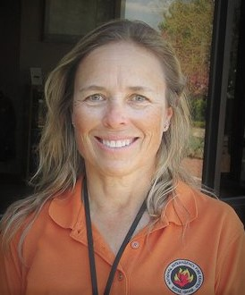
Information Technologies Update
Carrie Bilbao, BLM

Slide 26
Wildland Fire Information and Technology (WFIT)
FAM-IT Portal and Dashboard
IROC
Have access to self status
FAM-IT login: https://iwfirp.nwcg.gov/
Have an iNAP account
Ordering
Reporting capabilities

Slide 27
Wildland Fire Information and Technology (WFIT)
IIA Help Desk: 1-866-224-7677 https://iiahelpdesk.nwcg.gov/
InFORM: https://in-form-nifc.hub.arcgis.com/
Fire reporting
ArcGIS login
To report issues or provide feedback, email inform@firenet.gov

Slide 28
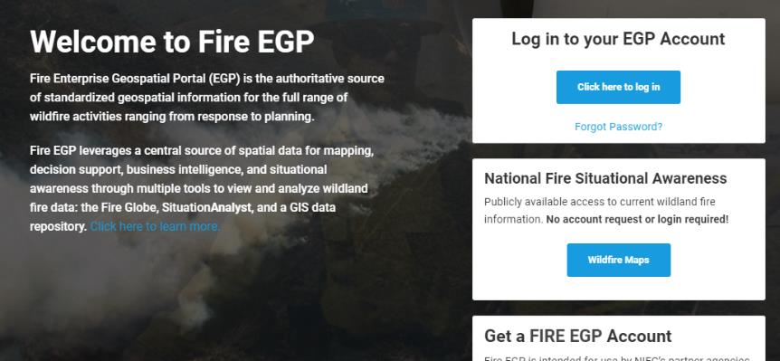
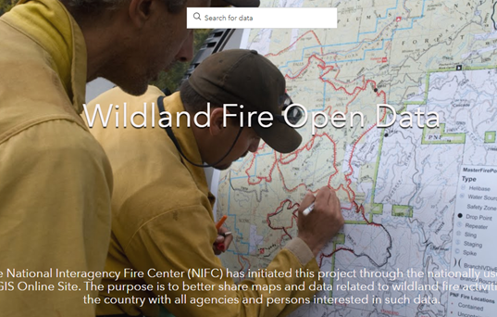
Maps
NIFC FTP migrated to: ftp.wildfire.gov
Fire Enterprise Geospatial Portal (EGP)
https://egp.nwcg.gov/egp/default.aspx?ReturnUrl=%2fegp%2fLaunchpad.aspx
Standardized geospatial info source of spatial data
NIFC Open Data site
https://data-nifc.opendata.arcgis.com/
Provides fire perimeter maps/data
Request for help here: NIFC Open Data Site Support Request Form.

Slide 29
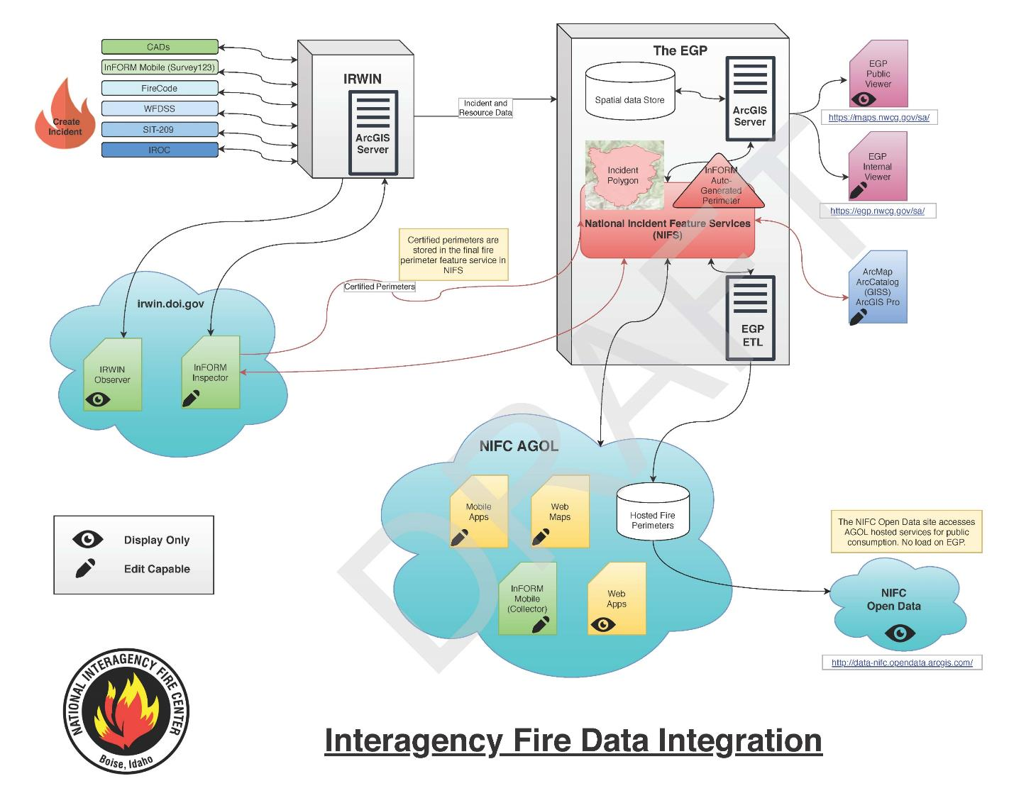

Slide 30
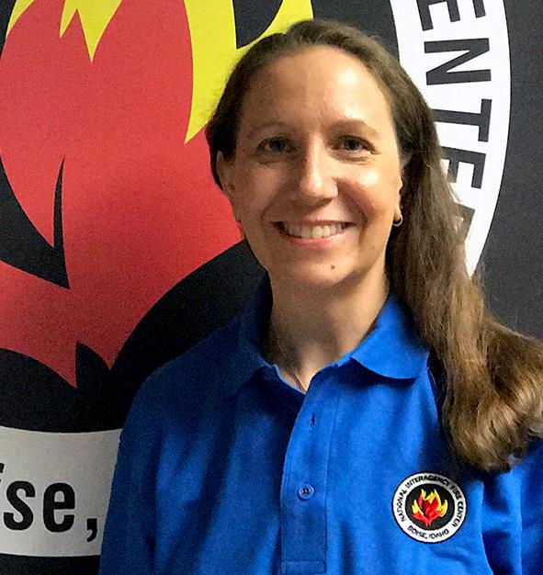
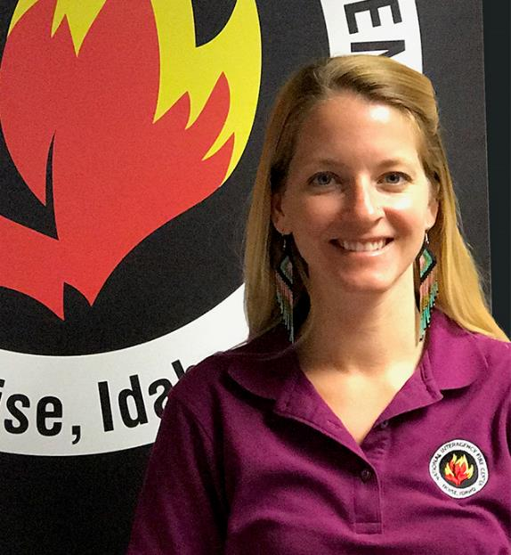
Questions and Answers
Tina Boehle, NPS
Kari Cobb, FWS

