Slide 1
InciWeb Administrative
Site Training
April 25, 2018

Slide 2
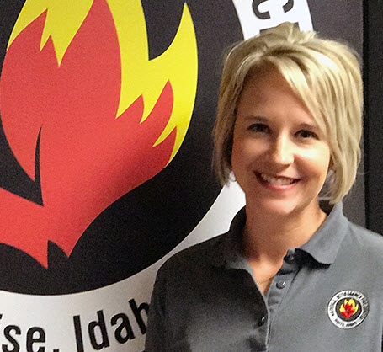
Christine Schuldheisz
Public Affairs Specialist
U.S. Forest Service, Washington Office, Fire and Aviation Management
National Interagency Fire Center
Boise, Idaho
Notes:
Hi everyone, my name is Christine Schuldheisz and I am a public affairs specialist for the U.S. Forest Service at the National Interagency Fire Center in Boise, Idaho. I am also the business lead for InciWeb. I’ve served as the business lead for about 5 years.
Before we get started I just want to thank you for using InciWeb.
Information about all fires of interest should be posted on InciWeb.
Fires may be considered of interest due to location, threats to homes, safety impacts, or political interests, even if they are small. It doesn’t matter what other communication tools you’re using, InciWeb is the go to place for information for senior Forest Service and USDA leadership and fires on National Forest System land are expected to be on there.

Slide 3
Objectives
In depth training of the InciWeb administrative site.
Create a new incident within the InciWeb administrative site.
Allow time for questions and answers at the end.
Reminder: The next hour of this webinar will be dedicated to the new InciWeb public website.
www.nifc.gov/PIO_bb/inciweb.html
Notes:
The purpose of this presentation is to provide you with in-depth training on how to create a new incident in the administrative site.
There are instructions on how to create a Ness Application Portal (NAP) account to get an InciWeb account on the PIO Bulletin Board in the InciWeb section – I put that URL at the bottom of your screen.
The goal is to make sure that you’re ready to go when you get that first fire or other incident on your unit or when you get that first assignment to work on a fire or other incident on another unit.

Slide 4
Accessing the Administrative Site
Option 1:
Option 2:
https://nap.nwcg.gov/NAP/#
Notes:
There are two ways to log into the InciWeb administrative site – by clicking on the ‘Login’ button in the footer of the new InciWeb public site or by clicking on the link https://nap.nwcg.gov/NAP/#

Slide 5
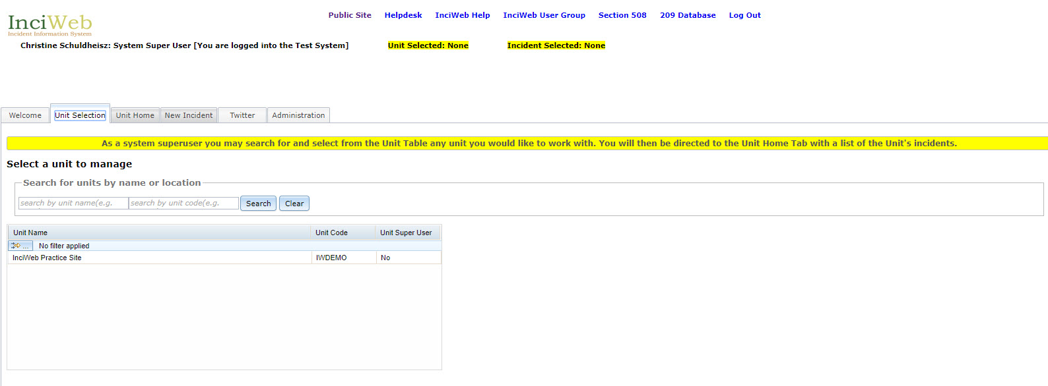
Unit Selection
Notes:
Just a quick note about this screen – my access is different than yours because I have a system superuser access that allows me to troubleshoot issues on every unit in InciWeb.
You can also see I’m on the TEST system and not PRODUCTION system that you will be on when you create an incident - I’m doing this for demonstration purposes and TEST is not available to users.
On this screen, you should see a link to the InciWeb Practice Site as well as links to units that you have access to. If you don’t see a link to the practice site, you will need to contact the interagency incident applications helpdesk and ask them to give you access to it.
The InciWeb Practice Site is designed to enable superusers and users to gain “hands on” experience with the InciWeb Administrative site. You can create new, and update existing, incidents on the InciWeb Practice Site without anything appearing on the InciWeb site on the internet.
Click the InciWeb Practice site or the unit that you have access to and want to work on, then click the “Unit Home” tab.

Slide 6
Unit Home Screen
Notes:
On the left side of the ‘Unit Home’ screen, you will see a table with a list of existing incidents for the unit that you have selected to work on. Under the ‘Status’ column incidents are identified as being ‘Active’ or ‘Inactive’. Inactive incidents won’t appear on the InciWeb public website. You can re-activate an incident on the 209 screen that I will show you next.
From the ‘Unit Home’ screen, you can select an incident by clicking on it in the table on the left. This will open the 209 screen for that incident. You can edit the 209 screen or choose other tabs to edit by clicking on the tabs at the top of the page (i.e. Contacts, Summary, Articles, etc.).
From the ‘Unit Home’ screen, you can also create a new incident by clicking on the ‘New Incident’ tab at the top of the page.
From here on, we’ll discuss how to enter and update incident information into the InciWeb Administrative site by creating a new incident.

Slide 7
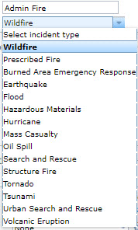
Creating a New Incident
Notes:
There are three sections on the New Incident Screen: “Basic 209 Information”, “Contact Information” and “Summary Information”.
Enter information into at least all of the required fields, indicated by a red *
If you don’t have an ICS-209 form, or if it is not complete, obtain the information from another official source, such as a unit Fire Management Officer or Incident Management Team Member.
The ‘Incident Name’ field automatically generates a Twitter hashtag, so it is recommended that you add the incident type after the incident name.
Click the arrow in the box to the right of the Incident Type field to reveal a drop down menu of incident types and select the appropriate one. On the right you’ll see a list of incident types you can choose from because InciWeb is not only fire and fire related activities, but all-hazard incidents as well.
In the “Contact Information” section, enter at least the name and phone number of the primary public information office or officer that you want other agencies, the public, and media to call for more information about the incident. This can be the name of a unit, such as Fire Information, or the name of a person, depending on the circumstances. You will have an opportunity to enter additional contacts on the ‘Contacts Screen’ which is coming up later.
In the ‘Contact Hours of Availability’ field, you will notice light gray text that reads M-F 9-5 p, etc. This is a suggested format for the days and hours that the contact office or person is available. However, you are not required to use this format and the application will accept information in this field in any format that it is entered in.
In the “Summary Information” section, enter an overview of the incident –priority information the public needs to know.
You can type text directly into the ‘Summary Information’ text box or you can “cut and paste” text from other documents using the “Paste from Word” tool.
Using the “Paste from Word” tools can save time if you have already created a document with information about the incident for another purpose, such as a news release or a briefing. But, be careful doing this because you can have extra characters and missing text when copying from an outside source.
After you have entered information into at least all of the required fields, click the ‘Save New Incident’ button at the top of the screen.

Slide 8
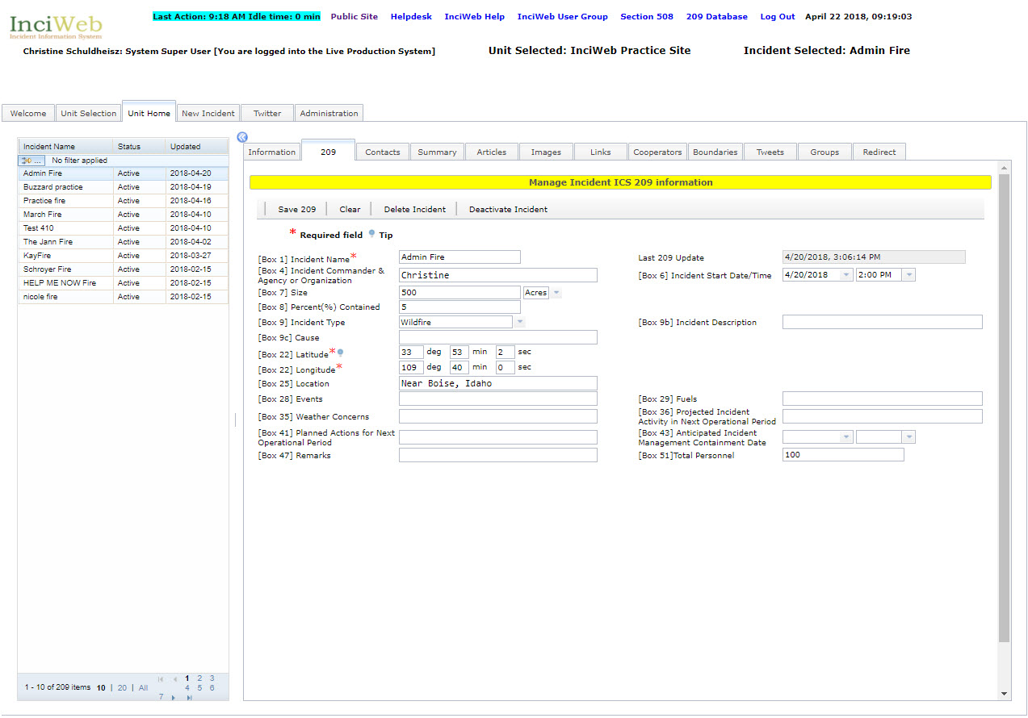
New Incident Created
Notes:
Now you can see your incident appears at the top of the left column – and the basic information you entered on the ‘New Incident” screen appears on the right in the 209 tab.
Now you can enter information into the fields on the ‘209’ screen from the ICS 209 form or from another official source as discussed in the New Incident Screen section.
The fields on this screen include box numbers that correspond to the box numbers on the ICS 209 form.
‘Incident Name’ and the latitude/longitude fields are required. The lat/long coordinates need to be numeric values greater than zero. This is required in order for the incident to appear on the map in the new InciWeb public website. There is a tool tip about lat/long coordinates if you click on the blue circle next to the word latitude.
When you have filled in as many of the fields as you can, click the ‘Save 209’ button at the top of the screen.
Superusers can change the status of an incident from active to inactive by clicking the ‘Deactivate Incident’ button at the top of the screen.
To change the status of an incident from inactive to active, click the ‘Activate Incident’ button at the top of the screen.
Superusers can delete an incident by clicking the ‘Delete Incident’ button at the top of the screen. InciWeb is not intended for long term storage of incident information, it is not a “system of record” so we recommend that superusers go in regularly and delete old incidents, that will help improve performance of the InciWeb site as well.
When finished – click on the ‘Save 209’ tab at the top.

Slide 9
Contacts
Notes:
This screen displays the contact that you entered when you created the incident and enables you to edit it and/or add more contacts.
When you see tables like this in the InciWeb administrative site, pencils indicate fields that can be edited and red dots with pencils indicate required fields that can be edited.
To enter or edit information in the contacts table, double click a cell, enter or edit information, and either hit “Tab” to move to the next cell or hit “Enter” to exit the table.
To add additional contacts, click the ‘Add Contact’ button, this will create a new line in the table to enter the additional contact.
Use the ‘Copy Contact’ function to add contacts if some of the information, such as a phone number or an email address, will be the same for different contacts. You can also delete a contact.
You can also mark a contact to be the primary contact by selecting on a contact and click on the ‘Set Primary Contact’ button. This contact will appear first on the public site.

Slide 10
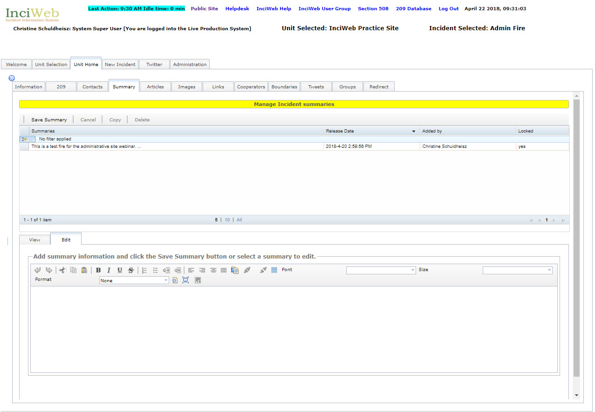
Summary
Notes:
On the ‘Summary’ screen, you can edit the summary that you wrote when you created the new incident and/or write new summaries.
The summary you created in the ‘New Incident’ tab appears in the ‘Summaries’ table. To create a new summary just enter the information in the editor at the bottom. Again, please be careful if you use the ‘Paste from Word’ feature as that often creates extra characters and formatting you didn’t intend to have. If your summary looks wrong on the public side it’s because you copy and pasted. Always double check your summary before posting.
You can also edit an existing summary by selecting one under the summaries table and select ‘Copy’. A new summary will appear in the table marked with a ‘no’ under the locked column. You can edit this summary and then save it as a new summary. The most recent summaries appear first.
Summaries marked with a ‘Y’ in the locked column mean it appears on the public site and can’t be edited – that’s why you need to make a copy and select the summary marked with a ‘no’ in the ‘Action’ column.

Slide 11
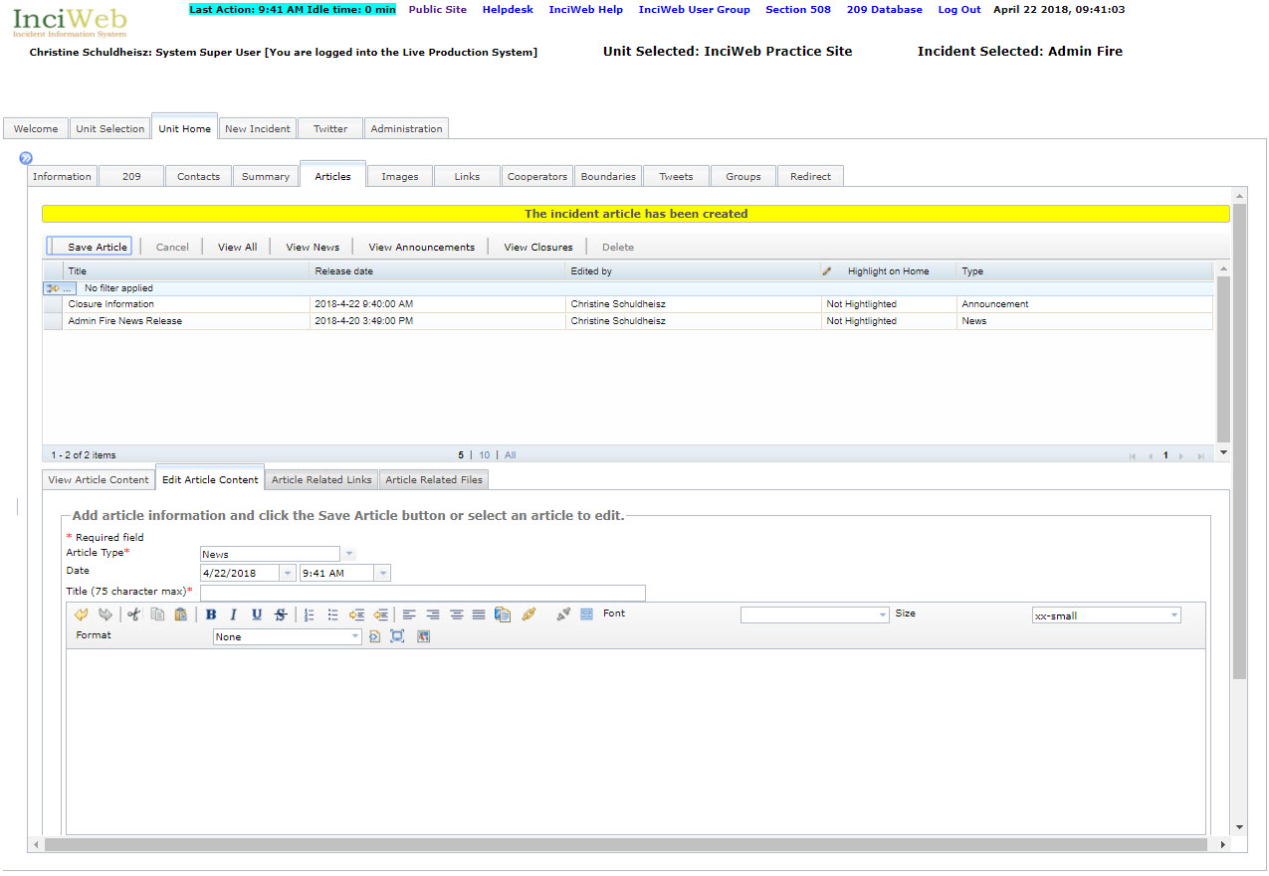
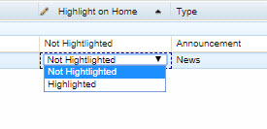
Adding Articles News, Announcements & Closures
Notes:
On the ‘Articles’ screen, is where you add information pertaining to “News,” “Announcements,” and “Closures.”
To start creating an article – just start typing in the editor box at the bottom. This editor is the same type you used to create a summary.
Click the arrow in the box to the right of the ‘Article Type’ field to reveal a drop down menu of article types. Indicate the type of article you want to add by selecting “News, “Announcement”, or “Closure.”
The date and time that the article was created are automatically generated by InciWeb but can be changed if needed. To change the date or time, click the arrows to the right of the ‘Date and Time’ fields. This will reveal a drop down calendar and times, select the appropriate date and time.
The last requirement is to fill in a title for the article.
When you’re done with writing your article – select ‘Save Article’ at the top.
The article that you have created will appear in the table.
To edit an article that you have created, click on the article in the table that you want to edit to highlight it, then click the ‘Edit’ button at the top of the screen.
You can view all of the different types of articles that you have created together by clicking the ‘View All’ button at the top of the screen. Or, you can view different types of articles that you have created separately by clicking the ‘View News’, ‘View Announcements’, and ‘View Closures’ buttons.
If you want to enhance the content of an article by adding a link to a website or by adding a document, click on the article in the table that you want to enhance and select from ‘Article Related Links’ or ‘Article Related Files’. If you choose to do this these related files will appear with the article on the public page.
One more thing you can do with articles is select to ‘highlight on home’. This allows you to select an article to have it appear on the public site at the top of your incident page information. To do this double-click simply in the drop down menu for the article you have selected and select ‘highlighted’. To un-highlight – simply change it back to ‘not highlighted’. I have demonstrated this in the pop-up you see on your screen.
NOTE: Make sure you only have one article highlighted at the same time. Having multiple articles highlighted at the same time will cause a ‘404 error on your incident page on the public website.

Slide 12
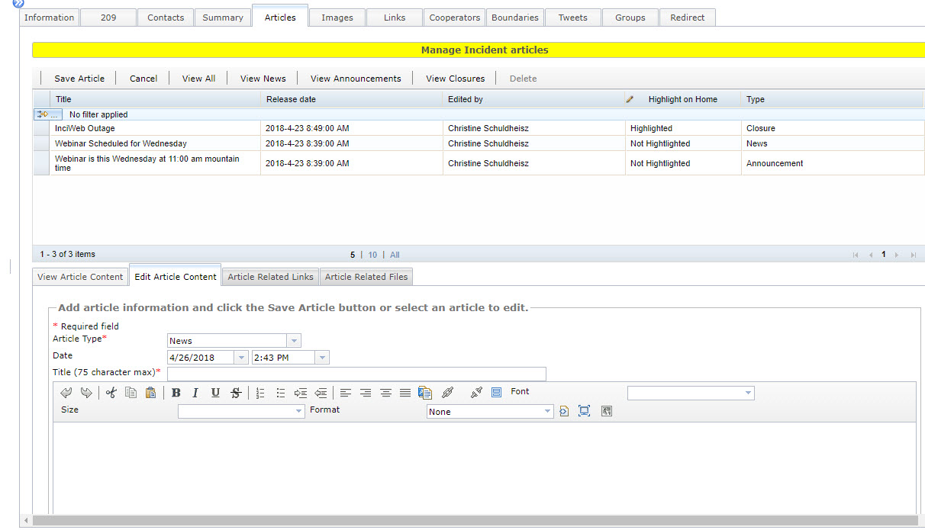
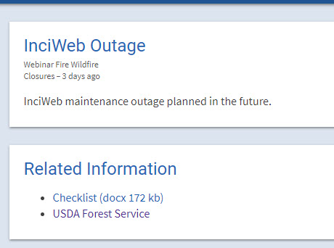
Adding Related Links or Related Articles to an Article
Notes:
You can add article related links and articles to any article you create. Select the article you wan to add related information to and click on either the ‘Article Related Links’ or ‘Article Related Files’.
Pop-up boxes will appear asking you to input and upload information. When you’re finished select the ‘Save Article’ button at the top. The insert shows what it looks like on the public website when you add related link and articles to an article – closure, news or announcement.

Slide 13
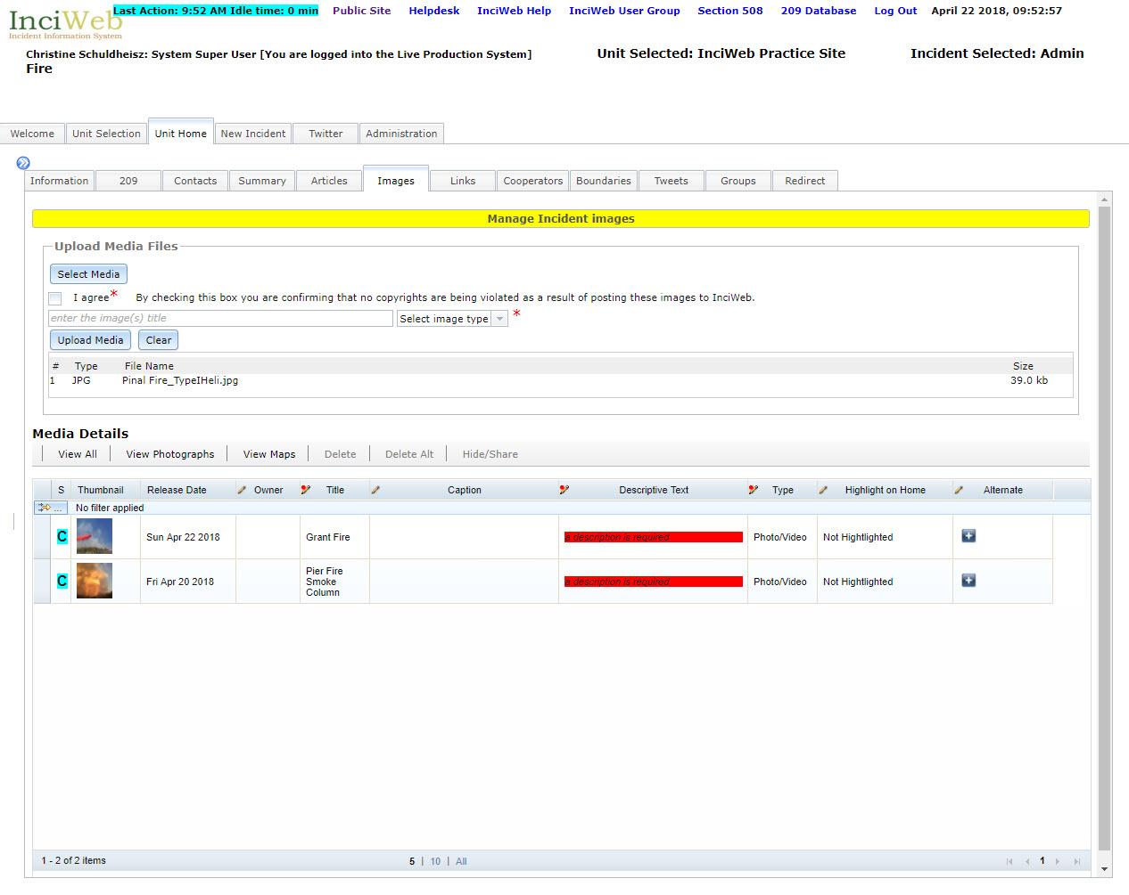
Adding Images, Videos and Maps
Notes:
Now we are on the images tab where you can upload photos, videos and PDF maps.
Confirm that the image is not copyright protected by checking the box to the left of “I agree” below the “Select Media” button. A tool tip with photo and video specifications will appear above ‘select media’ button when you hover over it. Click on the ‘select media button’ and choose your photo saved on your computer.
Enter a brief title in the field with “enter the image(s) title”. This will be displayed with thumbnail versions of the image on the InciWeb internet site.
Indicate the type of image you want to upload by clicking the arrow to the right of the ‘Select Image Type’ field to reveal a drop down menu and select ‘Photo/Video’ or ‘Map’. Then, click the ‘Upload Media’ button.

Slide 14
Uploaded Images Media Details Table
Notes:
The image will appear in the ‘Media Details’ section at the bottom of the screen where you can add information about the person who took the photo, edit title, add caption and descriptive text, highlight on home and add alternate file for a photo/video or map.
All you need to do is just double-click on the boxes and add the information you want – in the boxes identified with a pencil and/or pencil with a red circle that means the information box is required.
The release date is when the photo was added – not taken. If the photo date differs from this – simply put the date you want in the ‘Title’ box.
PLEASE add a caption to your photo and fill in the ‘owner’ information for the photo. Owner can be photographers name and/or agency employee works for. Preferably both if that’s the case. Enter the name and/or company if the photographer is non-government.
Highlighting an image is the same process I showed on the ‘Articles’ tab. Highlight on home will place the photo on your incident home page. NOTE: Videos and PDF’s can not be highlighted on home.
NOTE: Make sure you only have one image highlighted at the same time. Having multiple images highlighted at the same time will cause a ‘404 error on your incident page on the public website.

Slide 15
Adding Links
Notes:
Click on the ‘Add a Link’ button – and then you get the pop-up to type in your link.
Enter a brief description of the website into the Title field. Type, or copy and paste, the Internet address for the link into the URL field after http://
Click the ‘Add Link’ button.

Slide 16
Cooperators
Notes:
On this screen, you can select from a list of existing cooperators and add new cooperators.
Some national cooperators automatically appear in the ‘Available Cooperators’ table (at the bottom of the screen) for all units, such as the American Red Cross, and can be attached to any incident.
You can also add regional, state, and local cooperators specific to your unit or incident. The cooperators you add will be included in the ‘Available Cooperators’ table for your unit or incident, but will not be available to other units and incidents.
Under available cooperators – you can add new cooperator, add new and attach to incident or just attach cooperator to incident – you can also delete a cooperator from the available cooperators list.
The added cooperator will appear at the top – if you need to edit the information – just double click on the boxes marked with a pencil.

Slide 17
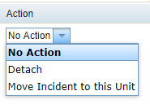
Boundaries
Notes:
The ‘Boundaries’ screen enables you to identify unit and state boundaries an incident has crossed.
To do that, find the name of the unit in the ‘Available Neighboring Units’ table and/or the name of the state in the ‘Available Neighboring States’ table on the left side of the screen.
If you don’t see the name of the unit or state that you are looking for in the tables, contact the Superuser for the unit as they are the only ones that can add units and states to the tables.
Click the ‘Attach’ button in the ‘Action’ column in the row of the unit and/or state whose boundary the incident has crossed in the ‘Available Neighboring Units’ and/or ‘Available Neighboring States’ tables on the left side of the screen.
Under the ‘Neighbors” table on the right under the action column is a drop-down menu. This drop-down gives you the option to ‘detach’ and also ‘move your incident to another unit’. This would be helpful if your incident moved to another unit who wants to manage the InciWeb page for the incident. The incident will then move to that unit you selected and disappear from your list of incidents under the ‘Unit Home’ button.

Slide 18
Twitter
Notes:
InciWeb includes a Twitter account.
As discussed in the ‘Create a New Incident Screen’ and ‘209’ screen sections, the hashtag for your incident will be whatever is entered into the ‘Name’ field on the ‘Create a New Incident’ screen and/or the ‘209’ screen and it appears here in twitter.
InciWeb automatically sends out tweets to the InciWeb Twitter account whenever you change or add a summary, article, photo, or map. When the automatic tweets are sent, they include state and unit identifier hashtags in addition to the incident name hashtag. This is a feature of the original InciWeb administrative site that cannot be changed at this time.
You can also type in your own tweet in the box. The remaining characters countdown will let you know how many characters you can use.
NOTE: Twitter increased its character limit to 280 – we are working on fixing this here.

Slide 19
Groups
Notes:
Sometimes, incidents are related to other incidents, such as when multiple incidents are occurring on the same unit or when multiple incidents are formally organized into a complex.
The ‘Groups’ screen enables you to let InciWeb visitors know that incidents are related by forming a group. Be sure to coordinate with all involved units and incident management teams, as well as area command if one has been established, when creating, editing, and deleting groups in InciWeb.
To create a group, at least two incidents must already have been created in InciWeb. One of the incidents is used to create the group.
The incident that you are currently working on will automatically be assigned to be the group parent and the group will be named after the incident. The group name will appear in the ‘Group Parent’ field.
To create a group, click the arrow to the right of the ‘Group Type’ field to reveal a drop down menu, then select the type of group you want to create - Complex, Theater, Related, or Unified Command. Then click the ‘Create’ button.

Slide 20
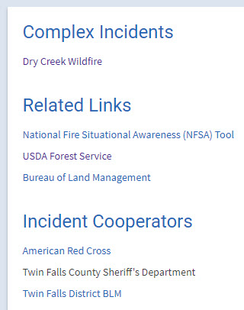
Group Created
This is how a complex, theatre, related and unified command appear on the InciWeb public website (at the bottom of the incident home page).
Notes:
The incident will be listed in a table as a group member and other incidents will now be able to join the group.
To join a group, click on the name of the group that you want to join in the ‘Available Groups’ table to highlight it (click the + icon to the left of the group name to see a list of group members), then click the ‘Join Group’ button. Your incident will appear in a table as a group member.
To delete a group, click the ‘Delete Group’ button.
This will delete the group for all of the other members as well.
You must have access to the unit you want to add to your complex –or coordinate with the user on the unit.

Slide 21
Leave a Group
Notes:
To remove an incident from the group, without deleting the group, click the ‘Leave Group’ button for the incident that is part of the group – complex, theatre, related, or unified command.
If you want to delete your complex (not your incident) select ‘Delete Group’ on your incident page under the ‘Groups’ tab as shown in the insert above.

Slide 22
Redirect
Notes:
Under some circumstances, such as when a fire that started on your unit burns into a fire that started on a neighboring unit, it might make more sense to send InciWeb viewers to the incident on the neighboring unit than to keep updating the incident that you created.
Instead of deleting the incident you created, you can send InciWeb viewers to the incident on the neighboring unit using the ‘Redirect Screen’.
Look in the ‘Available Incidents for Redirection’ table for incidents that you can redirect InciWeb visitors to. You can only redirect InciWeb viewers to incidents occurring on neighboring units.
If you don’t see the neighboring unit that you are looking for in the ‘Available Incidents for Redirection’ table, contact the Superuser for the unit as they are the only ones that can add neighboring units to the table, as discussed in the ‘Boundaries’ section.

Slide 23
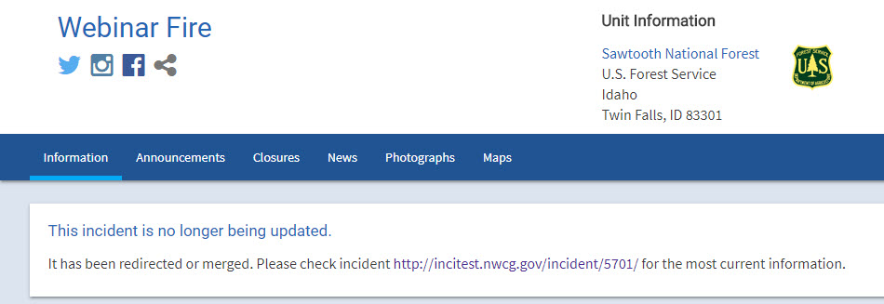
Redirect List of Incidents to Redirect To
Notes:
Incidents are grouped by neighboring unit. Click the ‘+’ icon to the left of the neighboring unit name to reveal a list of incidents occurring on a neighboring unit that you can redirect InciWeb visitors to.
Click on the name of the incident that you want to redirect InciWeb visitors to, to highlight it, then click the ‘Redirect To’ button.
A redirection banner will appear on the InciWeb public website indicating the incident was redirected to another unit and provides that incident link.
When you redirect an incident it becomes ‘inactive’ on your incident list on your ‘Unit Home’ tab.

Slide 24
Redirect Remove a Redirect
Notes:
To stop a redirect on your incident select the ‘Remove Redirect’ button. You’ll notice the incident/unit your incident is redirected to is listed above the ‘Remove Redirect’ button.
When you remove a redirect make sure you go to your incident ‘209’ tab and activate your incident. You can activate your incident on the 209 screen. If you don’t see the ‘Activate Incident’ button contact a superuser.

Slide 25
Tips & Reminders
Use the ‘InciWeb Practice Site’ to become familiar with the administrative site features before you are on an incident.
If you get a ‘404 Error’ on your incident page – check to see if you have more than one article or image ‘highlighted’ in your ‘Articles’ or ‘Images’ tab.
Videos and PDF’s cannot be highlighted on the incident home page.
Please spell-check and check your grammar; make sure your text appears correctly on the public site. When in doubt – copy your text in the editor and paste it into a blank Word Document.
If you are a superuser, make sure you’ve added neighboring units in your ‘Manage Neighbors’ tab under ‘Administration’.
Superusers - do the same for ‘Manage States’ under the ‘Administration’ tab.

Slide 26
Thank you!
Christine Schuldheisz
208-387-5145
cmschuldheisz@fs.fed.us
This webinar was recorded and playback details are listed at https://www.nifc.gov/PIO_bb/inciweb.html

Slide 27
New InciWeb Public Website
Christine Schuldheisz
Public Affairs Specialist &
InciWeb Business Lead
USFS Fire and Aviation Management
National Interagency Fire Center
208-387-5145
cmschuldheisz@fs.fed.us

Slide 28
What Is InciWeb?
InciWeb is public, information sharing website for current wildfires, fire-related activities and all-hazard incidents.
Interagency tool; U.S. Forest Service is lead agency.
It’s used locally, nationally and internationally by millions of people.
It’s for active, current incidents. It’s NOT for archival or historical purposes. Incidents older than one year are deleted from the system.
Federal, tribal, state and county units found in the NWCG Unit Identifier Book (PMS 931) are in InciWeb.
Invested stakeholders (audiences) include general public, news media, elected/appointed officials (all levels) and government agencies.

Slide 29
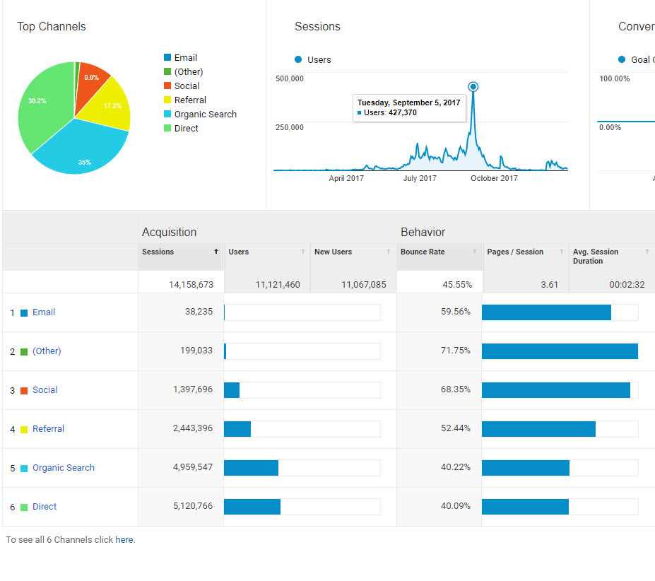
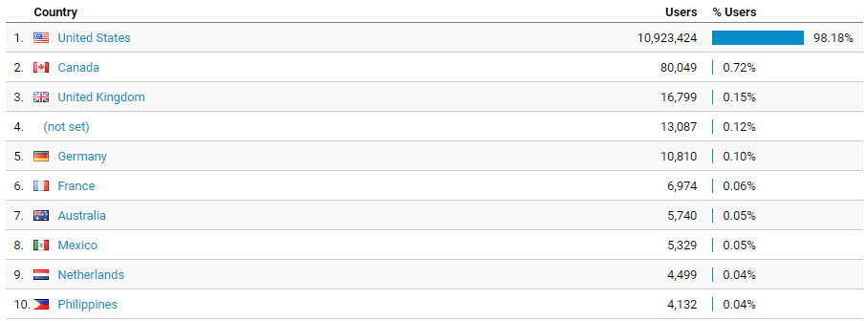
Google Analytics 2017
Notes:
In 2017 a total of more than 14 million people visited InciWeb.

Slide 30
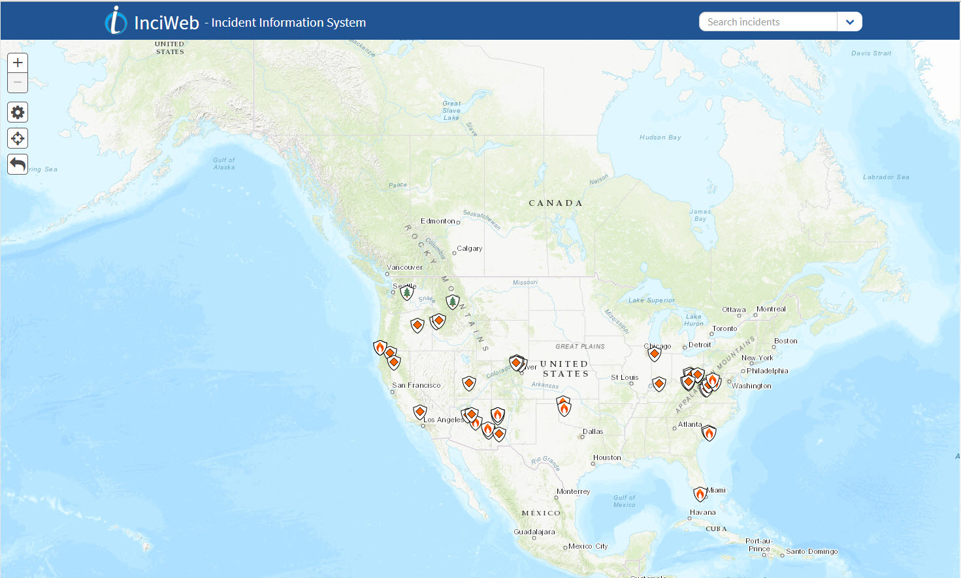
The New InciWeb
Clean, Modern Interface
Mobile Friendly
Map Based Navigation
Incorporate User’s Location
Stream-lined Formatting

Slide 31
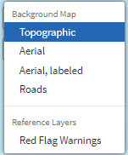
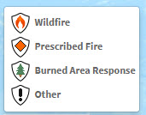
Navigating the Map
Home Button
Zoom In/Out
Background Layers
Zoom to My Location
Reset Map
Search by Incident or State Using Search Bar or Drop Down Menu
Legend Displaying Icon Meanings
Admin Site
Log In
General Information Tabs
(Same as Legacy Site)
InciWeb Twitter & Instagram
Notes:
This is the main map view of the new InciWeb public site.
The InciWeb logo at the top of the page serves as a home button when clicked on it takes you back to this main InciWeb page.
The search bar and search drop-down menu on the top right of the page is where a user can search incidents by incident name or state. You can type in the incident name or state in the search bar or use the drop-down menu to search incidents.
The ‘+’ and ‘–’ button on the left side of the screen allows a user to zoom in and out of the map.
In the row of the three icons the top ‘gear’ button allows a user to view the map in a topographic, aerial, aerial labeled or road view. There’s also a reference layer for red flag warnings. When selected red flag warnings will appear on the map.
The middle ‘location’ icon when selected zooms the map into the user’s location.
The left arrow resets the map.
The legend shows the icon meanings for wildfires, prescribed fire, Burned Area Emergency Response and other (all-hazard) incidents.
The footer contains several tabs for additional information.
The Twitter and Instagram icons are for InciWeb accounts.

Slide 32
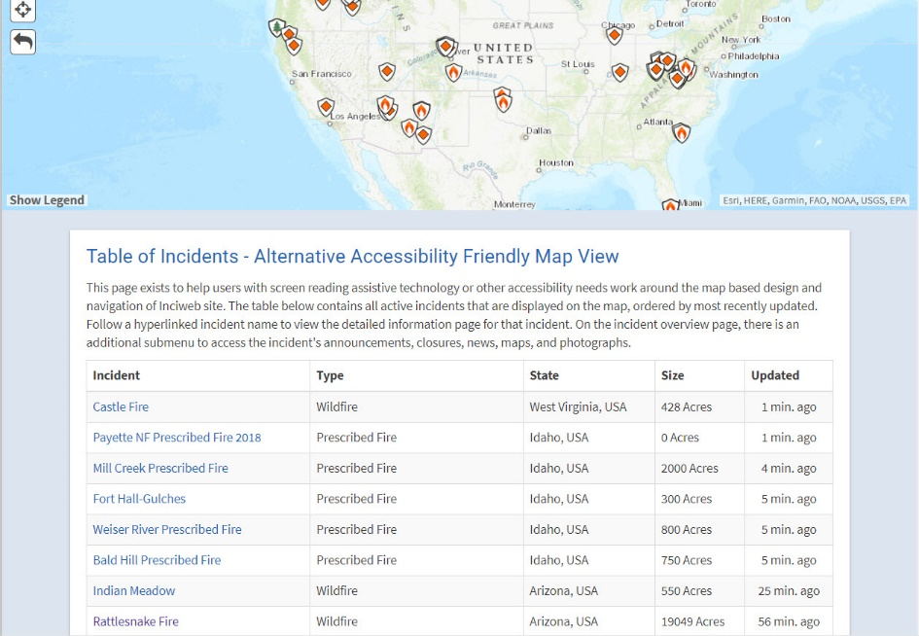
508 Compliant Table Help Tab
Notes:
There is a ‘Table of Incidents’ located in the ‘Help’ tab on the footer. The ‘Table of Incidents’ is required for web accessibility, but it can also be useful to view incidents listed in a table format in the order of most recently updated.

Slide 33
Incident Pop-Up Brief Incident Overview
Notes:
When you select an incident icon a pop-up will appear with the basic incident information – Incident Type; Updated; Size; Contained. Click on the ‘Go to Incident’ button to go to the incident home page.

Slide 34
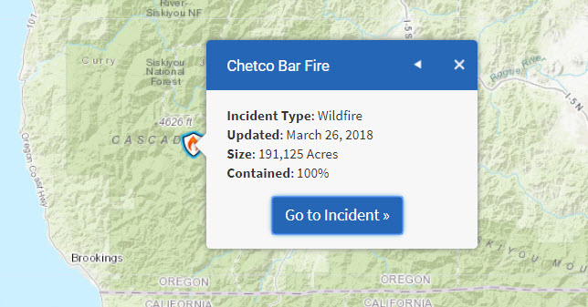
Multiple Incidents with Same Latitude/ Longitude
Notes:
Incidents that have the same latitude and longitude will have a triangle in the upper right corner of the pop-up box. Click on the triangle to see the incidents that share the same latitude/longitude.

Slide 35
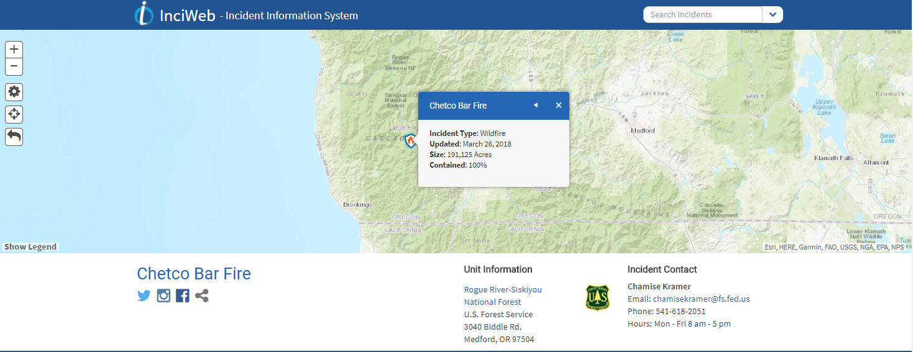
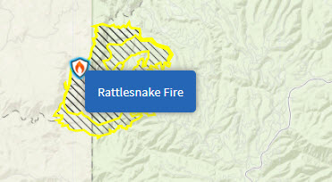
Incident Home Page
Perimeter Map
Incident Name
Incident Social Media Links/Sharing
Unit Information
Blue Bar:
Incident Contact
Information
Announcements
Closures
News
Photographs
Maps
Incident Perimeter Map Only Appears When a GIS Specialist Uploads the file to the NIFC FTP Site
Notes:
Perimeter maps will appear for an incident if there’s a perimeter map uploaded to the NIFC FTP site. Most GIS specialists have access to the FTP site to upload perimeter maps for an incident. If you don’t see a perimeter map zoom into the map until it appears. If it’s not there you will need to contact your GIS specialist.

Slide 36
Incident Home Page
Notes:
When you click on the ‘Go to Incident’ button in the pop-up it will take you to the homepage for the incident selected.
The Twitter, Instagram and Share social media links below the incident name are specific to the incident name – ie. #ChetcoBarFire. The Facebook link is specific to the unit the incident is on – the unit Facebook account.
You’ll notice an ‘arrow’ in the upper right hand corner in some of the boxes that when selected will minimize/maximize the box.

Slide 37
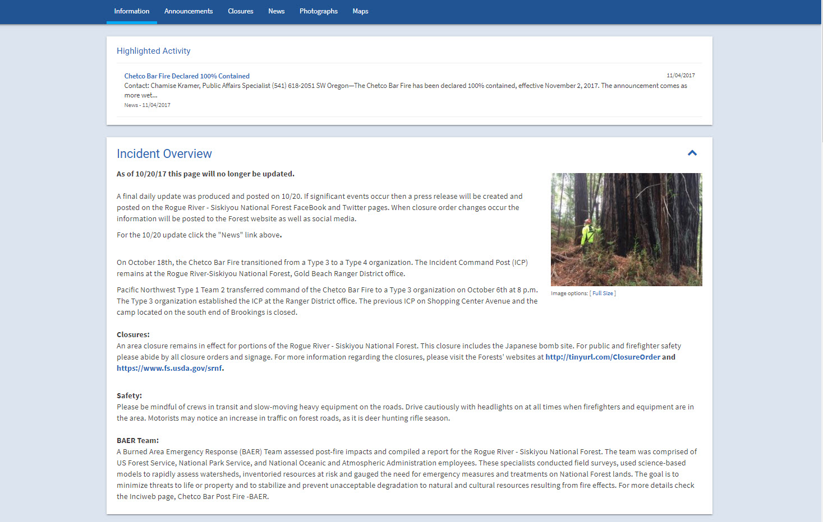
Incident Home Page
Highlighted Activity (if one is selected in Administrative panel)
Incident Overview
Blue Arrow in Incident Overview Box (indicates minimize/maximize box)

Slide 38
Incident Home Page
Incident Information (Basic Information, Outlook, Current Situation)
Recent Articles (News, Closures, Announcements)
Related Links
Cooperators
Agency Logos
General Information Tabs/InciWeb Social Media Links

Slide 39
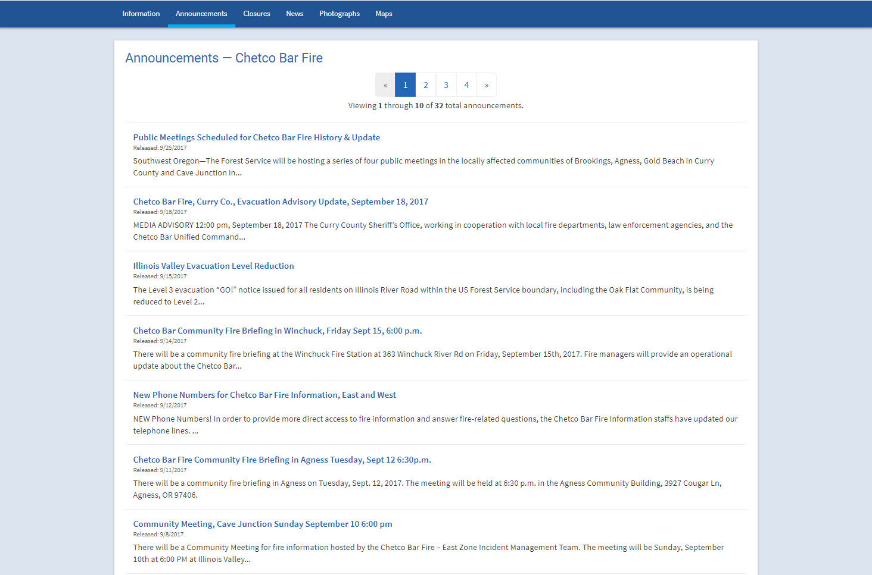
Incident Page – Announcements
Announcements (as identified in administrative panel) ordered by most recent first
Click on Title for Full Closure Information

Slide 40
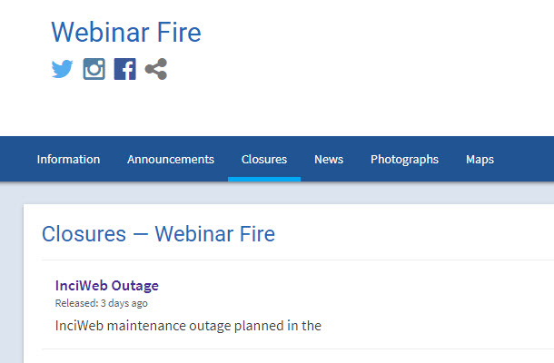
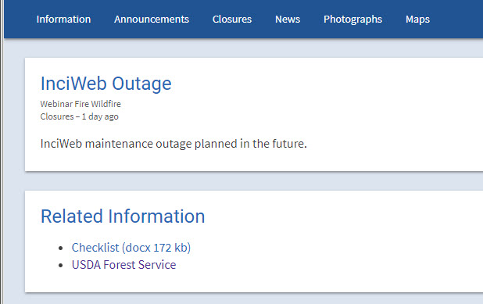
Incident Page – Closures
Closures (as identified in admin panel) ordered by most recent on first
Click on Title for Full Announcement
Related Links and/or Related Files Appear When Article is Open (this is the same for all articles)

Slide 41
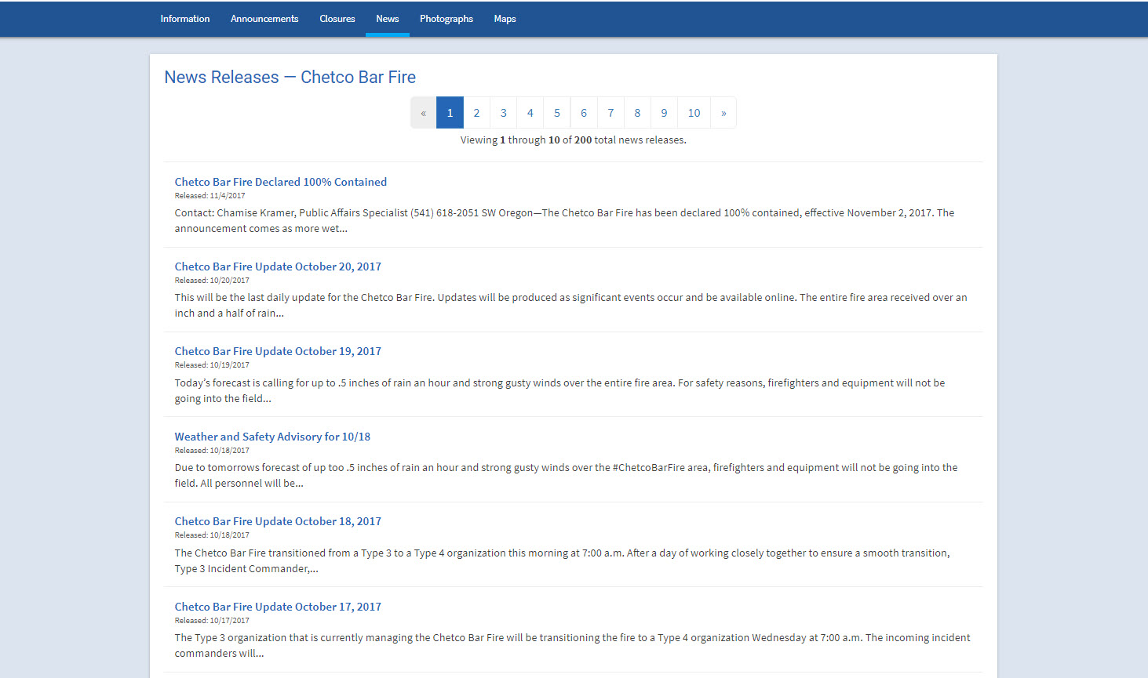
Incident Page – News
News Releases (as identified in admin panel) ordered by most recent first
Click on Title for Complete News Release

Slide 42
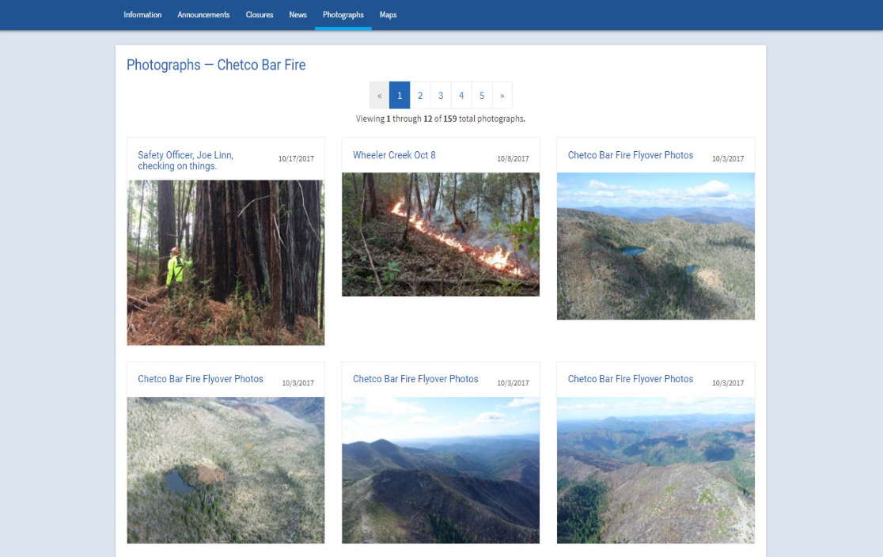
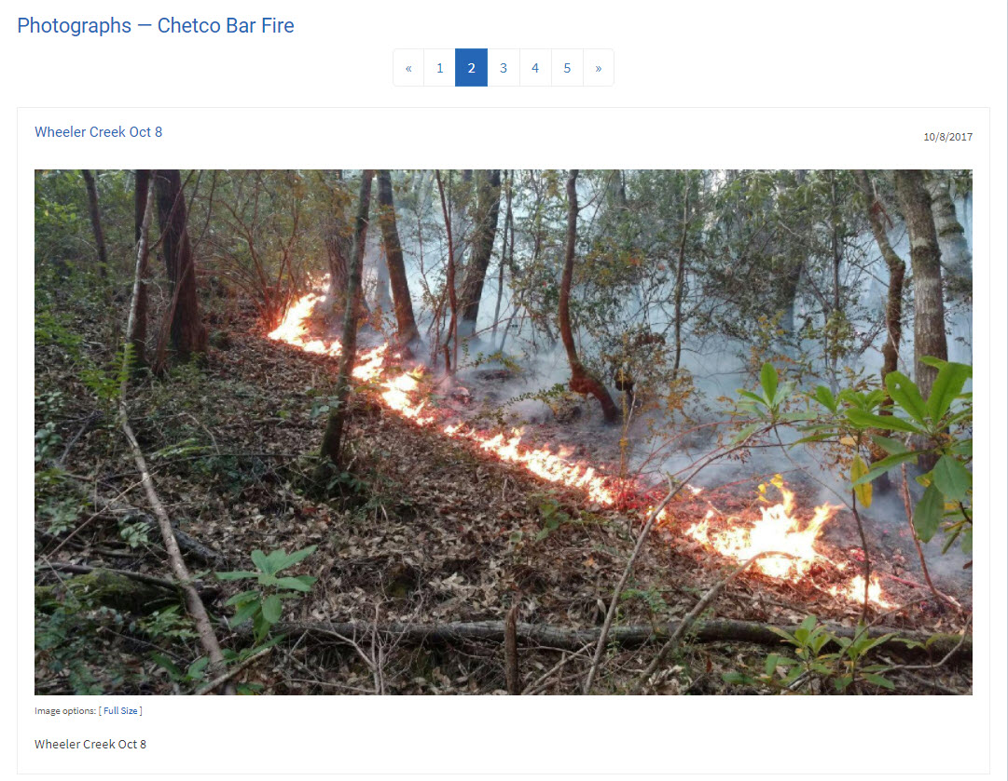
Incident Page – Photographs
Photographs Shown in Order of Most Recent Uploaded
Date Stamp When Photo Was Uploaded – Not When Photo Was Taken
Title Appears Above Photo
Caption Appears Below Selected Photo

Slide 43
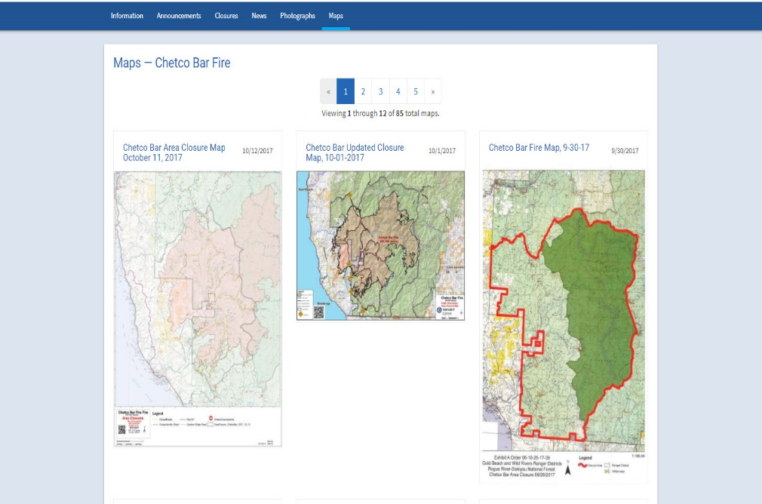
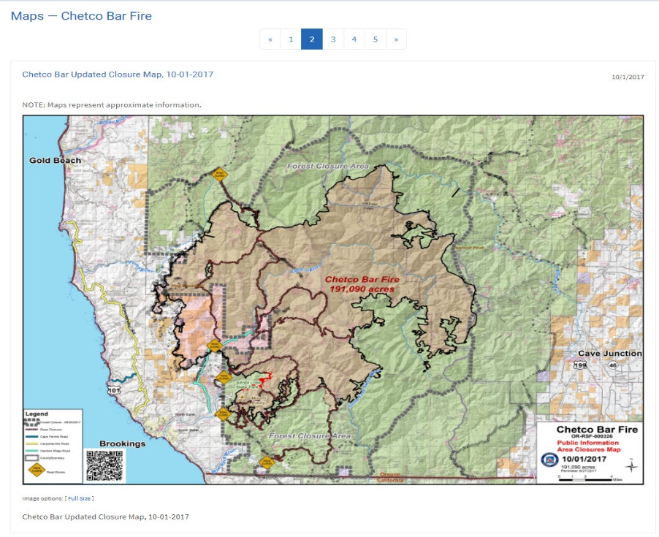
Incident Page – Maps
Maps Appear in Order of Most Recent Uploaded
Date Stamp When Map Was Uploaded - – Not When Map Was Taken
Title Appears Above Map
Caption Appears Below Selected Map

Slide 44
Administrative Site To-Do List
Avoid copy and paste text from an outside source into the InciWeb summary. If you do this make sure your text displays correctly on the InciWeb pubic website.
Make sure your InciWeb Unit Account has the correct address, telephone number, website and Facebook URL. (administrative site)
Superusers should make sure their account users have access to unit and that user’s accounts are not expired.
Please add captions and photo credits for all photos uploaded to InciWeb.
NAP passwords expire every 60 days – I can’t change this.

Slide 45
Know Your Screen Audience
Know your audience: “Who is reading this?”
Most important information first: “What do I need to know to keep myself, my family and my property safe?”
Don’t be clever or creative: Don’t ask people to think, they don’t have time
Use familiar words ~ don’t be scientific, fancy or special
Write short paragraphs ~ four sentences max
Use short sentences ~ 12 words on average
Avoid using today, yesterday, tomorrow
Double-check your writing
Remember: You are writing for a mobile device
F12 on your keyboard with the Chrome browser allows you to see what your website looks like on a mobile device

Slide 46
All information about InciWeb is posted on the
NIFC PIO Bulletin Board
https://www.nifc.gov/PIO_bb/inciweb.html
Christine Schuldheisz
Public Affairs Specialist &
InciWeb Business Lead
USFS Fire and Aviation Management
National Interagency Fire Center
208-387-5145
cmschuldheisz@fs.fed.us

