Slide 1




Hiring documents and internal forms
DOI Casual Payment center

Slide 2

AGENDA
Payroll Records
Emailing Documents
Hiring Documents/Internal Forms
FEHB/FEDVIP
Guidance on How to Complete Time and Attendance
Travel Reimbursement
Datamart Reports

Slide 3
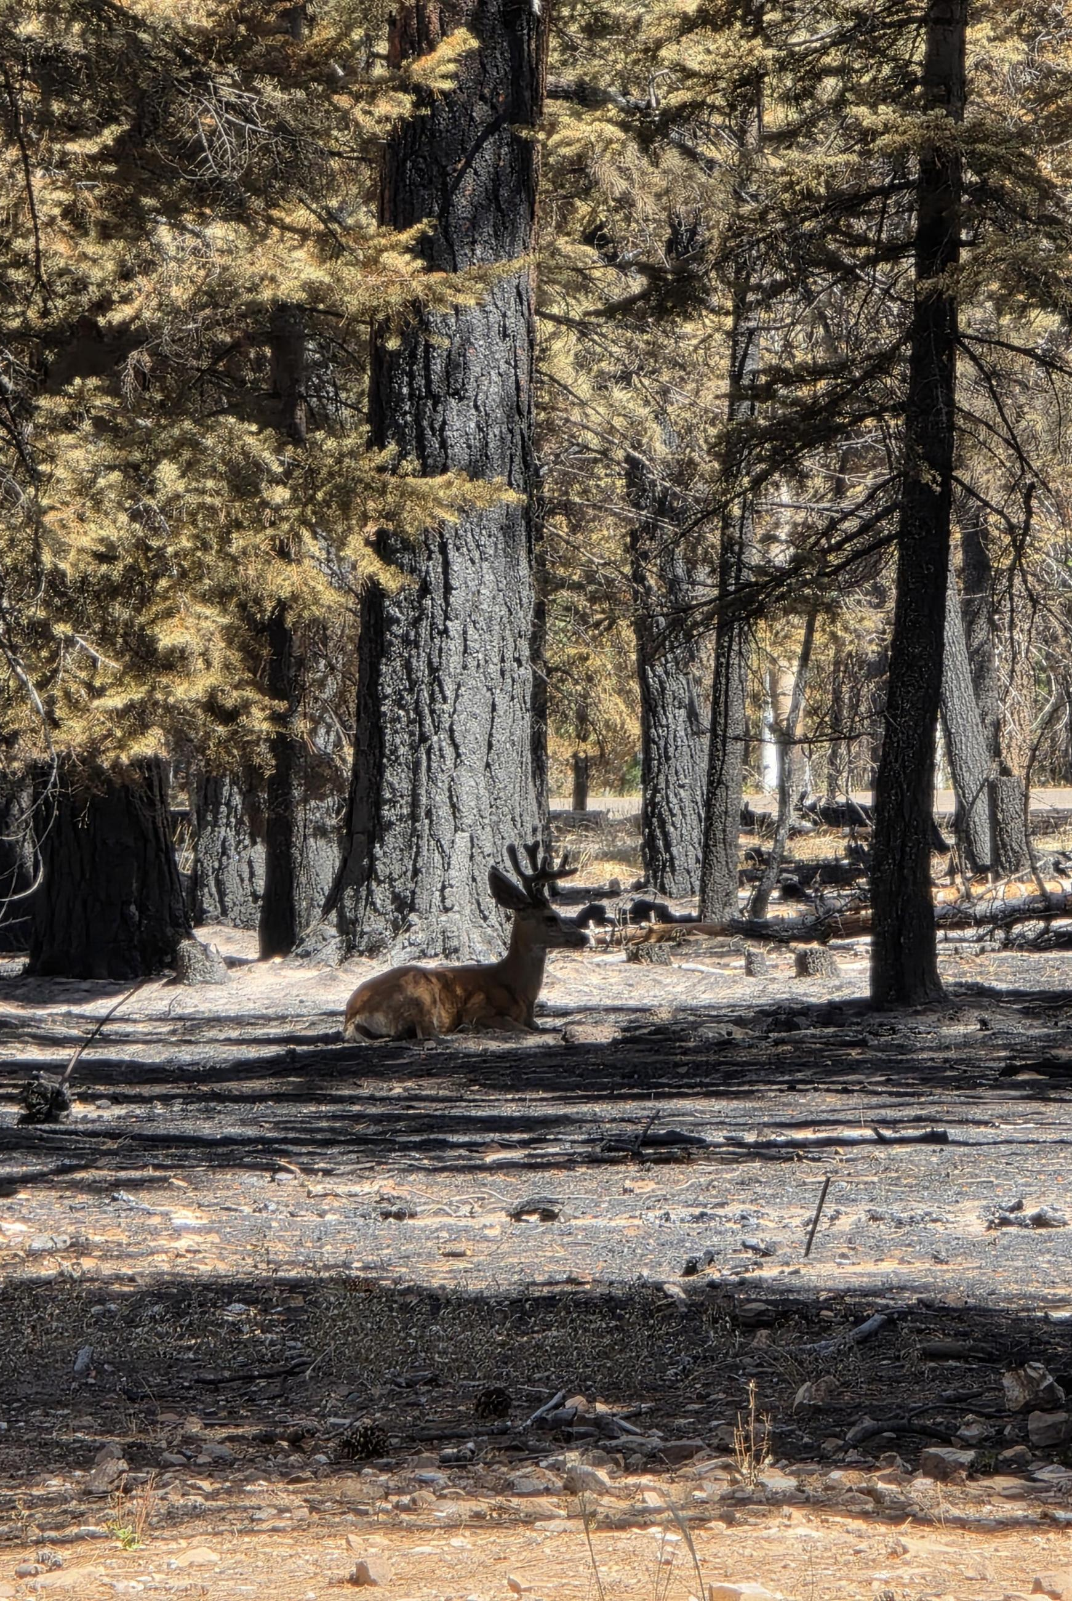
Payroll records
PAYROLL RECORDS Maintained on a calendar year basis as opposed to a fiscal year basis.
CASUAL FILES
Records are stored on a calendar year basis. Current and previous year’s records are available by request.

Slide 4
Emailing Documents to the Casual Payment Center (CPC)
CPC email address is on a secured network.
casualpay@blm.gov
Forms with PII (Personally Identifiable Information) and OF-288s can be emailed securely to CPC
PII should never be emailed outside the DOI network (per the Privacy Act of 1974).
PII includes name in association with SSN, addresses, bank account, phone numbers, birth dates, email addresses, etc.
Best way to send documents is:
Use Adobe PDF
Electronically prepare or scan all documents into a single PDF file
Attach file to email (CPC will reply to emails to inform sender the number of OF-288s and forms received)
DO NOT:
Send Photos
Locked Documents or Encrypted Files
PDF Portfolios

Slide 5
Hiring Documents
The following documents will be retained at the hiring unit.

Slide 6

I-9 Form
The purpose of the I-9 Form is to:
  Document verification of the identity and employment authorization of each new employee (citizen and non-citizen) to work in the United States.
  Employers must ensure newly hired employees complete and sign Section 1 no later than the first day of employment.
  Employers must examine evidence of identity and employment authorization within 3 business days of the employee’s first day of employment.

Slide 7
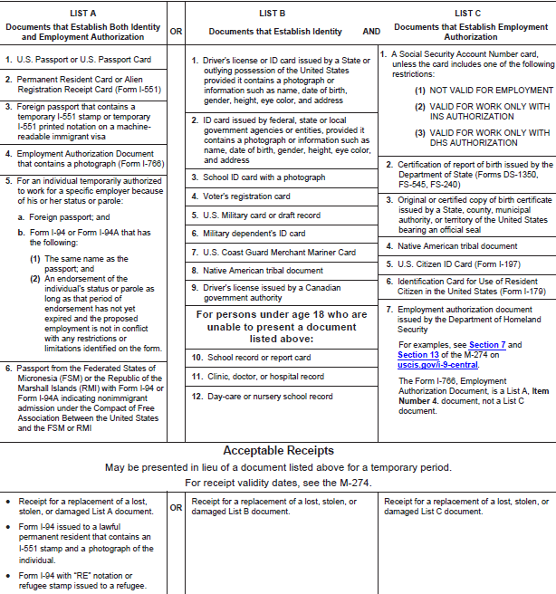
Acceptable Documents and Important Notes
Employees may present one selection from List A, or a combination of one selection from List B and one selection from List C.
No documents can be expired.
The examiner of the documents and the employee must both be physically present during the examination of the employee’s documents.
All documents must be original (except for a certified copy of a birth certificate).
I-9 forms only need to be updated every 3 years OR if any of the documents originally provided have expired.

Slide 8
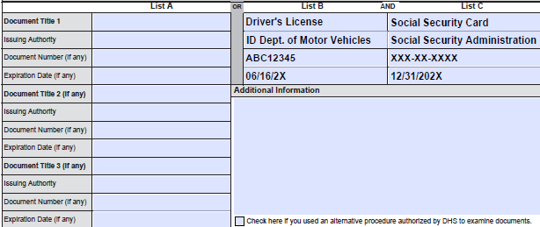
Section 2 of I-9:
Review and Verification
This is an example of documents presented from Lists B and C.
List B contains documents that establish identity only.
List C contains documents that establish employment authorization only.
  List A establishes identity and employment authorization in one document.
  If documents from List B and C are presented, a document from List A should not be presented.
REMEMBER: Employers CANNOT specify which document(s) they will accept from an employee.

Slide 9
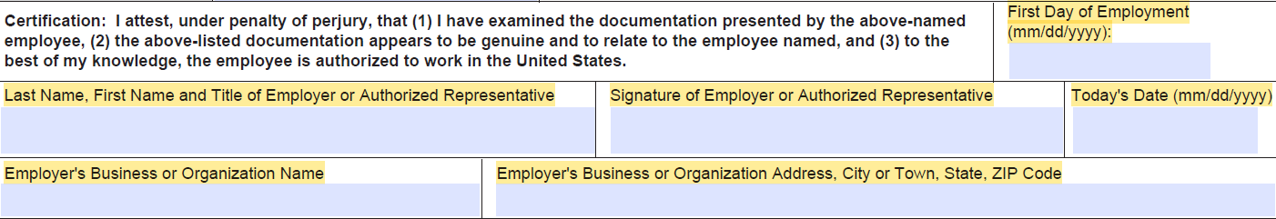
i-9 certification
Enter the Employee’s first day of employment.
Sign and date the attestation on the date Section 2 is completed.
Provide name and title of person completing Section 2.
The Form I-9 can be completed in early spring, if the employee has accepted an employment offer.
Photocopy all document(s) presented for verification. The CPC may request a copy of the Form I-9 and photocopy of documents when e-VERIFY is used for social security name/number mismatch report. Photocopies must be retained with Form I-9 in case of inspection by DHS. Employers must always complete Section 2 even when a photocopy of an employee’s document(s) has been made.

Slide 10
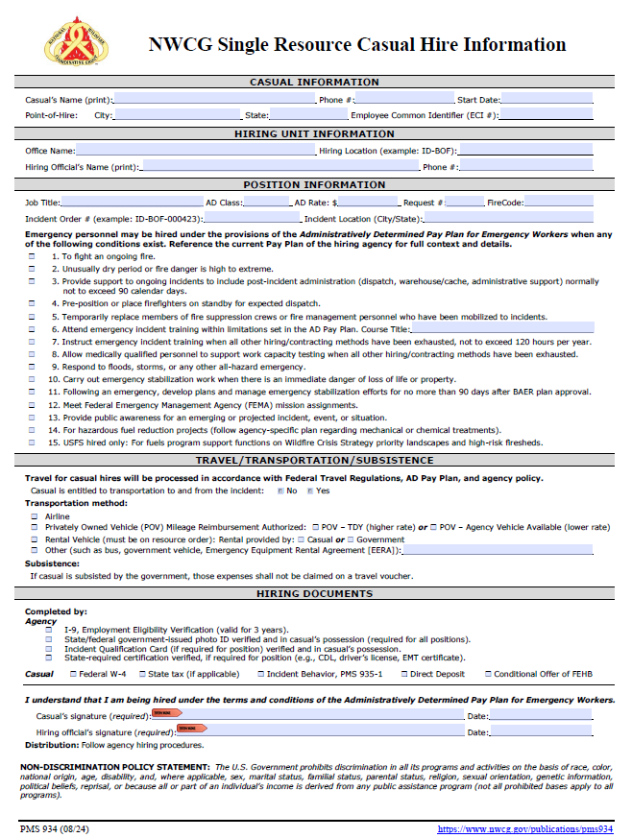
Single Resource Casual Hire Form
This form sets the formal agreement between the Agency and the Casual/AD to ensure there is no misunderstanding. It establishes the authority to pay under the AD Pay Plan.
This form establishes what the government will pay for travel and what expenses are reimbursable.
It provides a checklist for hiring documents to ensure prompt payment for work performed.
IMPORTANT NOTE: If the form is not properly signed and dated, it may not be an acceptable document if a grievance is filed by a Casual/AD.

Slide 11
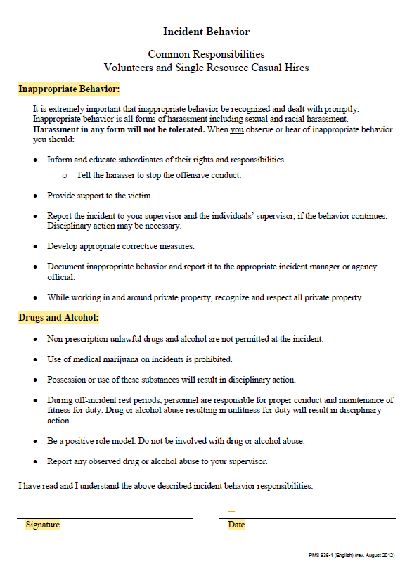
Incident Behavior Form
This form covers inappropriate behavior as well as drug and alcohol abuse and should be completed annually.

Slide 12
Hiring Documents Cont.
The following documents will be sent to the casual payment center.

Slide 13
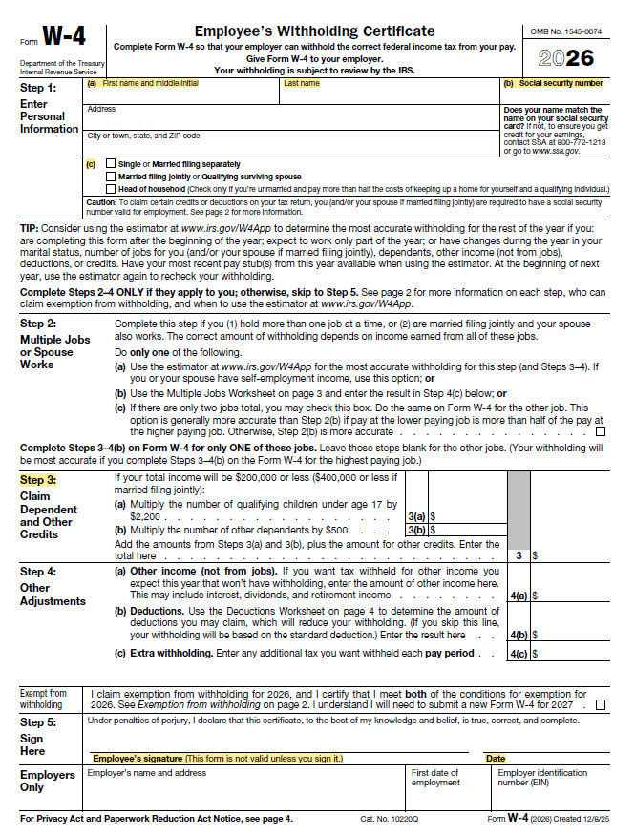
2026 W-4 Form
Please use the current year Form W-4.
Step 1(a) and Step 1 (b) must be completed with Name and Social Security Number.
Step 1 (c) must be marked with one Marital Status.
If claiming dependents, Step 3 Block 3 must have a dollar amount (e.g., $2,000.00; $500.00), not a single-digit number (e.g., 1, 2, 3 etc.).
Form must be signed and dated at the bottom.
IMPORTANT NOTES:
  Address – must be mailing address where casual receives mail (e.g., PO Box vs. physical address).
  No need to include instruction pages when sending to the CPC.

Slide 14

State Taxes
New employees: Federal Personnel Payroll System (FPPS) will automatically default state taxes to single and zero deductions for the hired at state.
A Tribal Exemption form (if applicable) can be submitted each calendar year by casuals to exempt themselves from state taxes.
If the casual would like to claim a different deduction for state taxes, use specific state tax form.
There are nine states that do not have individual income withholding tax (e.g., AK, FL, NH, NV, SD, TN, TX, WA, WY).

Slide 15
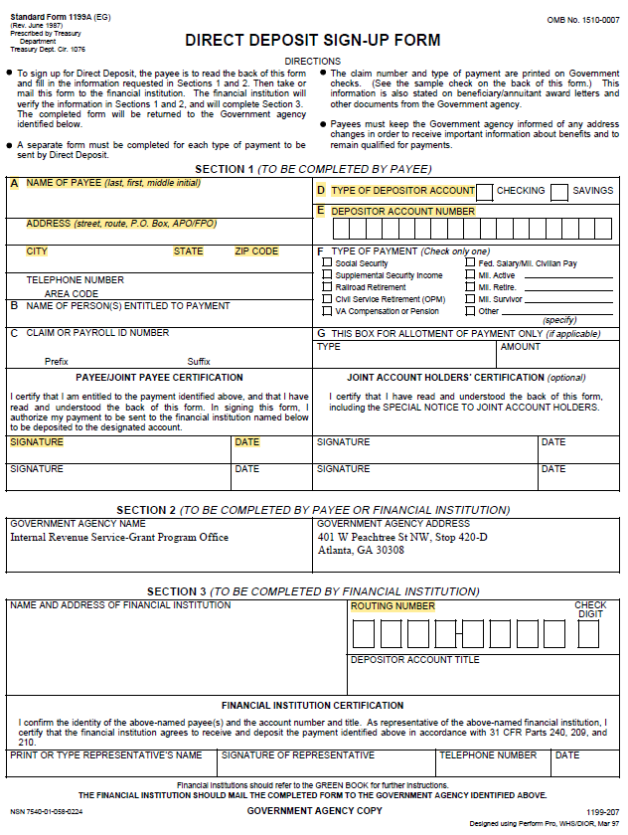
Direct Deposit Form
All fields must be legible and accurate.
Section 1 (To be completed by payee)
  A – Name, Address, City, State, Zip Code, Signature & Date
  D – Type of Depositor Account (check either Checking or Savings)
  E – Depositor Account Number
Section 3 (To be completed by payee or financial institution)
  Routing Number – must be 9 digits
If the Direct Deposit form is incomplete or illegible, the profile will not be updated, and the agency will be contacted if form accompanies an OF-288. Otherwise, Direct Deposit will be returned to Casual/AD.
IMPORTANT NOTES:
  Address – must be mailing address where casual receives mail (e.g., PO Box vs. physical address).

Slide 16
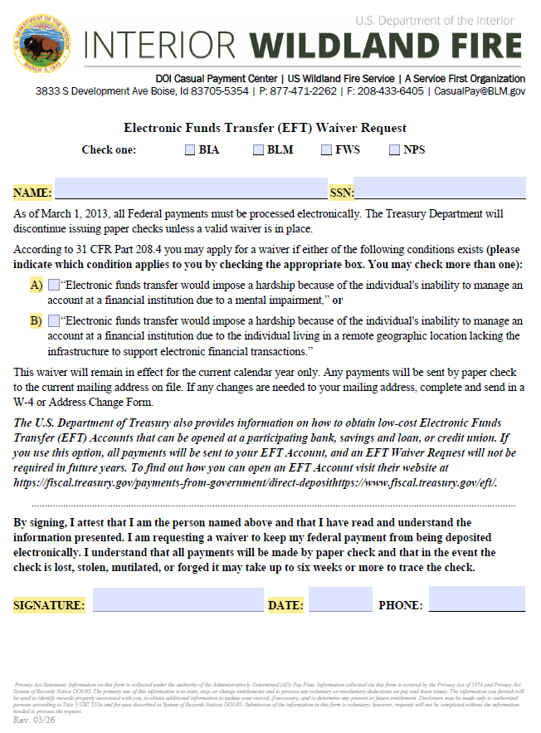
EFT Waiver Form
Must be completed EACH CALENDAR YEAR when Casual/AD is requesting a Treasury Check.
Name and SSN must be completed.
Either Box A or Box B must be checked as to why the casual is requesting a paper check.
Signature must be present, and the date must be current year.

Slide 17
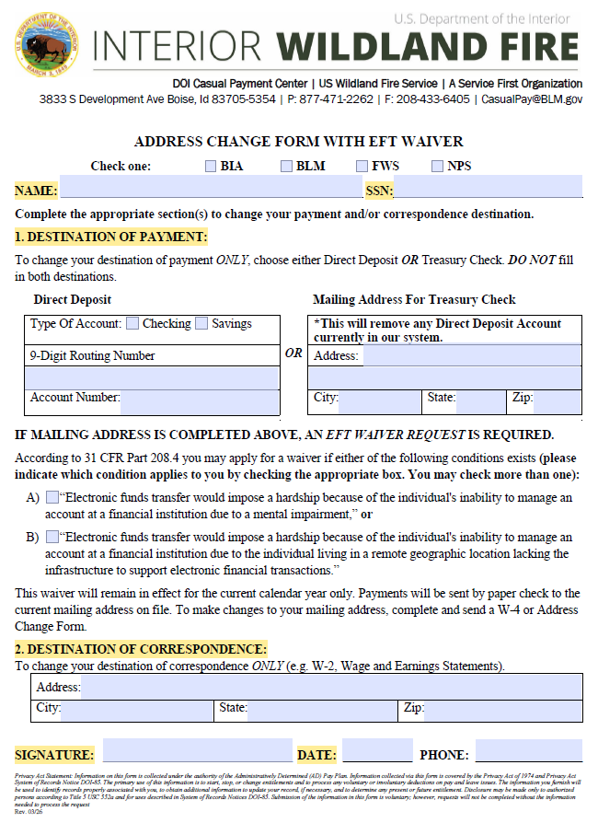
Address Change Form
The Address Change Form can change both Destination of Payment and Destination of Correspondence.
  However, both are not required.
Remember to indicate where mail is received, including apartment/unit numbers.
IMPORTANT NOTE:
    Address – must be mailing address where casual receives mail (e.g., PO Box vs. physical address).

Slide 18
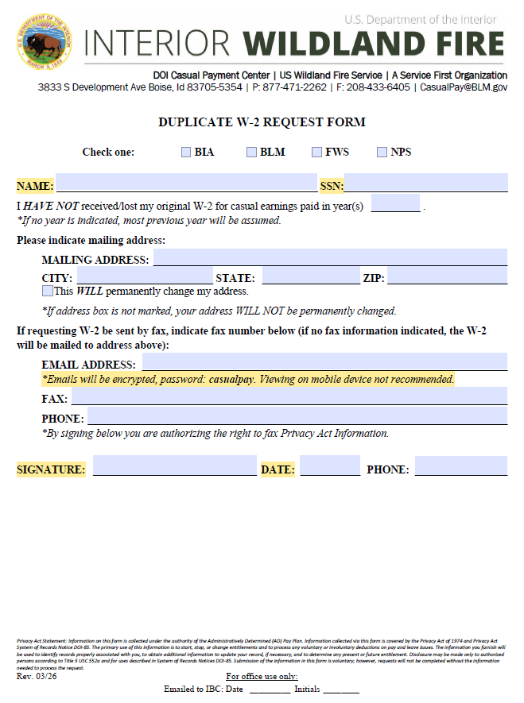
Duplicate W-2
Request Form
Casuals can request a duplicate W-2’s be sent via mail, fax, or email.
If casual requests the W-2 be emailed, the file will be encrypted with a password (due to personally identifiable information-PII).
The password is then found on the Duplicate W-2 Request form.
Password: casualpay

Slide 19
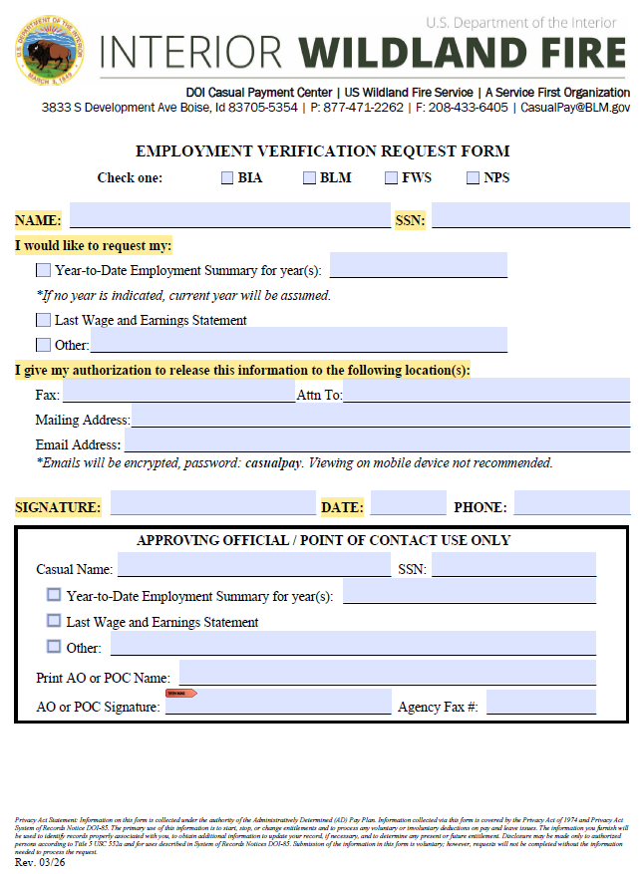
Employment Verification Request Form
The Employment Verification Request Form is used for Verifications, Employment Summaries, and Wage and Earning Statements (WESs).
Requests will be emailed, faxed or mailed within two business days.
AO/POCs may call and request Employment Summaries on behalf of the Casual/AD by completing the APPROVING OFFICIAL/POINT OF CONTACT USE ONLY section.

Slide 20
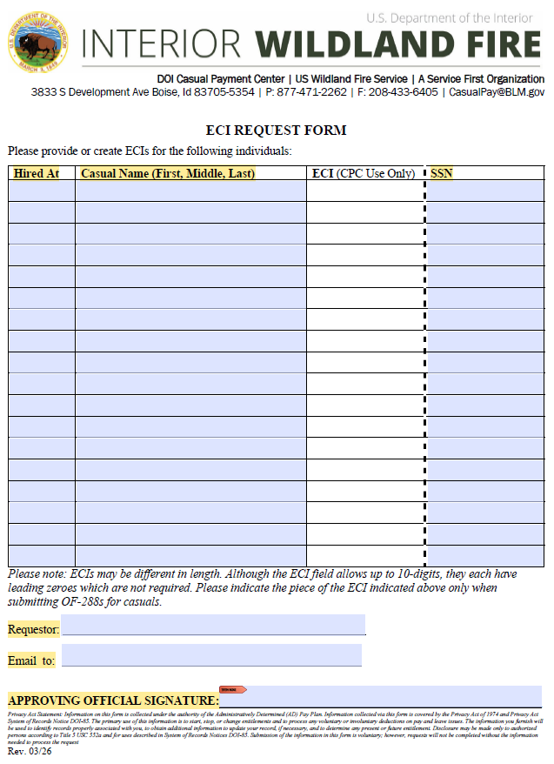
ECI Request Form
The ECI Request form is used to request ECIs.
Indicate Hired At, Casual’s First, Middle Initial, Last Name and complete SSN.
Verify legibility before submitting form.
Request must be from an Approving Official or Point of Contact.
  Indicate the requestor’s name and email to send list to as well as signature at the bottom.

Slide 21
FEHB/FEDVIP
FEHB form must be sent to CPC annually

Slide 22
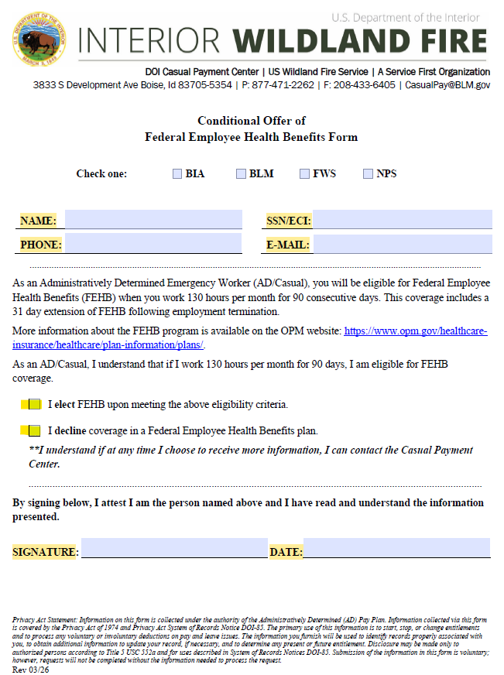
Federal Employee Health
Benefits Form (Conditional Offer)
Must be submitted each calendar year.
Name and SSN/ECI must be completed along with a signature and current year date.
“I Elect” means if the Casual/AD meets the qualification criteria, the CPC will email and mail notification of eligibility to select a health care plan.
“I Decline” means the Casual/AD will not be contacted by the CPC about health care.
A Casual/AD can change status anytime.
Casuals qualify once they have worked 130 hours per month for 90 consecutive days.
  https://www.opm.gov/healthcare-insurance/healthcare/plan-information/plans/

Slide 23
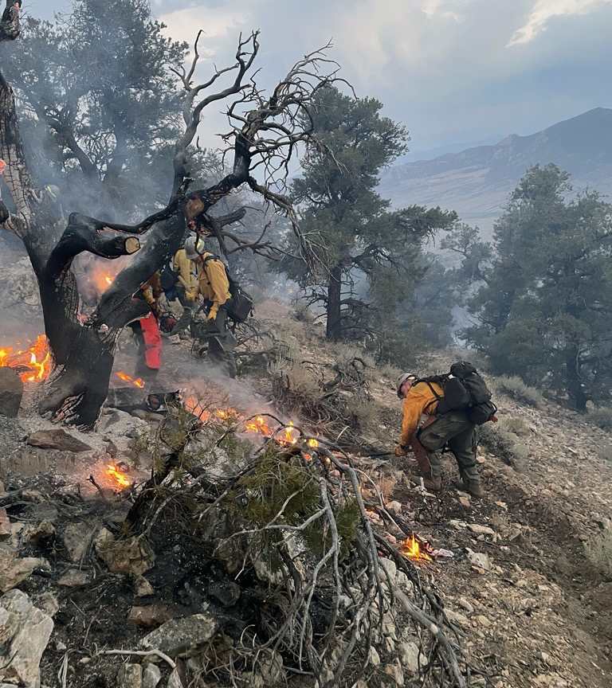
FEDVIP Benefits
The Federal Employee Dental and Vision Insurance Program (FEDVIP) provides comprehensive dental/vision insurance.
Once casuals qualify for Federal Employee Health Benefits (FEHB), they also qualify for Vision and Dental benefits.
  Information on FEDVIP will be emailed/mailed to Casual/AD at the same time as FEHB insurance information.
  No separate form to fill out.
Information regarding FEDVIP can be found at https://benefeds.com.

Slide 24
GUIDANCE ON HOW TO COMPLETE TIME AND ATTENDANCE

Slide 25
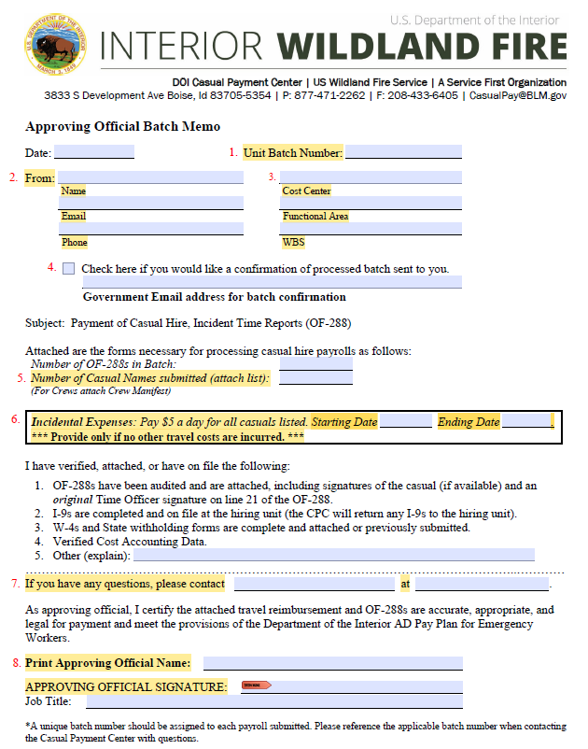
Approving Official Batch Memo
Indicate a unique Batch Number.
Current agency contact information (name, phone, email).
NEW! Charge code information (indicate Cost Center, Functional Area, and WBS)
Valid email address if requesting a confirmation.
Casual count.
List reimbursements for Incidental Expenses by indicating Starting and Ending dates.
List other agency contacts for the specific batch that the CPC may contact for questions.
Approving Official name and signature required.

Slide 26
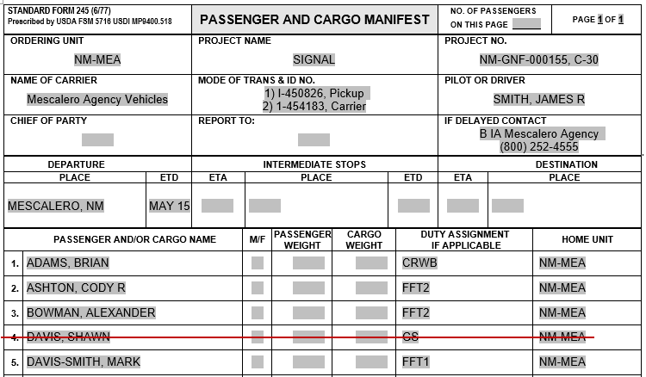
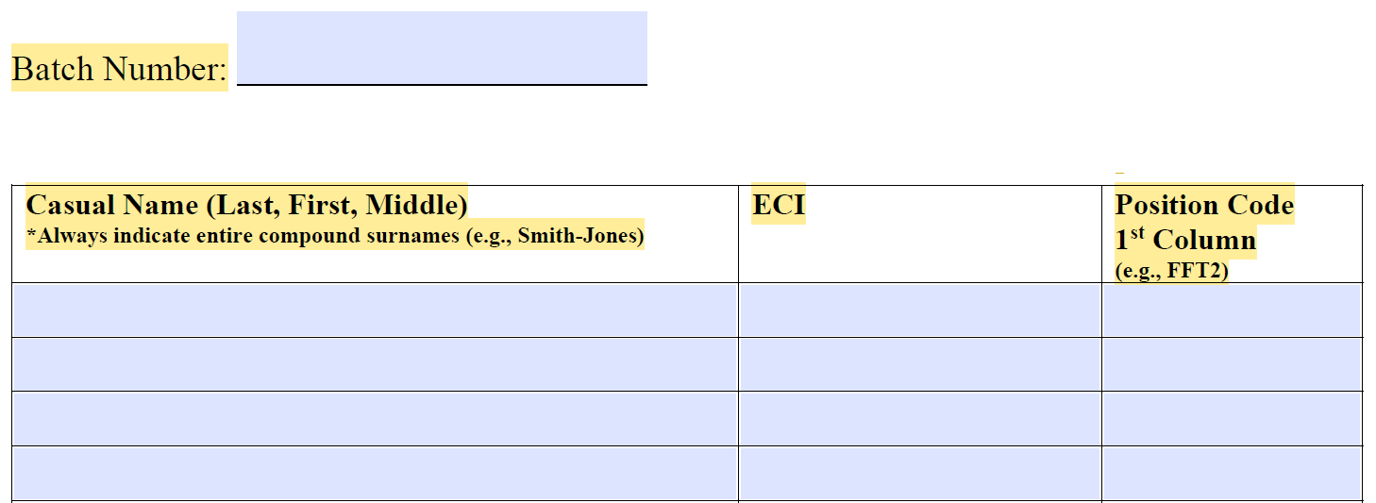
Batch Memo Manifest
  Agency Batch Number.
  List of casual names.
    Ensure to add entire compound surname (Smith-Jones) if applicable.
  ECI (Employee Common Identifier)
  Position Code (from 1st column if different PCs on OF-288)
  In lieu of the CPC Batch Memo Manifest, the Passenger/Cargo Manifest can be used.
  If the list is long, attach the Passenger/Cargo Manifest with the list of Casual/ADs to the Approving Official Batch Memo.
  Cross off names of Casual/ADs who do not have OF-288s included in the batch and GS employees.

Slide 27
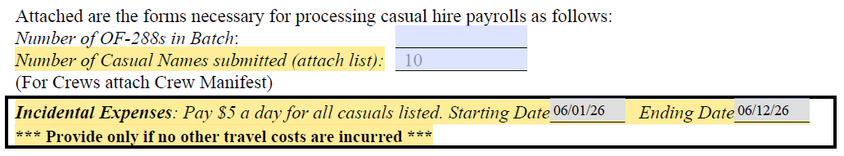
Incidental expenses on the batch memo
As part of the batch approval process, the AO will certify that the OF-288s are accurate, appropriate, and legal for payment.
Start and End Dates for reimbursement should be completed by AO. The CPC will add dates and totals to each OF-288 based on the fire codes used for specific dates.
If there are casuals who joined the crew late or departed early, indicate those individuals and instruct to use dates on their OF-288s.
Travel reimbursement is not for planned events, (e.g., Training or Rx).
If there are receipts, (e.g., lodging, baggage) it must go through ETS (Electronic Travel System) or Manual process (BIA).

Slide 28
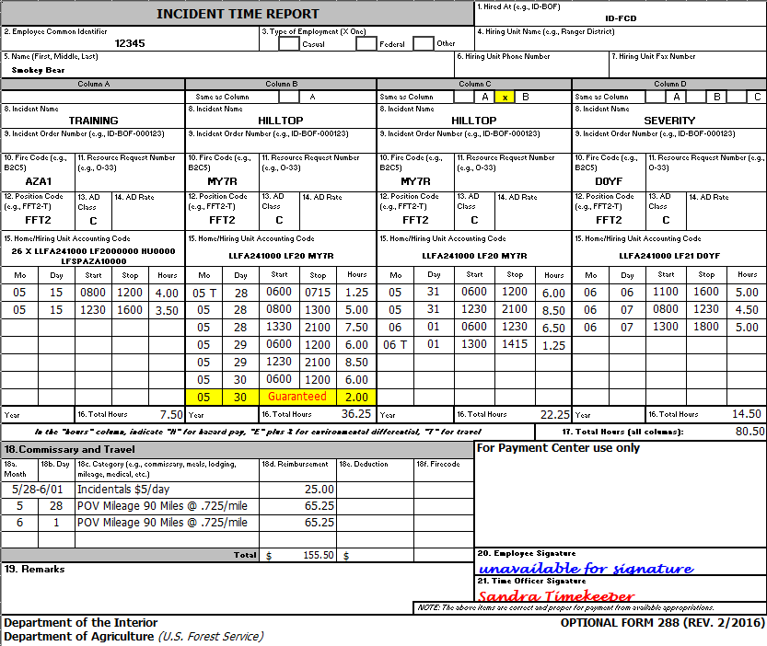
BLM OF-288 Timesheet
Ensure the HA is indicated (box 1).
Verify the correct casual ECI and name is indicated (box 2 and 5).
Indicate Position Code. AD Class does not have to be listed, but if indicated, must not conflict (box 12 and 13).
Indicate cost code. Can use approved abbreviated cost codes if preferred (box 15 or can be indicated in remarks, box 19).
Use military time in 15-minute increments. Indicate Guarantee time (month, day, and # of hours).
Travel comments can be made on the OF-288 (box 18).
Time Officer Signature must be present (box 21).
NOTE: $167 Boot Stipend will be applied automatically once casual qualifies.
*Blank OF-288’s can be omitted.

Slide 29
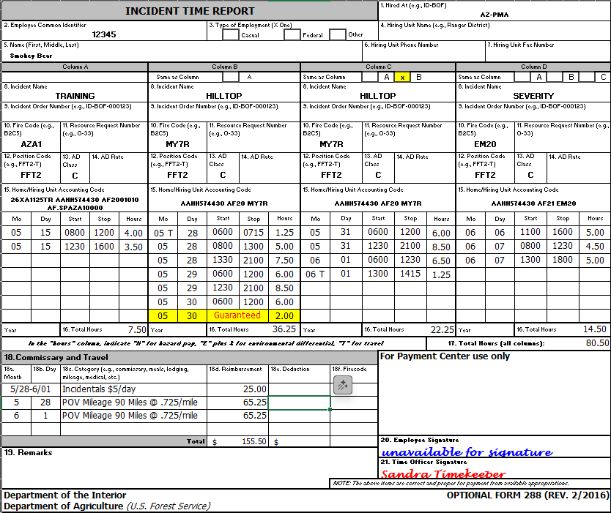
BIA OF-288 Timesheet
Ensure the HA is indicated (box 1).
Verify the correct casual ECI and name is indicated (box 2 and 5).
Indicate Position Code. AD Class does not have to be listed, but if indicated, must not conflict (box 12 and 13).
Indicate cost code. Can use approved abbreviated cost codes if preferred (box 15 or can be indicated in remarks, box 19).
Use military time in 15-minute increments. Indicate Guarantee time (month, day, and # of hours).
Travel comments can be made on the OF-288 (box 18).
Time Officer Signature must be present (box 21).
NOTE: $167 Boot Stipend will be applied automatically once casual qualifies.
*Blank OF-288’s can be omitted.

Slide 30
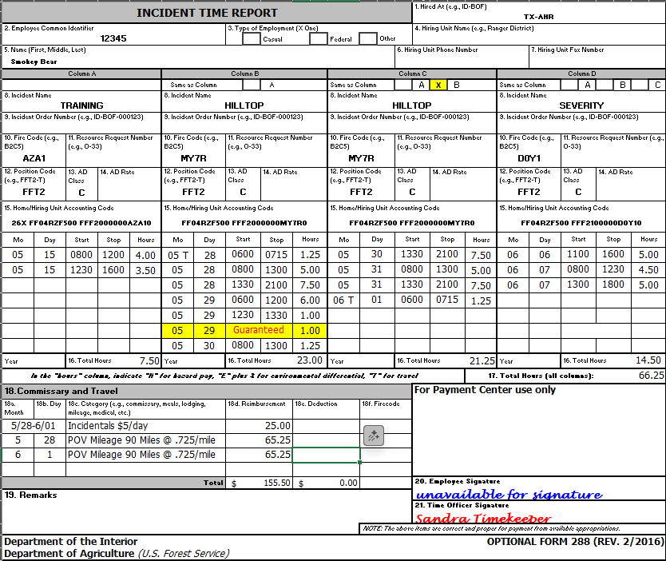
FWS OF-288 Timesheet
Ensure the HA is indicated (box 1).
Verify the correct casual ECI and name is indicated (box 2 and 5).
Indicate Position Code. AD Class does not have to be listed, but if indicated, must not conflict (box 12 and 13).
Indicate cost code. Can use approved abbreviated cost codes if preferred (box 15 or can be indicated in remarks, box 19).
Use military time in 15-minute increments. Indicate Guarantee time (month, day, and # of hours).
Travel comments can be made on the OF-288 (box 18).
Time Officer Signature must be present (box 21).
NOTE: $167 Boot Stipend will be applied automatically once casual qualifies.
*Blank OF-288’s can be omitted.

Slide 31
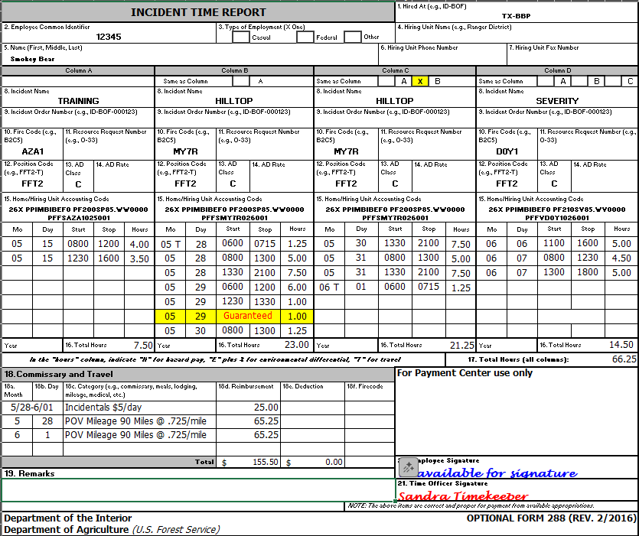
NPS OF-288 Timesheet
Ensure the HA is indicated (box 1).
Verify the correct casual ECI and name is indicated (box 2 and 5).
Indicate Position Code. AD Class does not have to be listed, but if indicated, must not conflict (box 12 and 13).
Indicate cost code (box 15 or can be indicated in remarks, box 19).
Use military time in 15-minute increments. Indicate Guarantee time (month, day, and # of hours).
Travel comments can be made on the OF-288 (box 18).
Time Officer Signature must be present (box 21).
NOTE: $167 Boot Stipend will be applied automatically once casual qualifies.
*Blank OF-288’s can be omitted.

Slide 32
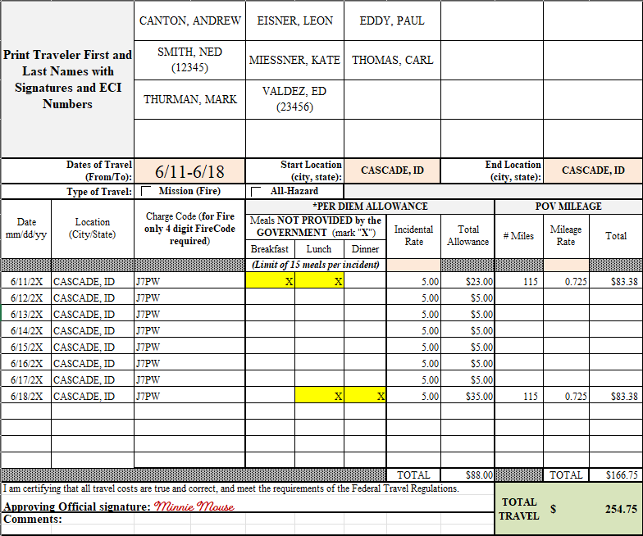
Travel Worksheet
Travel worksheet can be used for a single casual or multiple casuals (if reimbursement amounts are the same for all casuals).
List casual names. Add ECI if common or similar last name.
Indicate Dates of Travel and Type of Travel.
List dates and city/state where casual spent the night and the 4-digit fire code for reimbursement of M&IE.
Indicate which meals were not provided by the government.
Ensure POV mileage is calculated at the rate of $0.725 per mile (rate changes effective January 1st every year).
Add Approving Official signature.

Slide 33
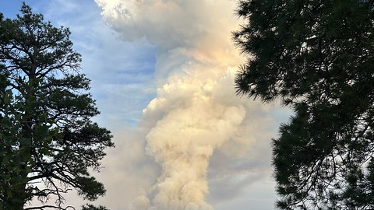
Travel Reimbursement on the OF-288
Can only claim 15 meals per incident on OF-288.
POV mileage reimbursement on OF-288.
  Must indicate which days POV mileage was used, number of miles driven, and total amount to be reimbursed.
  POV must be itemized per day (not lumped together)
If there are receipts (e.g., luggage, hotel, fuel, etc.), travel reimbursement must be made via the Electronic Travel System (ETS)- Concur.
When claiming M&IE and/or POV mileage reimbursement, only one method of reimbursement can be used, the OF-288 or Concur.

Slide 34

Meal Equation
1st day of travel reimbursement is $51 (3/4 rate – full rate is $68).
The government DID NOT provide Breakfast or Lunch ($16 for Breakfast and $19 for Lunch).
The casual is entitled to reimbursement for those meals not provided.
Because the government provided Dinner, the casual is NOT entitled to that amount, therefore $28 must be deducted from the total amount.
$51 - $28 (dinner provided) = $23
Although the first and last day are prorated at ¾ rate, the amount of each meal is not prorated, therefore the entire amount of that meal must be deducted.
For days 8/12-8/17, all meals were provided; Incidental Expenses of $5 reimbursed only for those days.

Slide 35
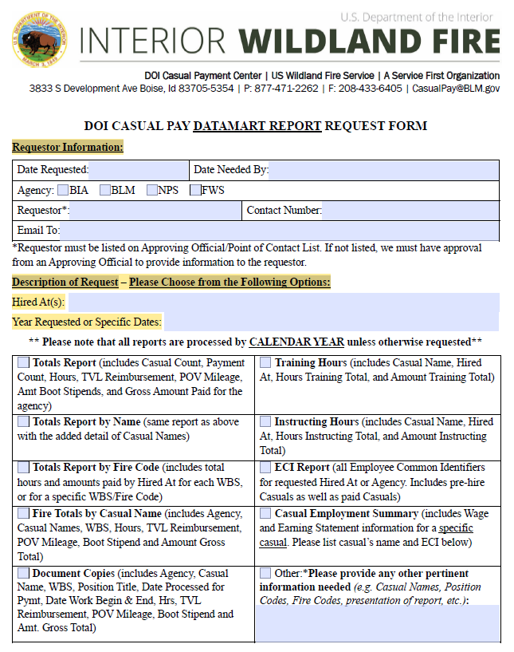
DOI Casual Pay Datamart report
Request Form
Requestor Information: Complete entire section (Date Needed By, Agency, Requestor, How report should be sent (e.g., email).
  Requestor must be listed on our AO/POC lists.
Indicate the agency (if needing report for entire agency or specific Hired At(s) you would like reported and dates being requested.
Check the box for the report(s) being requested.
Email request form to the CPC (casualpay@blm.gov).
Reports are created on a calendar year basis unless otherwise stated (e.g., need reports based on Fiscal Year.

Slide 36
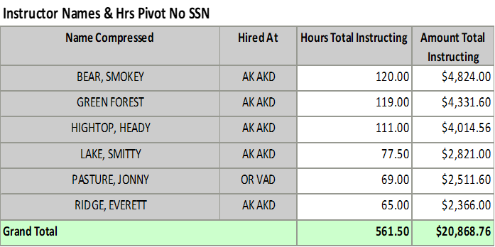
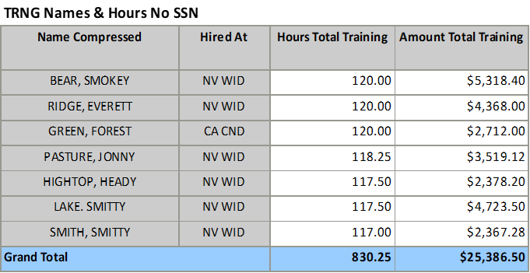
Datamart Report Request Examples

Slide 37
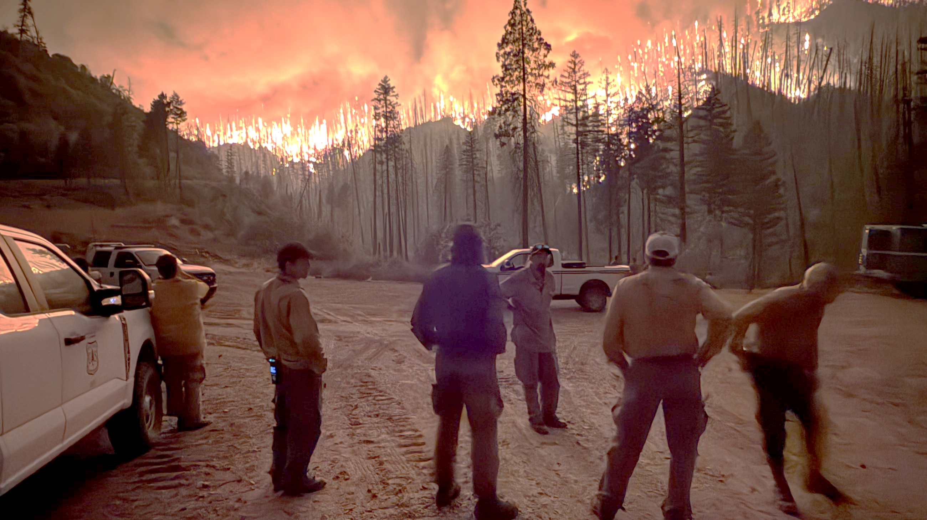
THANK YOU
National Interagency Fire Center
US Wildland Fire Service (USWFS)
DOI Casual Payment Center MS 270
3833 S. Development Ave, Boise, ID 83705
Phone: (877) 471-2262
Fax: (208) 433-6405
Email: casualpay@blm.gov
Office Hours: 8:00 am – 4:00 pm Monday – Friday
Website: https://www.nifc.gov/programs/casual-payment-center

