Slide 1
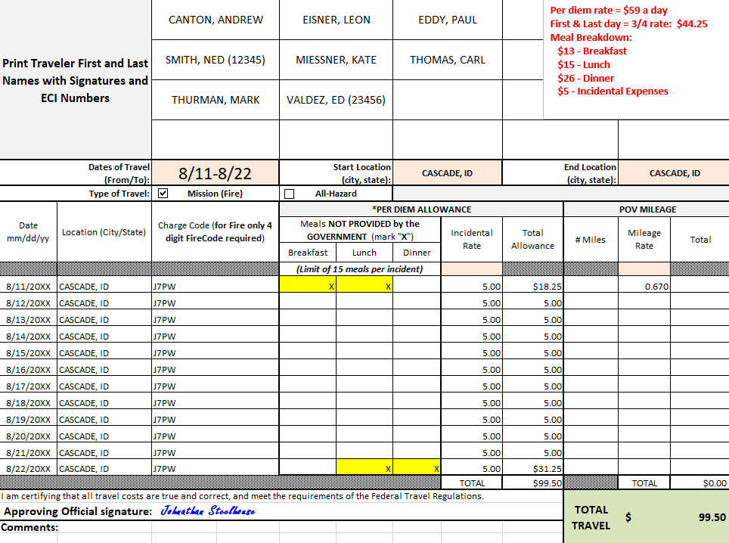
Travel Worksheet for a Crew
List casual names: add ECI if common or similar last name
Indicate dates and Type of Travel
List dates to be reimbursed for M&IE, city/state of where the night was spent, and 4-digit fire code
Ensure POV mileage is indicated at reimbursement rate of $0.67 per mile
Approving Official signature
The first & last day of travel are always calculated at ¾ rate (includes $5 incidental expenses) minus the cost of any meals provided: $44.25 - $26 = $18.25 (total allowance for 1st day)
8/12-8/21 - All meals provided at incident; only Incidental Expenses of $5 reimbursed

Slide 2
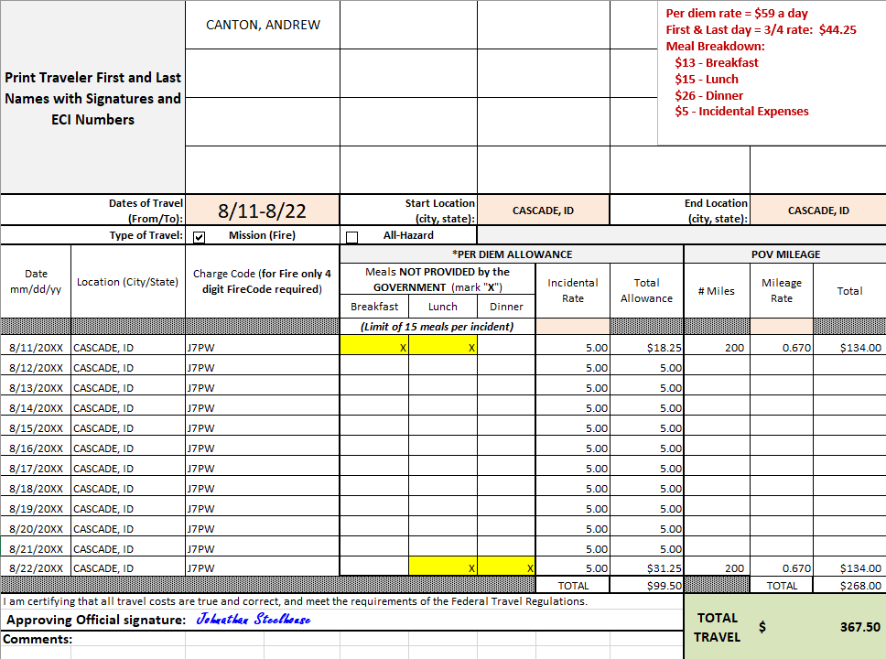
Travel Worksheet for a Single Casual
Casual name: add ECI if common last name
Indicate dates and Type of Travel
List dates to be reimbursed for M&IE, city/state of where the night was spent, and 4-digit fire code
Ensure POV mileage is indicated at reimbursement rate of $0.67 per mile
Approving Official signature
The first & last day of travel are always calculated at ¾ rate (includes $5 incidental expenses) minus the cost of any meals provided: $44.25 - $26 = $18.25 (total allowance for 1st day)
8/12-8/21 - All meals provided at incident; only Incidental Expenses of $5 reimbursed

