Slide 1
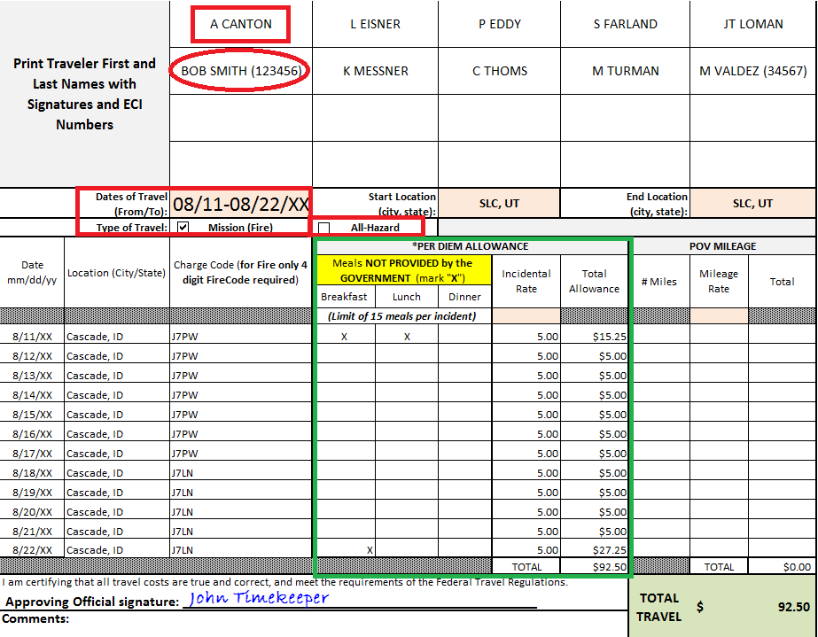
Travel Reimbursement Options Individual
Travel Worksheet
Attach to Batch Memo (crew reimbursement).
Indicate AD names and ECI’s if they have a common or similar last name
The 1st day of travel
(3/4 rate which includes $5 incidental) minus the cost of any meals that were provided:
$38.25 - $23 = $15.25
total allowance for 1st day.
Indicate Dates
&
Type of Travel
All meals were provided at the incident; therefore only I/E’s of $5 were reimbursed 8/12-8/21/XX
Indicate dates to be reimbursed for M & I/E,
the city/state of where they spent the night, and the 4-digit fire code
Per Diem Rate = $51 a day
First & Last Day = ¾ rate: $38.25
Meal Breakdown:
$11-Breakfast
$12-Lunch
$23-Dinner
$ 5-I/E (Incidental Expenses)
Ensure Approving Official signature is indicated

Slide 2
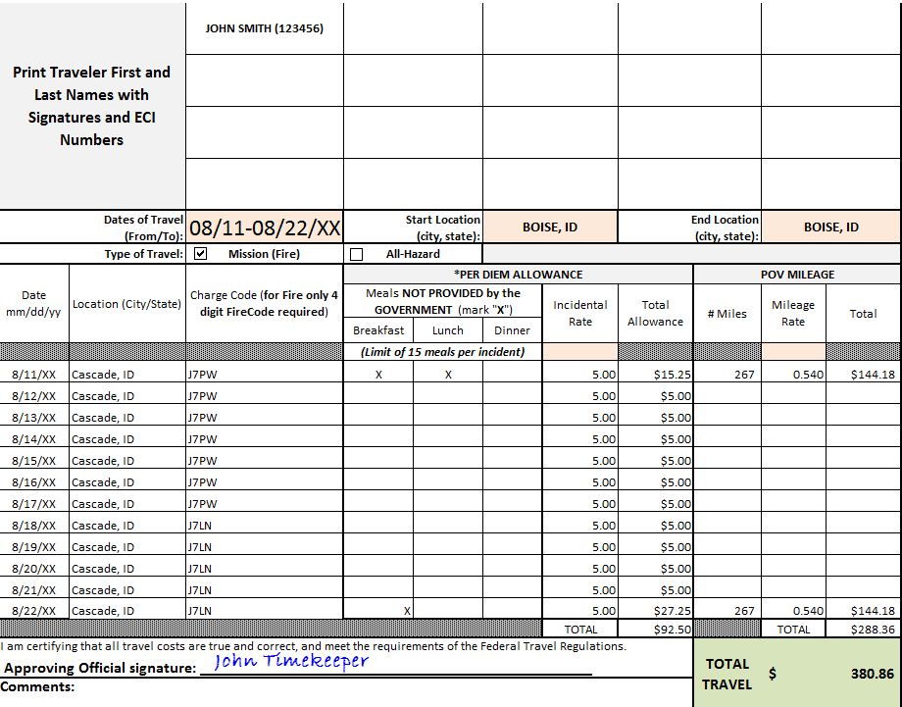
Travel Reimbursement Options Individual
Travel Worksheet
Attach to OF-288 (individual reimbursement).
Per diem rate example for John Smith’s worksheet:
Indicate AD name and ECI
Per Diem Rate = $51 a day
First & Last Day = ¾ rate: $38.25
Meal Breakdown:
$11-Breakfast
$12-Lunch
$23-Dinner
$ 5-I/E (Incidental Expenses)
The 1st day of travel
(3/4 rate which includes $5 incidental) minus the cost of any meals that were provided:
$38.25 - $23 = $15.25 total allowance for 1st day.
Indicate Dates
&
Type of Travel
Indicate dates to be reimbursed for M & I/E,
the city/state of where they spent the night, and the 4-digit fire code
All meals were provided at the incident; therefore only I/E’s of $5 were reimbursed 8/12-8/21/XX
Ensure Approving Official signature is indicated
Ensure POV mileage
is indicated, reimbursement
rate is .54 cents per mile

