Slide 1
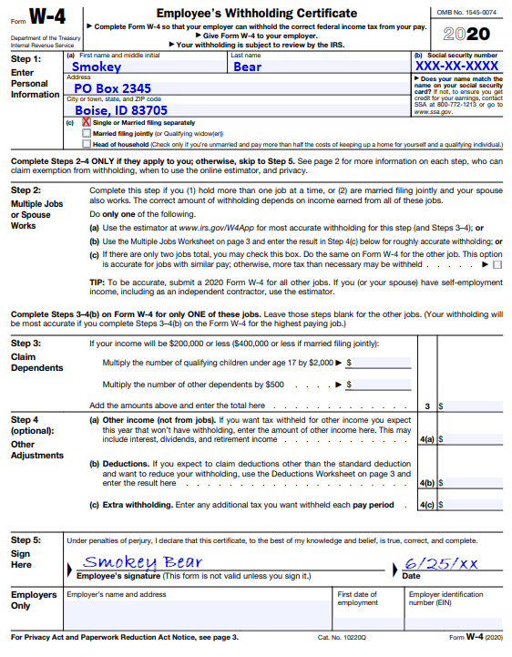
2020 Form W-4
FR
FABRIKAM RESIDENCES
Newly designed format
Changing from Allowances to Deductions

Slide 2
Step 1:
1a) First Name, Middle Initial, Last Name, Mailing Address 1b) Complete Social Security Number
1c) Marital Status
Single or Married filing separately
Married filing jointly
Head of household

Slide 3
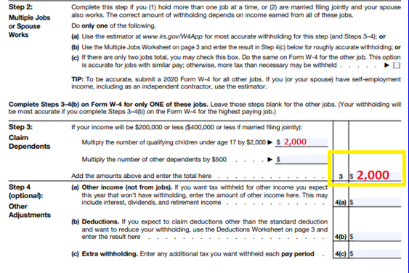
Steps 3 & 4:
Complete Steps 2-4 ONLY if they apply to you; otherwise, skip to Step 5.
If you are claiming Dependents, you must
multiply the number of qualifying children under age 17 by $2,000.00, and
number of other dependents by $500.00,
ADD the amounts and enter the total amount on line 3
If you would like Extra Withholding from each payment, enter the amount on line 4c.

Slide 4
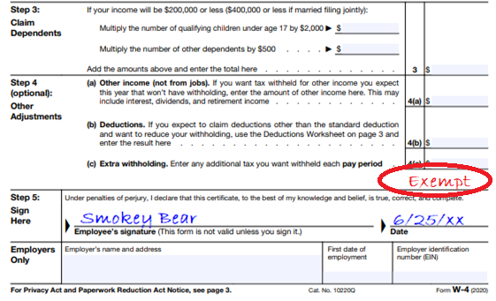
Claiming Exempt
NO FEDERAL TAXES DEDUCTED FROM
PAYMENTS
If you are claiming EXEMPT, you must write EXEMPT under line 4c
Lines 3, 4a, 4b, and 4c must be left blank

Slide 5
Step 5:
Sign and date Form W-4
Previous years Form W-4s will be VOID as of January 2020.

Slide 6
Find the new 2020 Form W-4:
Casual Payment Center Website:
https://www.nifc.gov/programs/cpc_forms.html
https://www.irs.gov/forms-pubs/about-form-w-4
IRS Website:

Slide 7
FAQs: 2020 Form W-4:
When can we start using the new 2020 Form W-4?
The newly designed 2020 Form W-4 can be used with respect to wages to be paid in 2020 (all new hires should use the new form).
Are returning employees required to use the redesigned form?
No. Employees who have furnished Form W-4 in any year before 2020 are not required to furnish a new form merely because of the redesign. Employers will continue to compute withholding based on the information from the employees most recently furnished Form W-4.
What about employees paid prior to 2020 who want to adjust withholding from their pay dated January 1, 2020, or later?
Employees must use the redesigned form.
https://www.irs.gov/newsroom/faqs-on-the-2020-form-w-4

