Slide 1





Fire Season Review
2021
DOI Casual Payment Center

Slide 2
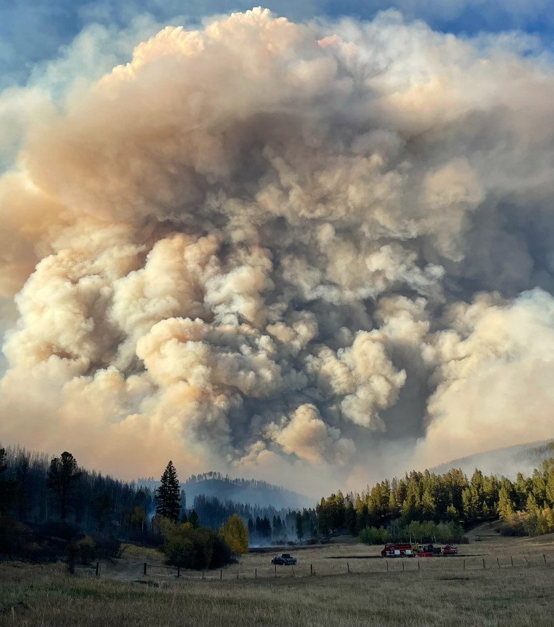
Casual Payment Center
3833 S Development Ave
Boise, ID 83705
Phone: 877-471-2262
Fax: 208-433-6405
Email: casualpay@blm.gov
Website: https://www.nifc.gov/programs/casual-payment-center
Overall Winner: Photo by Lauren Kokinda

Slide 3
FISCAL YEAR 2021 TOTALS

Slide 4
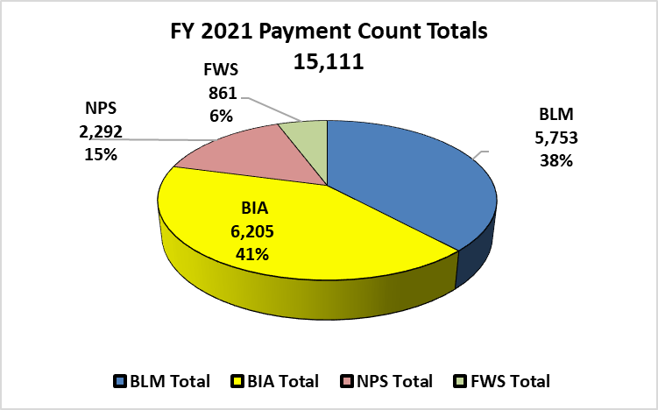
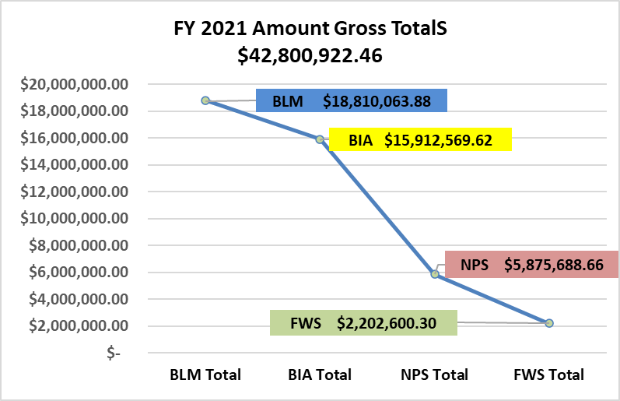
FISCAL YEAR 2021 TOTALS
Payment Counts and Amount Gross Totals

Slide 5
CALENDAR YEAR 2021 TOTALS

Slide 6
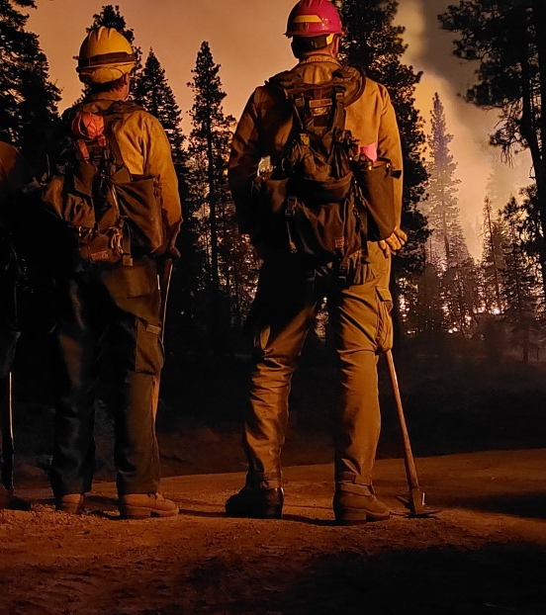
2021 CPC Updates
COVID Staffing:
  Fire Season (Jun-Oct) 6 employees staffed in-office with remaining staff teleworking.
  Nov-May: in-office staffed Tuesday & Thursday mornings with remaining staff teleworking.
Continued to finalize transition of internal lead job assignments from paper process to an electronic process.
Fully staffed workforce adding:
Jenny Hugi, Assistant Center Manager
(208) 387-5775; jhugi@blm.gov
Cheryl Cramer, Emergency Firefighter Payments Specialist
(208) 387-5776; ccramer@blm.gov
Director’s Pick_Photo by Peter Fromberz

Slide 7
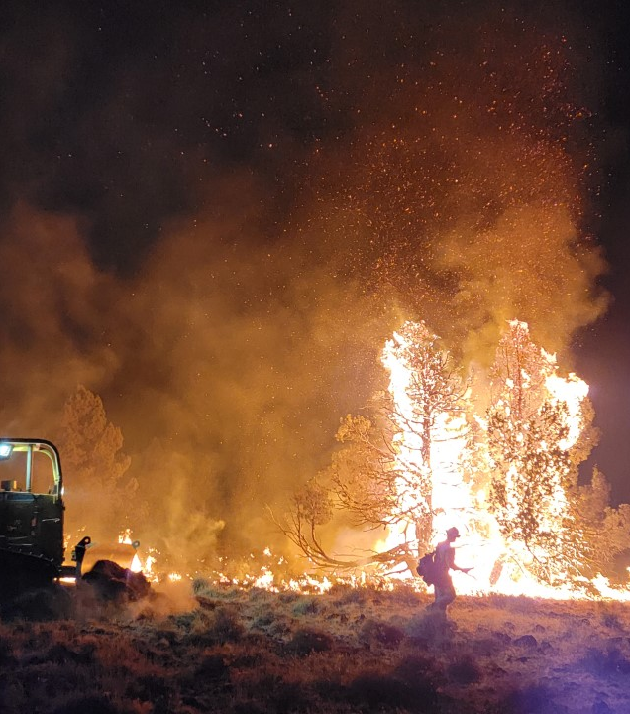
NERV Payment Invoices: BLM
Supported BLM by preparing NERV Payment Invoices.
Equipment Category Winner_Sara Boyko_Willow Valley Fire_Dozer_2021

Slide 8
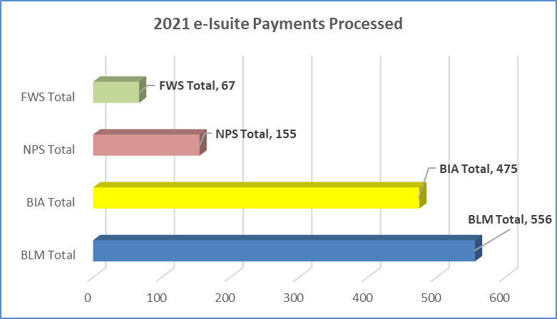
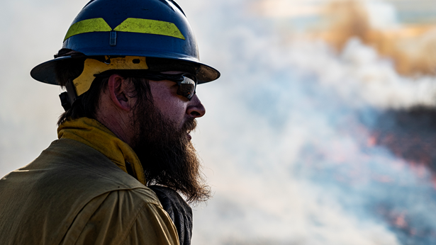
e-ISuite Payments Processed
Emailed Batches
Forest Service experienced a prolonged period where files were not being uploaded into FPPS over the summer due to duplication errors. DOI Casual Pay continues to use available e-ISuite files when available.
This practice expedited the CPC’s processing of payments saving delivery time and mailing costs.
Photo by Jerrod Fast_2018 Horse Park Fire

Slide 9
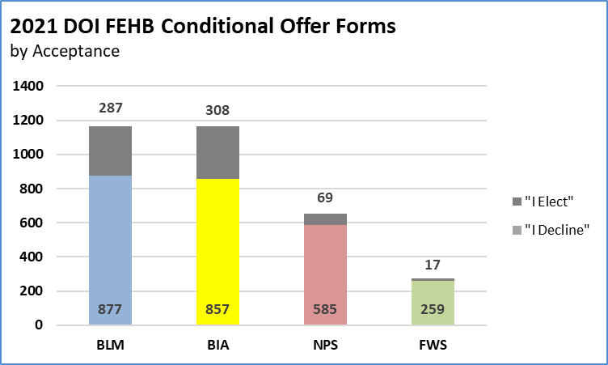
FEHB Conditional Offer Forms
Overall Statics for BLM, BIA, NPS, & FWS

Slide 10
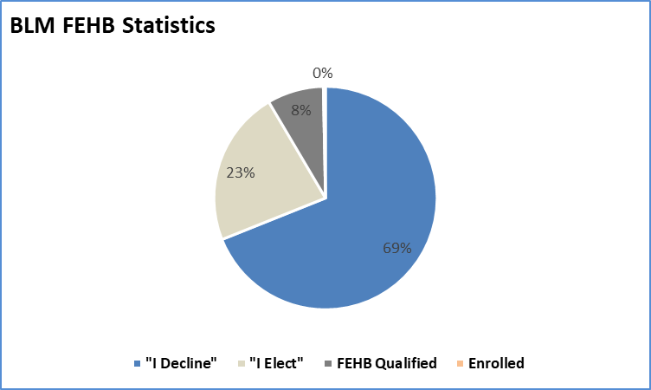
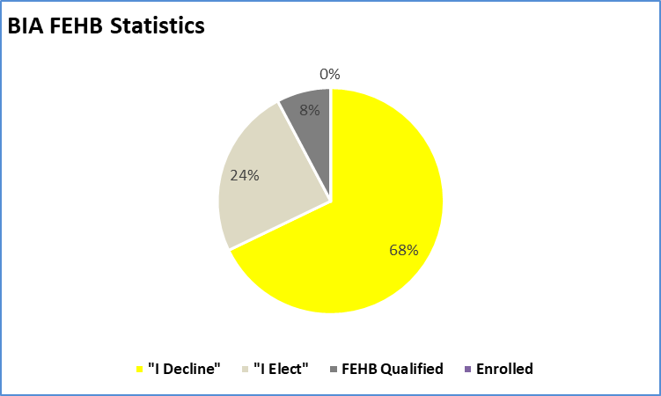
FEHB Conditional Offer Forms for BLM & BIA

Slide 11
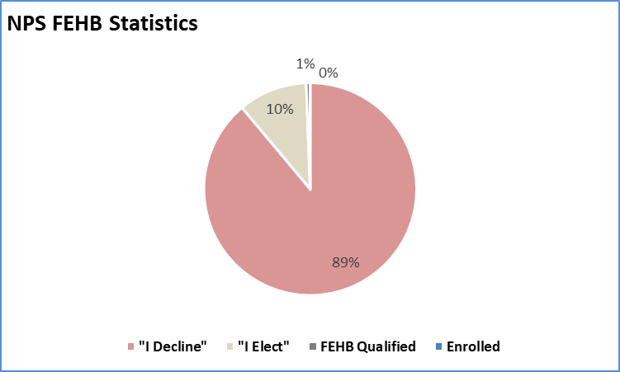
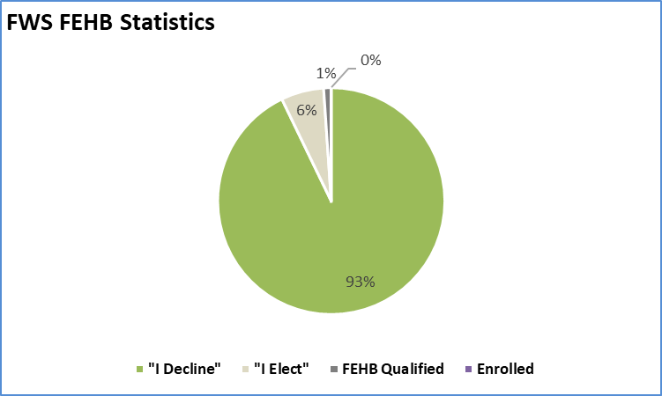
FEHB Conditional Offer Forms for NPS & FWS

Slide 12
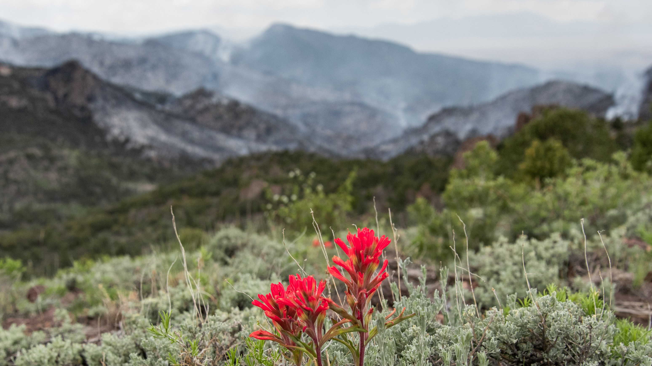
QUESTIONS?
The Land We Protect Category Winner_Ben Hoke_2021_Wilson Creek Fire

