Slide 1






Hiring Documents &
Internal Forms
National Interagency Fire Center
Casual Payment Center MS 270
3833 S Development Ave
Boise, ID 83705
Phone: 877-471-2262
Fax: 208-433-6405
Email: casualpay@blm.gov
Office Hours: 8:00 am – 4:00 pm Monday – Friday
Website: https://www.nifc.gov/programs/casual-payment-center
DOI SharePoint: CPC Team - Home (sharepoint.com)

Slide 2

Documents/forms to be covered
Hiring Documents
FEHB/FEDVIP/Internal Forms
Batch Memo/OF-288
Travel Reimbursement
Emailing Documents

Slide 3
Emailing to the Casual Payment Center (CPC)
Within the DOI Network
OF-288s
Forms with PII
When an email is received the CPC will respond with a confirmation of receipt for tracking purposes:
  OF-288 Count
  Forms Count
Outside the DOI Network
Do not email PII (Personally Identifiable Information)
Protected by the Privacy Act of 1974
Name in association with SSN (including last four)
Addresses
Bank Account Information
Phone Numbers
Dates of Birth
Email Addresses
PLEASE MAIL OVERNIGHT ALL PAYMENT PACKETS containing PII if the DOI Network is not accessible!
Notes:
As we being reviewing the documents covered today remember they should be kept in a locked cabinet because of the PII.

Slide 4
Preparing AD OF-288 Electronic Payments
Tips for sending AD-OF288’s to the CPC for processing
  Adobe PDF (if available using Adobe Pro allows the Agency and CPC to easily document any necessary changes and track the process of the payment)
  Electronically prepare or scan all documents into a single PDF file
  Attach the PDF to an email so we can respond directly that we received the payment information
When sending batches electronically, avoid sending:
  Photos (i.e. .jpg, .png, .tiff, etc.) – photos sometimes come in very small and hard to see
  Locked documents (prohibits us from documenting our internal process)
  PDF Portfolio
    Once a PDF Portfolio is signed, we must open each PDF individually, save it, then combine the documents to start the payment process

Slide 5
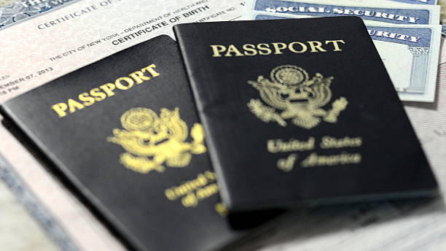
FORM I-9: What is the purpose?
Document
Document verification of the identity & employment authorization of each new employee (citizen and non-citizen) to work in the United States.
Ensure
Employers must ensure newly hired employees complete and sign Section 1 no later than the first day of employment.
Examine
Employers must examine evidence of identity and employment authorization within 3 business days of the employee’s first day of employment.

Slide 6
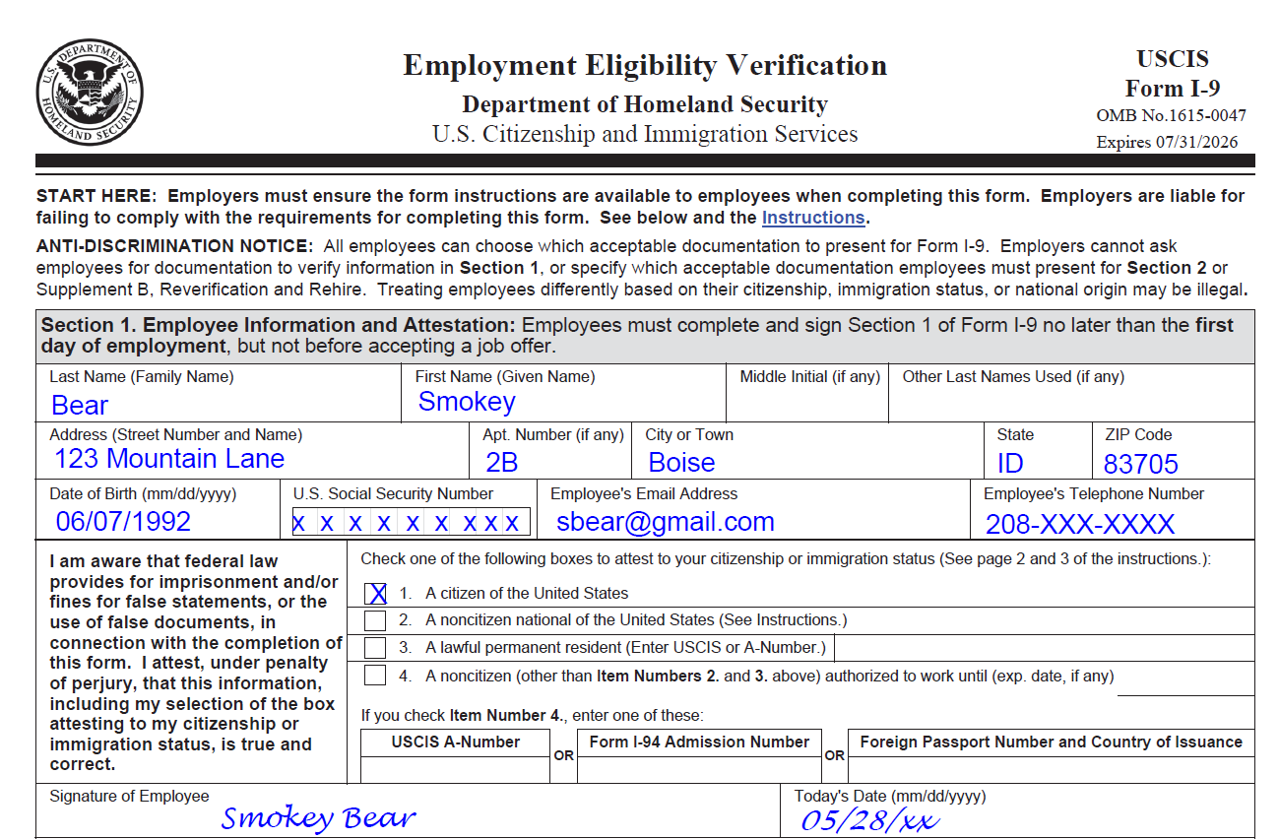
SECTION 1 FORM I-9
Ensure most current form is completed
Employee’s name must match supporting documents
Email address & phone number are optional; indicate N/A if information is not provided
One of the boxes must be checked
Ensure employee signature and date is completed
RETAINED AT HOME UNIT
Notes:
Section 1 must be completed the first day of employment by the employee.

Slide 7
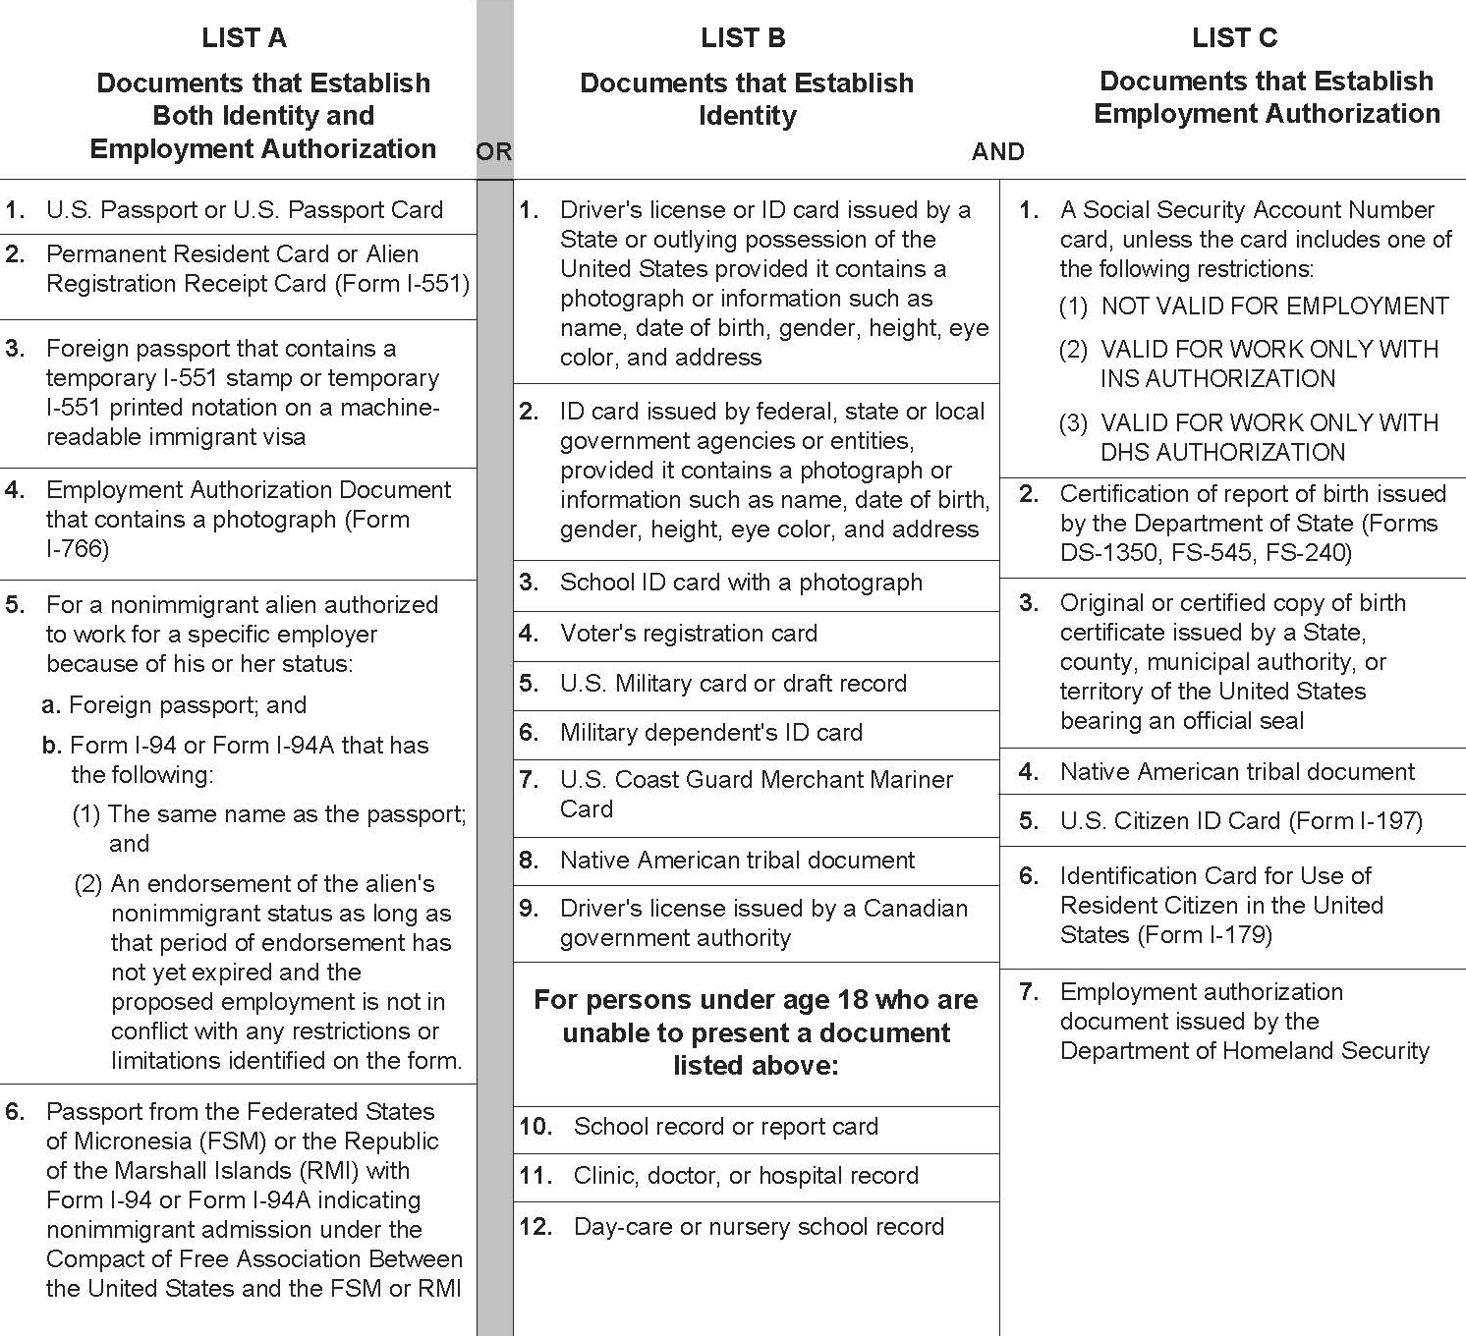

List of acceptable documents
Employees may present one selection from List A, or a combination of one selection from List B and one selection from List C.
All documents must be unexpired.

Slide 8
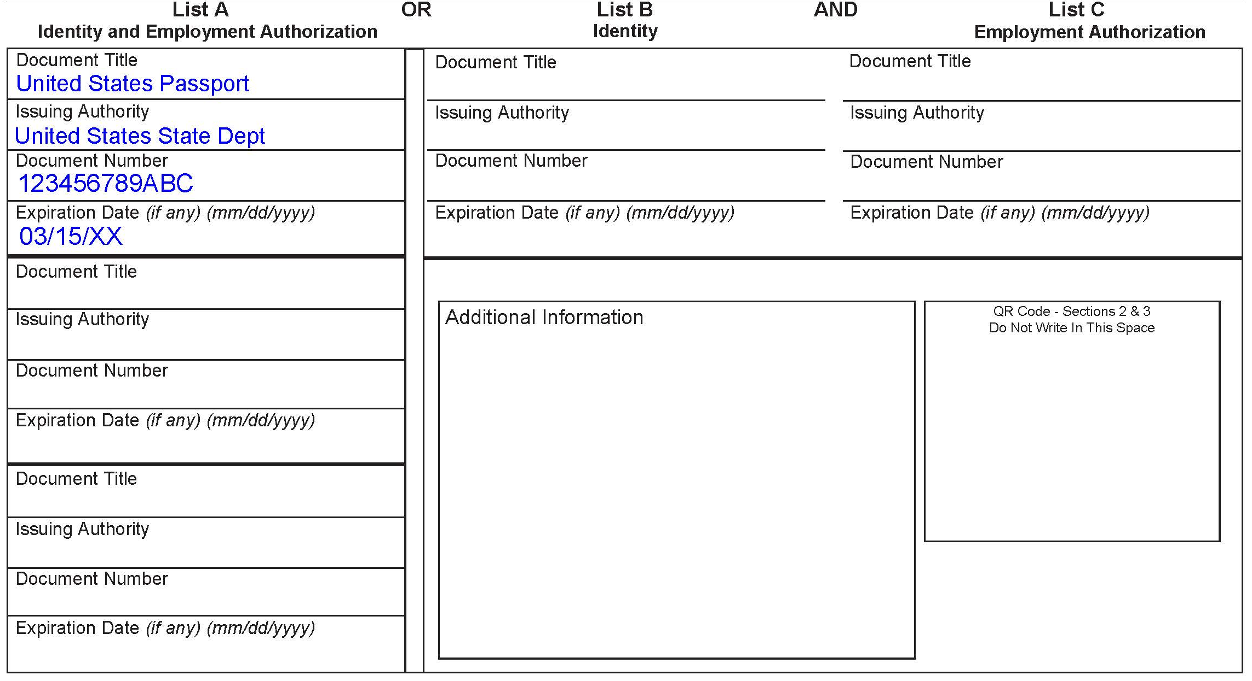
Section 2 of the Form I-9
EMPLOYER OR Authorized representative review & verification
This is an example of a document presented from List A.
The employer must clearly indicate Document Title, Issuing Authority, Document Number and Expiration Date.
All documents must be unexpired and original except for a certified copy of a birth certificate.
REMEMBER: Employers CANNOT specify which document(s) they will accept from an employee.
Notes:
You the employer completes Section 2 of the Form I-9.

Slide 9
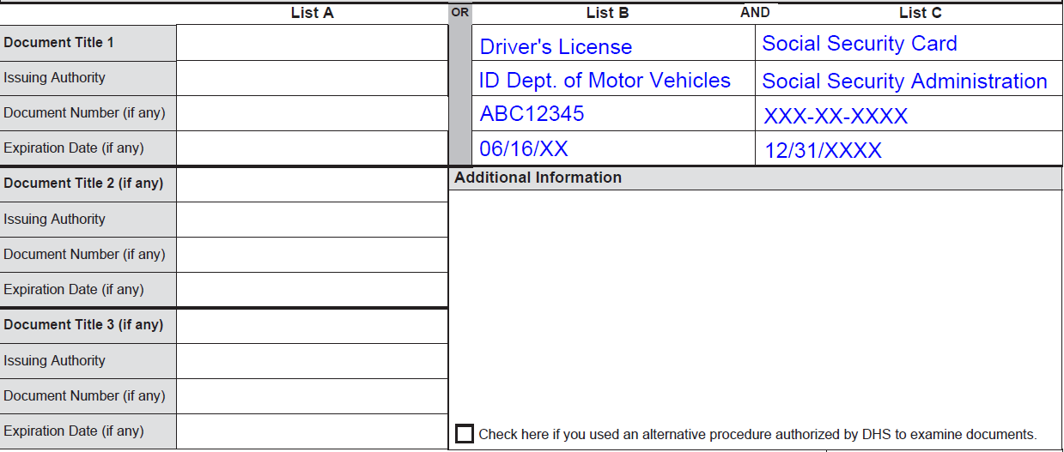
Section 2 of the Form I-9 (cont.)
EMPLOYER OR Authorized representative review & Verification
This is an example of documents presented from Lists B & C.
List B contains documents that establish identity only.
List C contains documents that establish employment authorization only.
If documents from List B & C are presented, a document from List A should not be presented.
The examiner of the documents and the employee must both be physically present during the examination of the employee’s documents.

Slide 10
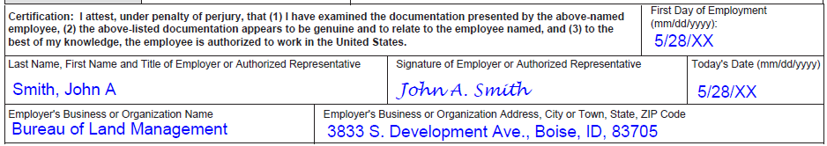
Certification of Form I-9
Enter the Employee’s first day of employment.
Sign & date the attestation on the date Section 2 is completed.
Provide name and title of person completing Section 2.
The Form I-9 can be completed in early spring, if the employee has accepted an employment offer.
*Employers may, but are not required to, photocopy the document(s) presented. If photocopies are made, they should be made for ALL new hires. Photocopies must be retained with Form I-9 in case of inspection by DHS. Employers must always complete Section 2 even if they photocopy an employee’s document(s).

Slide 11
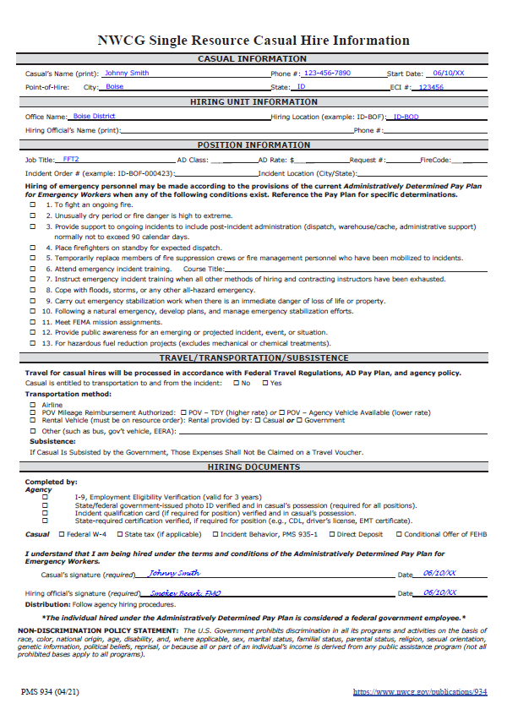
Single Resource Casual Hire Information Form
This form sets the formal agreement between the Agency and the Casual/AD to ensure there is no misunderstanding. It establishes the authority to pay under the AD Pay Plan.
This form establishes what the government will pay for travel and what expenses are reimbursable.
It provides a checklist for hiring documents to ensure prompt payment for work performed.
If the form is not properly signed and dated, it may not be an acceptable document if there is a grievance filed by a Casual/AD.

Slide 12
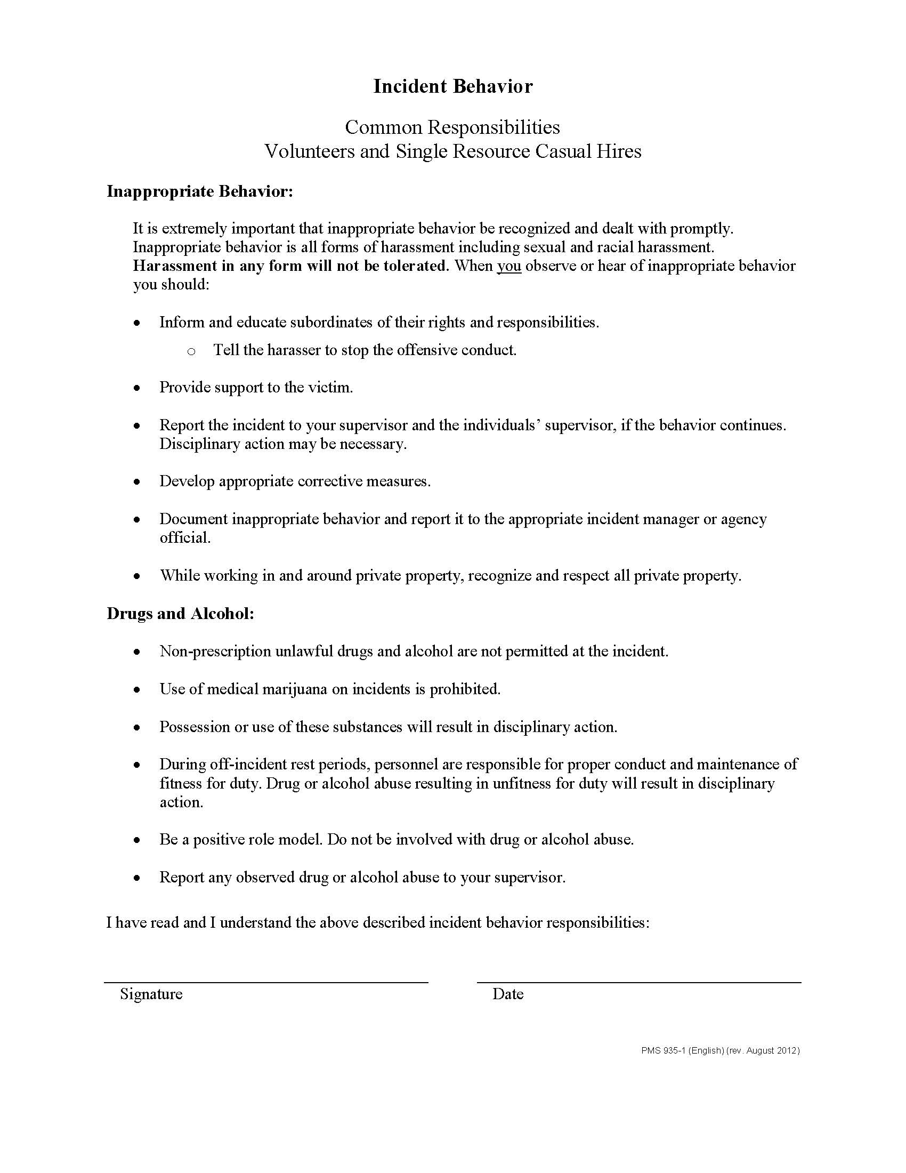
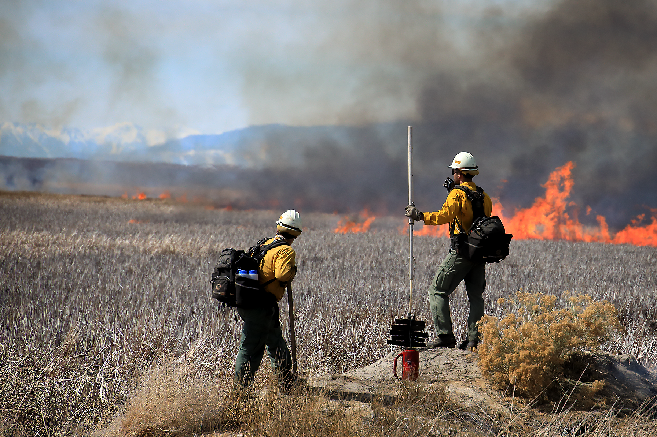
Incident Behavior Form
This form covers behavior as well as Drug & Alcohol abuse.
This form should be completed annually.

Slide 13
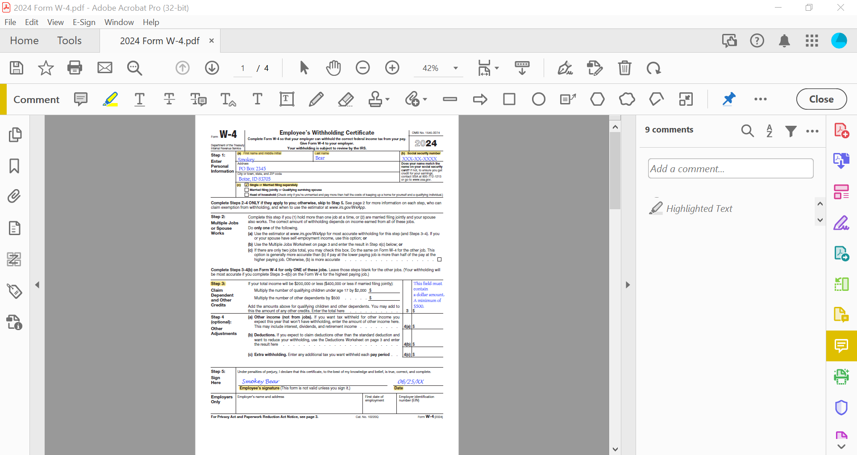
2024
FORM W-4
Please use a current year form when submitting Form W-4.
Step 1(a) and Step 1 (b) must be completed with Name and Social Security Number.
Step 1 (c) must be marked with one Marital Status.
If claiming dependents, Step 3 Block 3 must have a dollar amount (i.e., $2,000.00; $500.00), not a single-digit number (as in allowances, 1, 2, 3 etc.).
Form must be signed and dated.

Slide 14
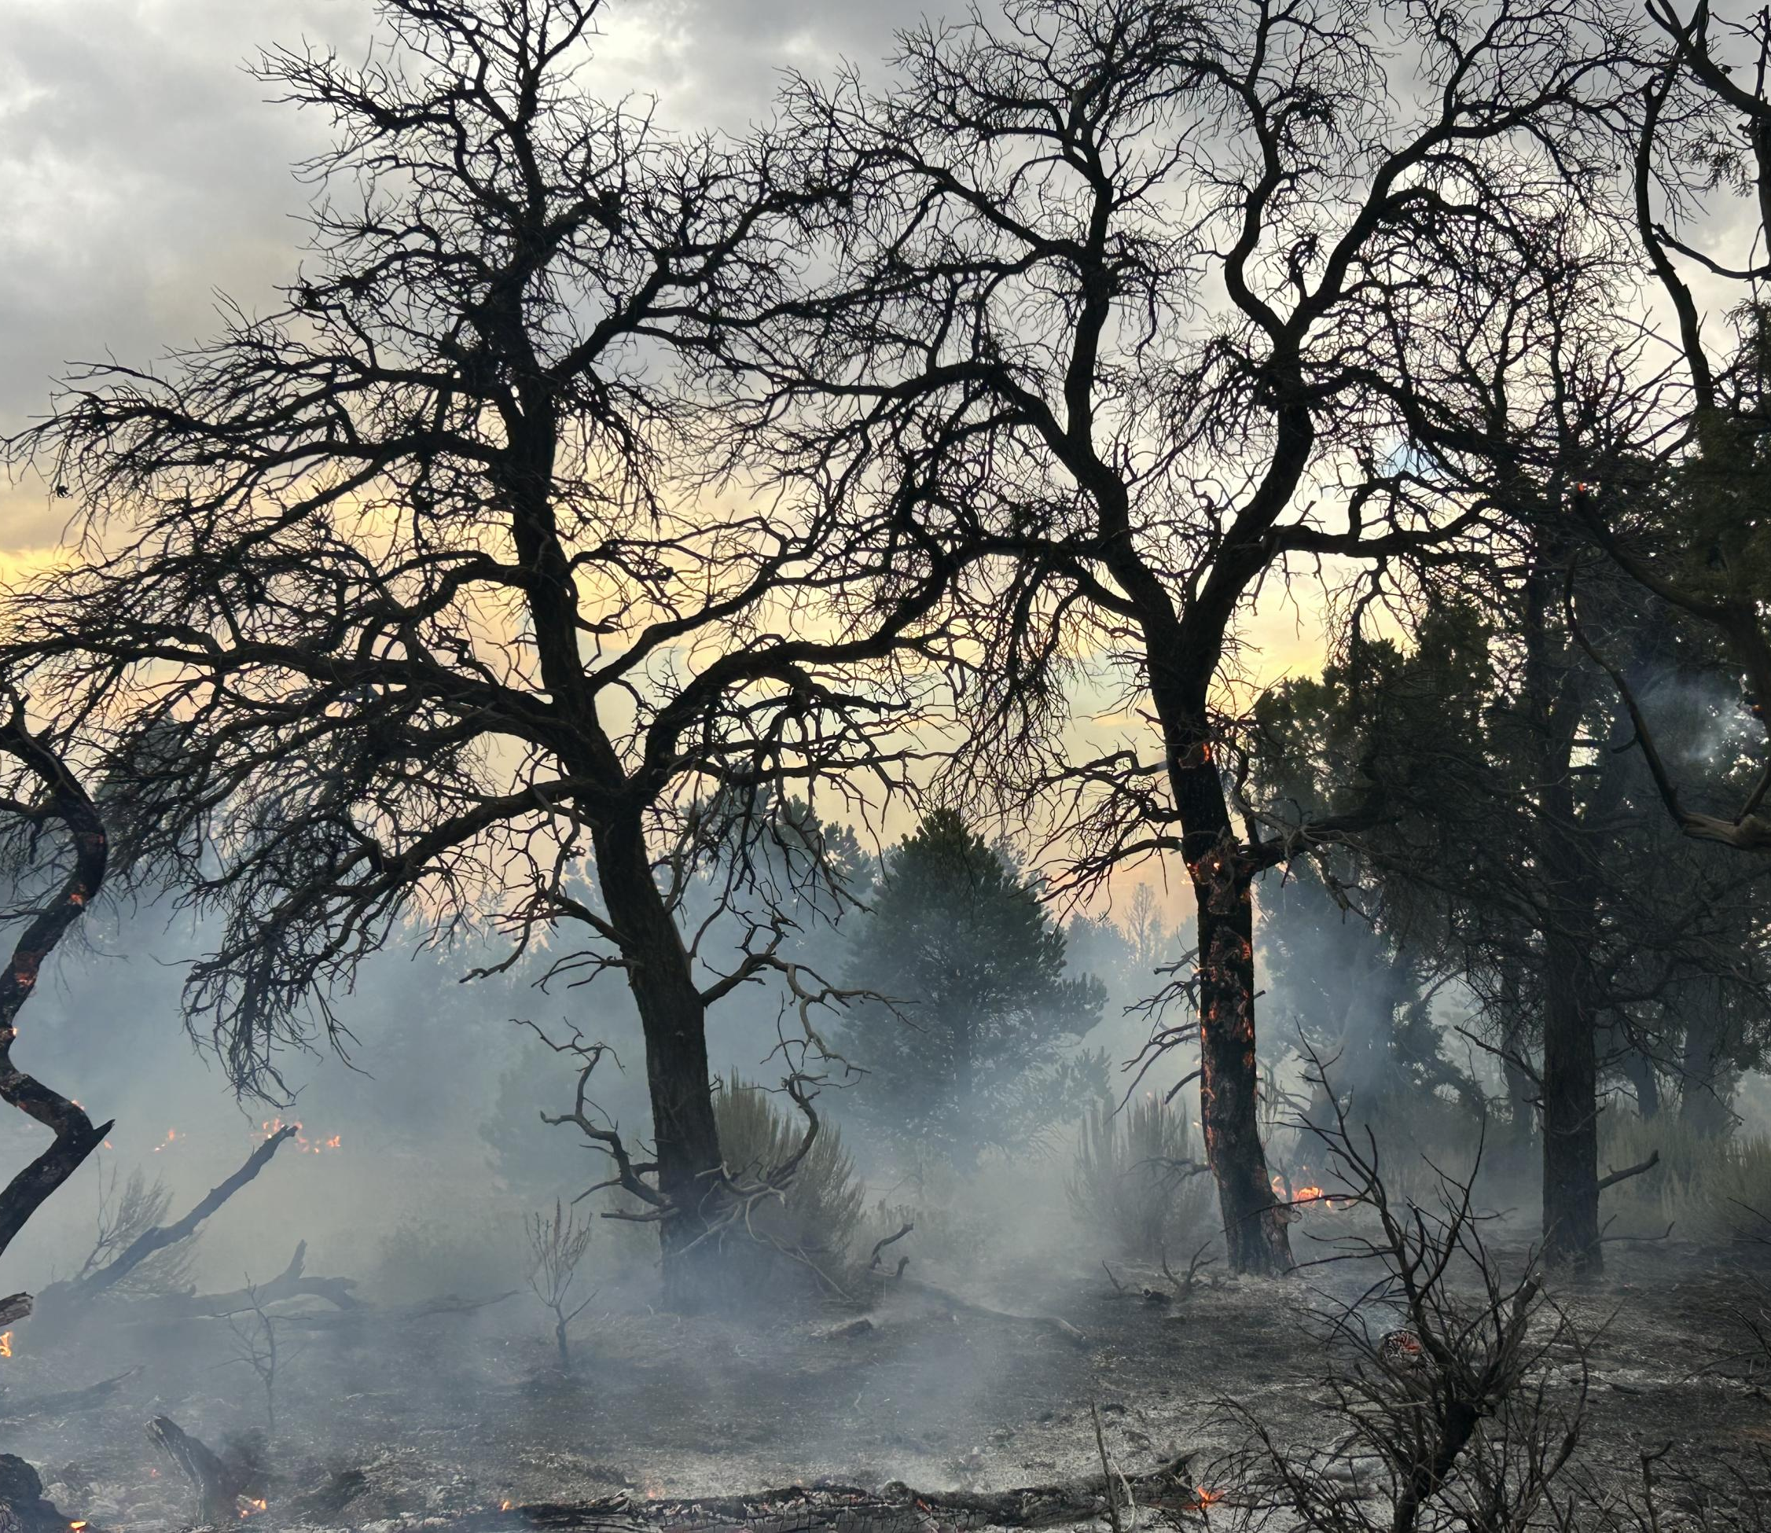
State Taxes
New employees, the Federal Personnel Payroll System (FPPS) will automatically default state taxes to single and zero deductions for the hired at state.
A Tribal Exemption form (if applicable) can be submitted each calendar year by casuals to exempt themselves from state taxes.
If the casual would like to claim a different deduction for state taxes, use specific state tax form.
There are nine states that do not have individual income withholding tax (e.g., AK, FL, NH, NV, SD, TN, TX, WA, WY), therefore, no state tax is withheld.

Slide 15
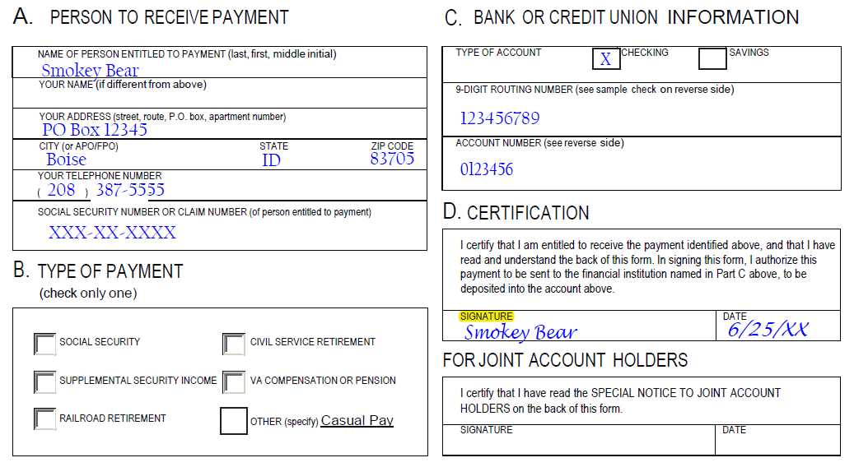
Direct Deposit Form
All fields must be legible and accurate.
Account information must be entered in the proper fields (Section C).
  Must include Type of Account.
Signature & Date.
If the Direct Deposit form is incomplete or illegible, a profile will not be updated, and the agency will be contacted if form accompanies an OF-288, otherwise Direct Deposit will be returned to Casual/AD.

Slide 16
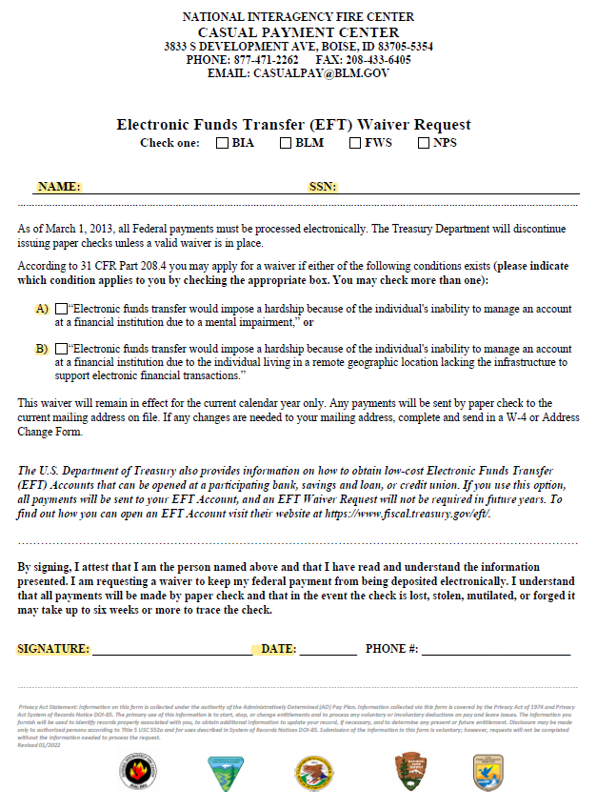
EFT Waiver
Must be completed EACH CALENDAR YEAR when Casual/AD is requesting a Treasury Check
Name and SSN must be completed.
One of the boxes must be checked.
Signature must be present, and the date must be current year.

Slide 17
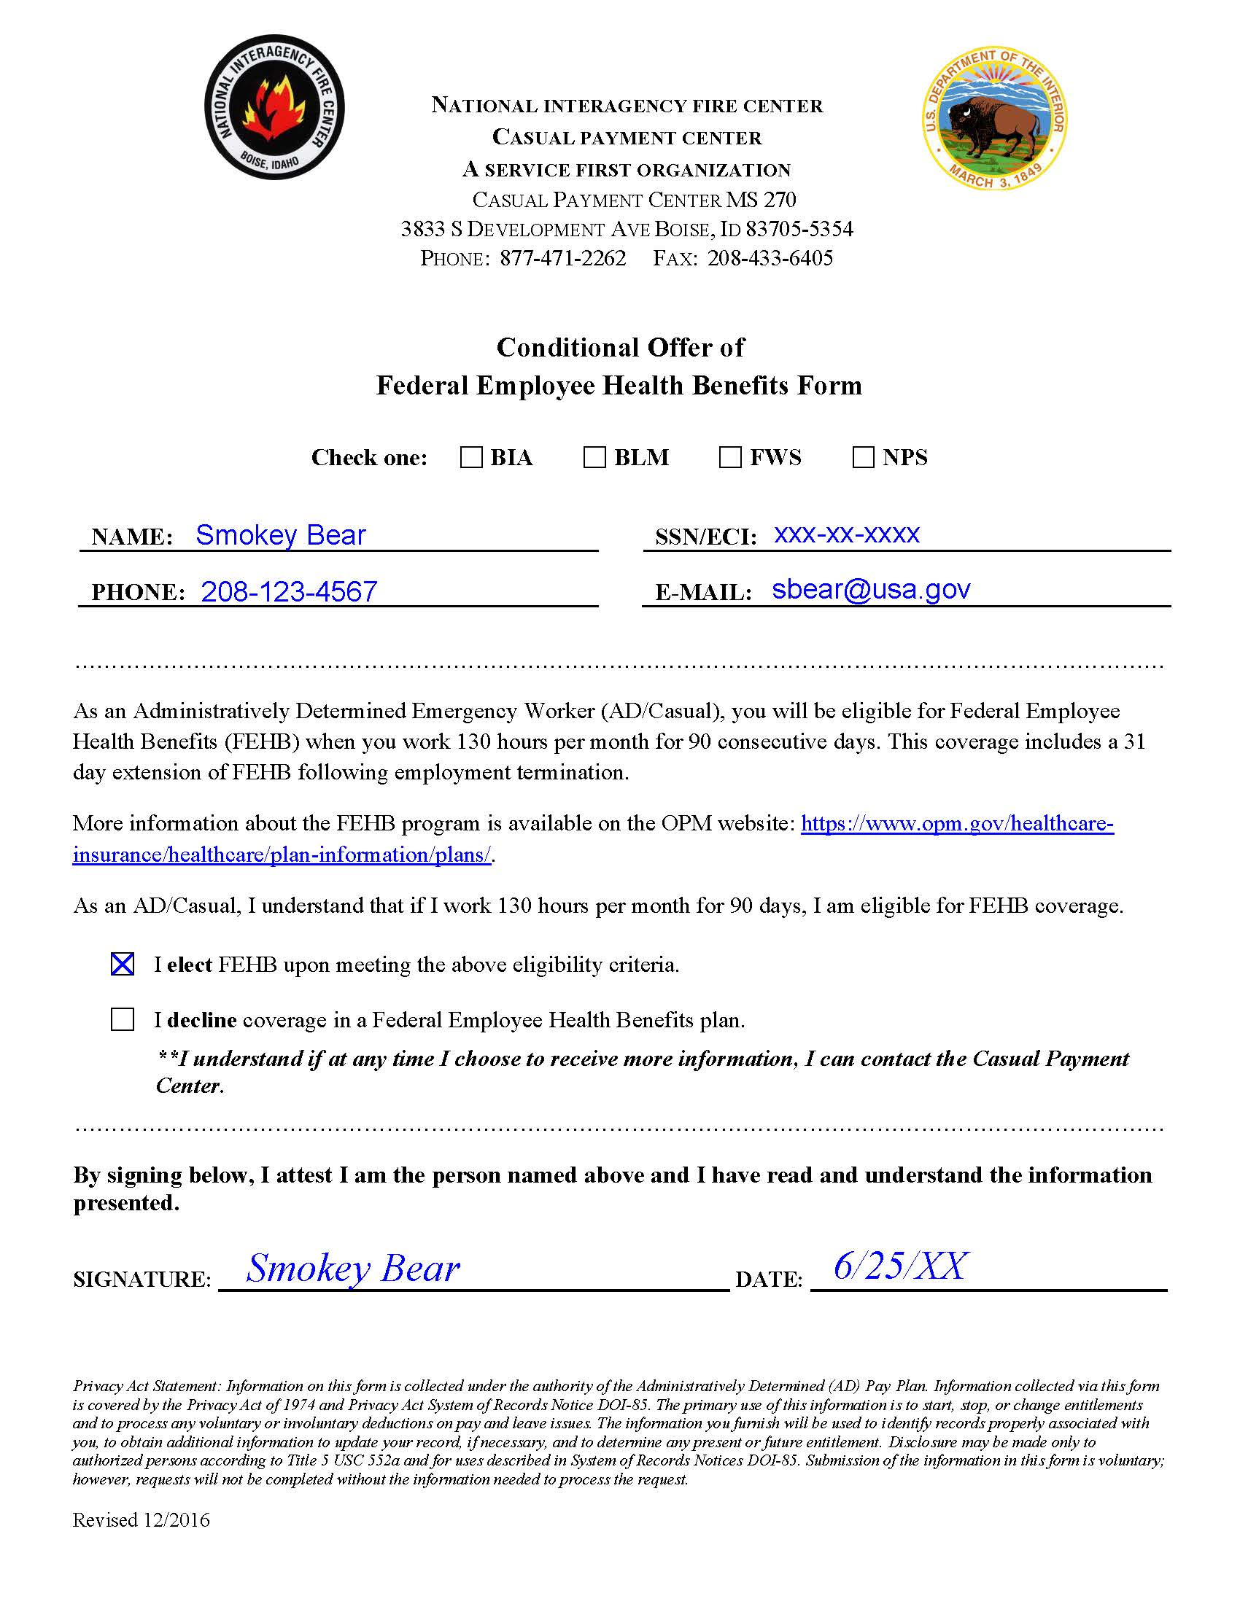
Federal Employee Health Benefits Form
Must be submitted each calendar year to account for all employees being offered health care.
Name, SSN/ECI must be completed along with a signature and current year date.
“I Elect” simply means if the Casual/AD meets the qualification criteria, the CPC will send notification of eligibility to select a health care plan.
“I Decline” means the Casual/AD will not be contacted by the CPC about health care if they meet eligibility requirements.
A Casual/AD can change status anytime.
Casuals qualify once they have worked 130 hours per month for 90 consecutive days.

Slide 18
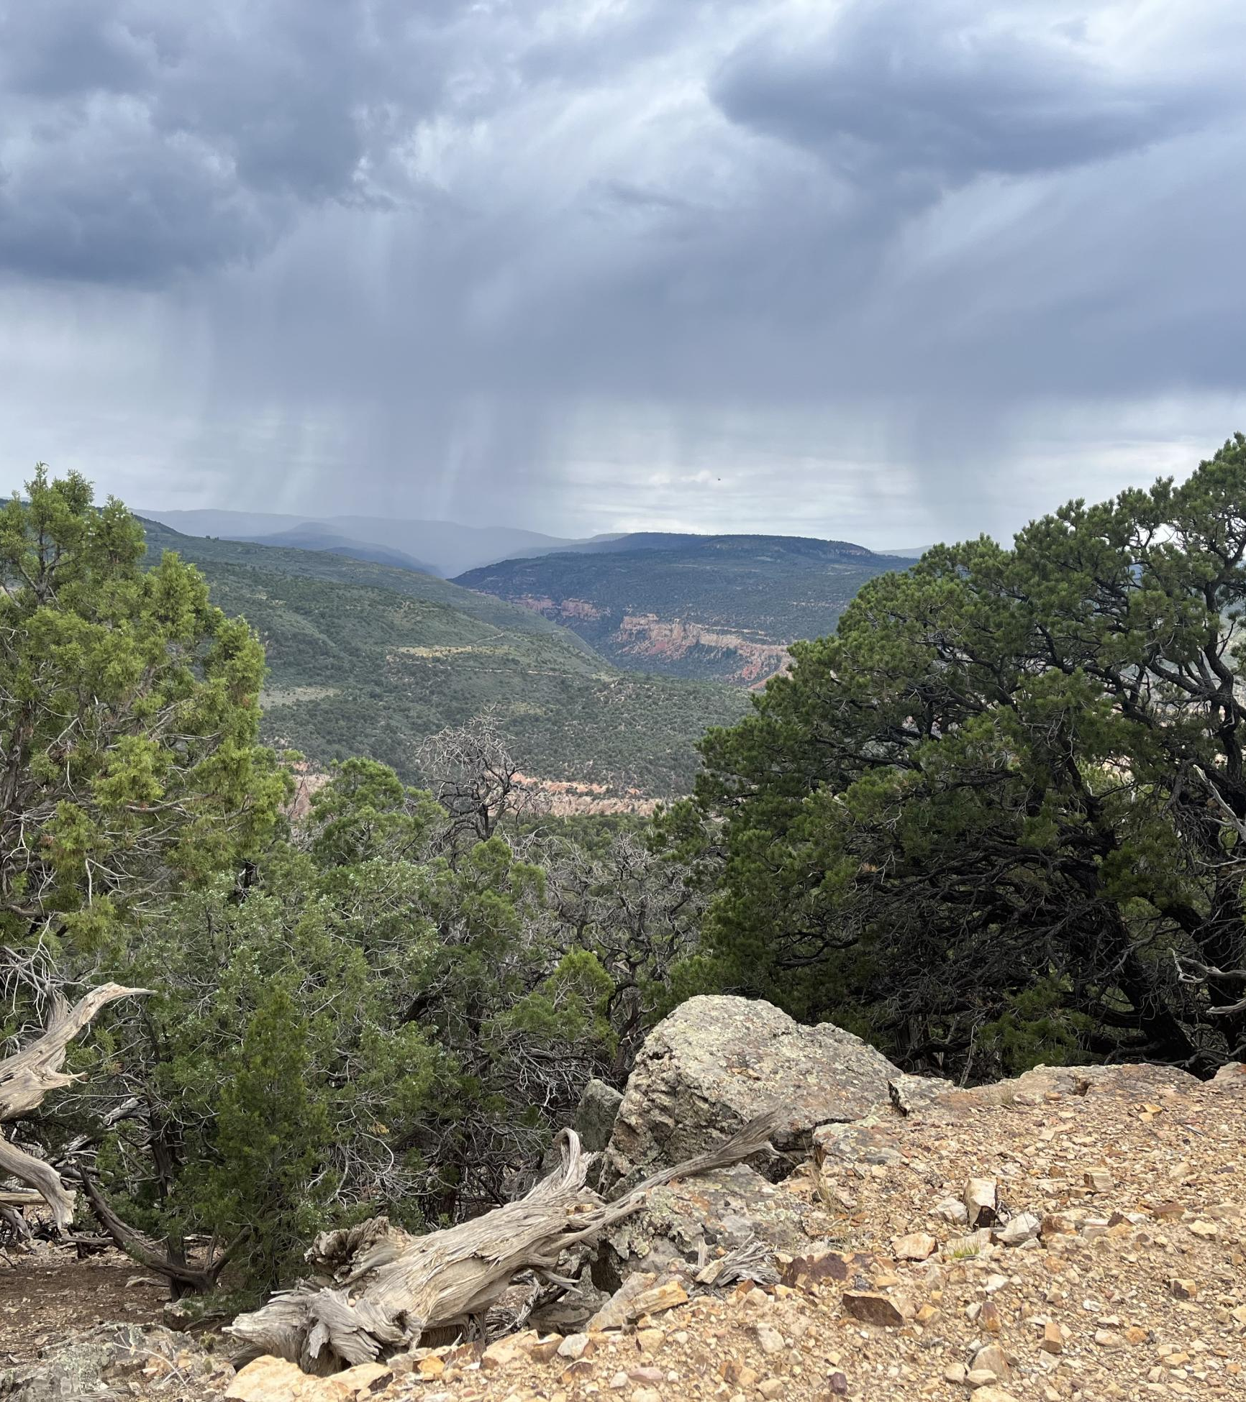
FEDVIP Benefits
Once casuals qualify for Federal Employee Health Benefits (FEHB), they are also eligible to sign up for Vision and Dental benefits.
Information regarding FEDVIP can be found at https://benefeds.com.
Casuals qualify once they have worked 130 hours per month for 90 consecutive days (same as FEHB).

Slide 19
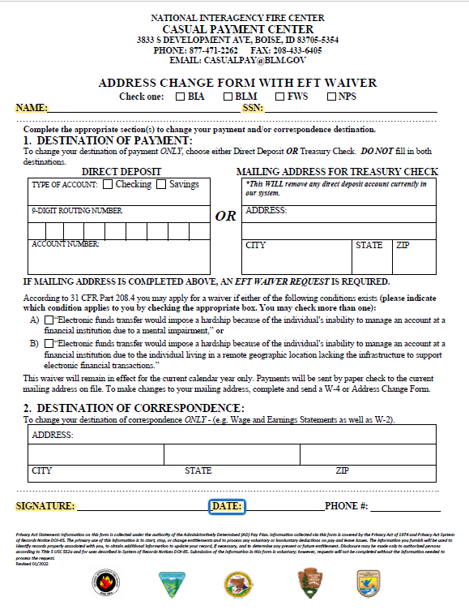
ADDRESS CHANGE FORM
The Address Change Form can change both Destination of Payment and Destination of Correspondence.
  However, both are not required.
Remember to indicate where mail is received; do not forget Apartment/Unit Numbers.
Submit form to the CPC

Slide 20
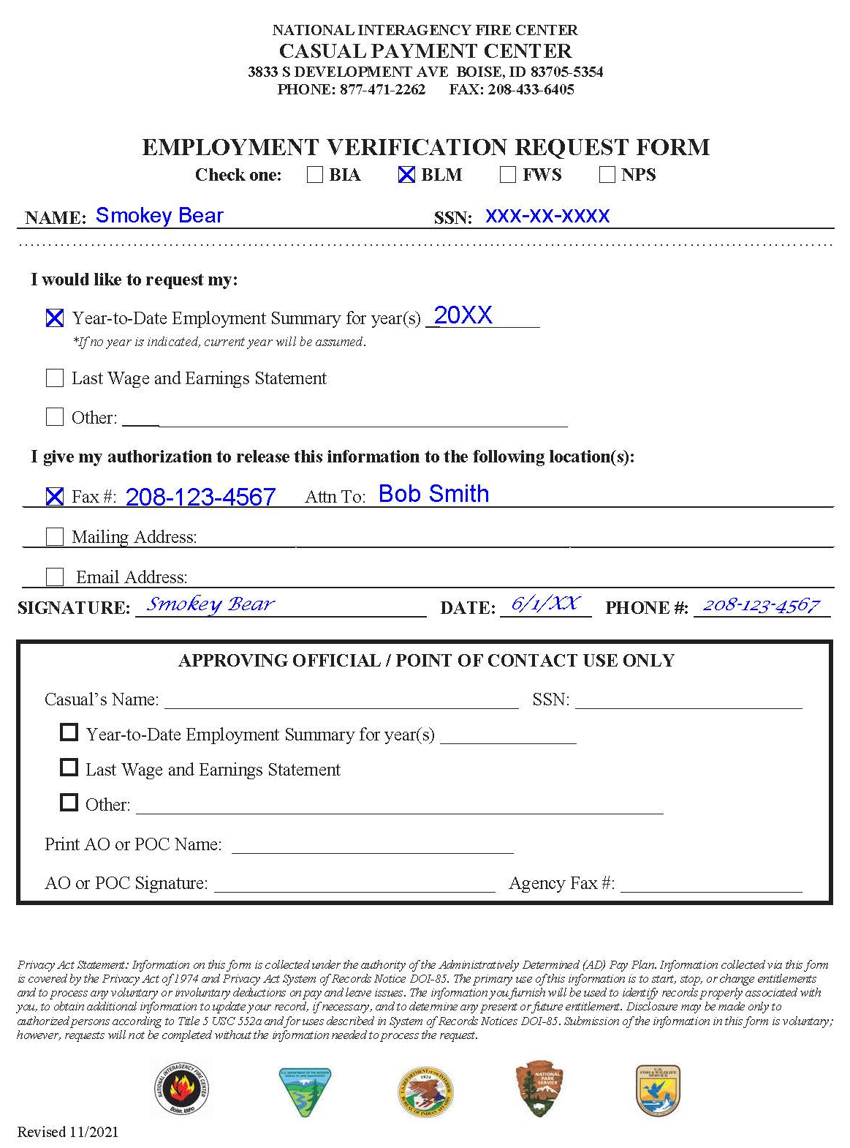
EMPLOYMENT VERIFICATON REQUEST FORM
The Employment Verification Request Form is used for Verifications, Employment Summaries, and Wage & Earning Statements (WESs).
Requests will be emailed, faxed or mailed within two business days.
AO/POCs may call and request Employment Summaries on behalf of the Casual/AD.
Submit form to the CPC

Slide 21
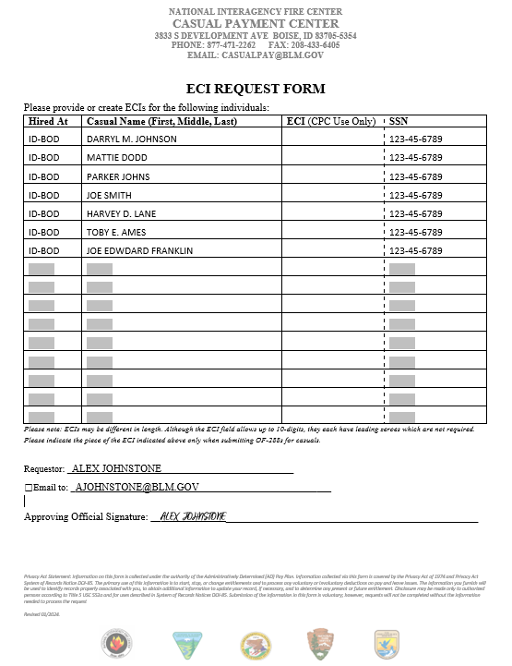
ECI Request Form
Requesting ECIs? Use the ECI Request form!
Indicate Hired At, Casual First, Middle Initial, Last Name and complete SSN.
Verify legibility before submitting form.
Request must be from an Approving Official or Point of Contact.

Slide 22
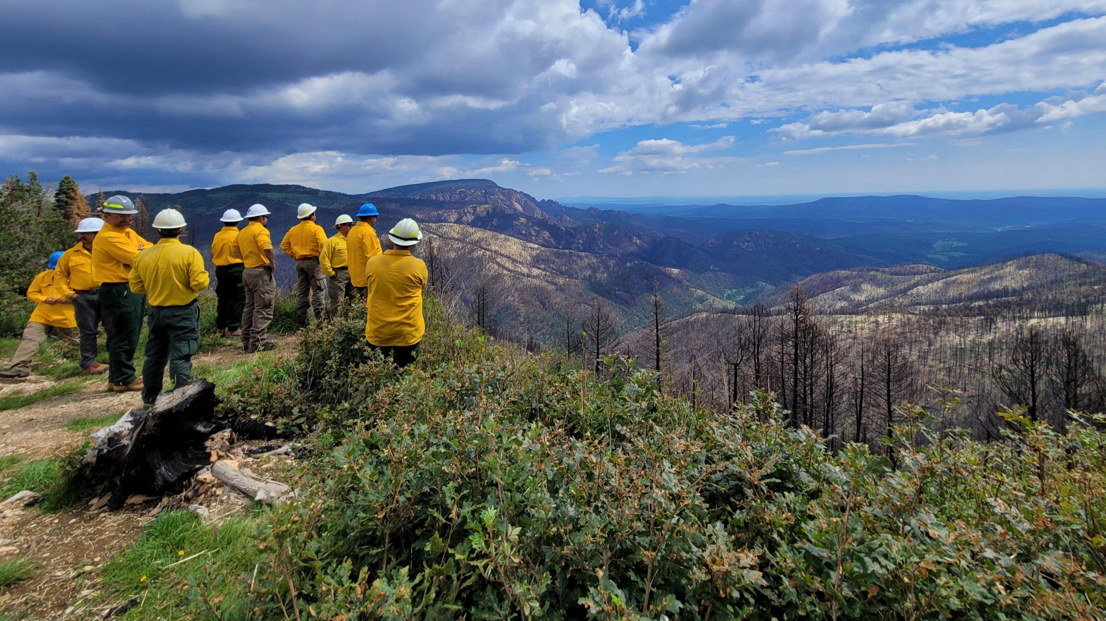
Guidance on how to complete
Time & Attendance
Approving Official Batch Memo
Batch Memo Manifest
OF-288
Travel Worksheet

Slide 23
Approving Official Batch
Memo
Indicate a unique Batch Number
Current agency contact information
Valid email address if requesting a confirmation
Casual count
List reimbursements for Incidental Expenses by indicating Starting & Ending dates
List other agency contacts for the specific batch that the CPC may contact for questions
Approving Official name & signature required
*Fillable form available on the CPC website

Slide 24
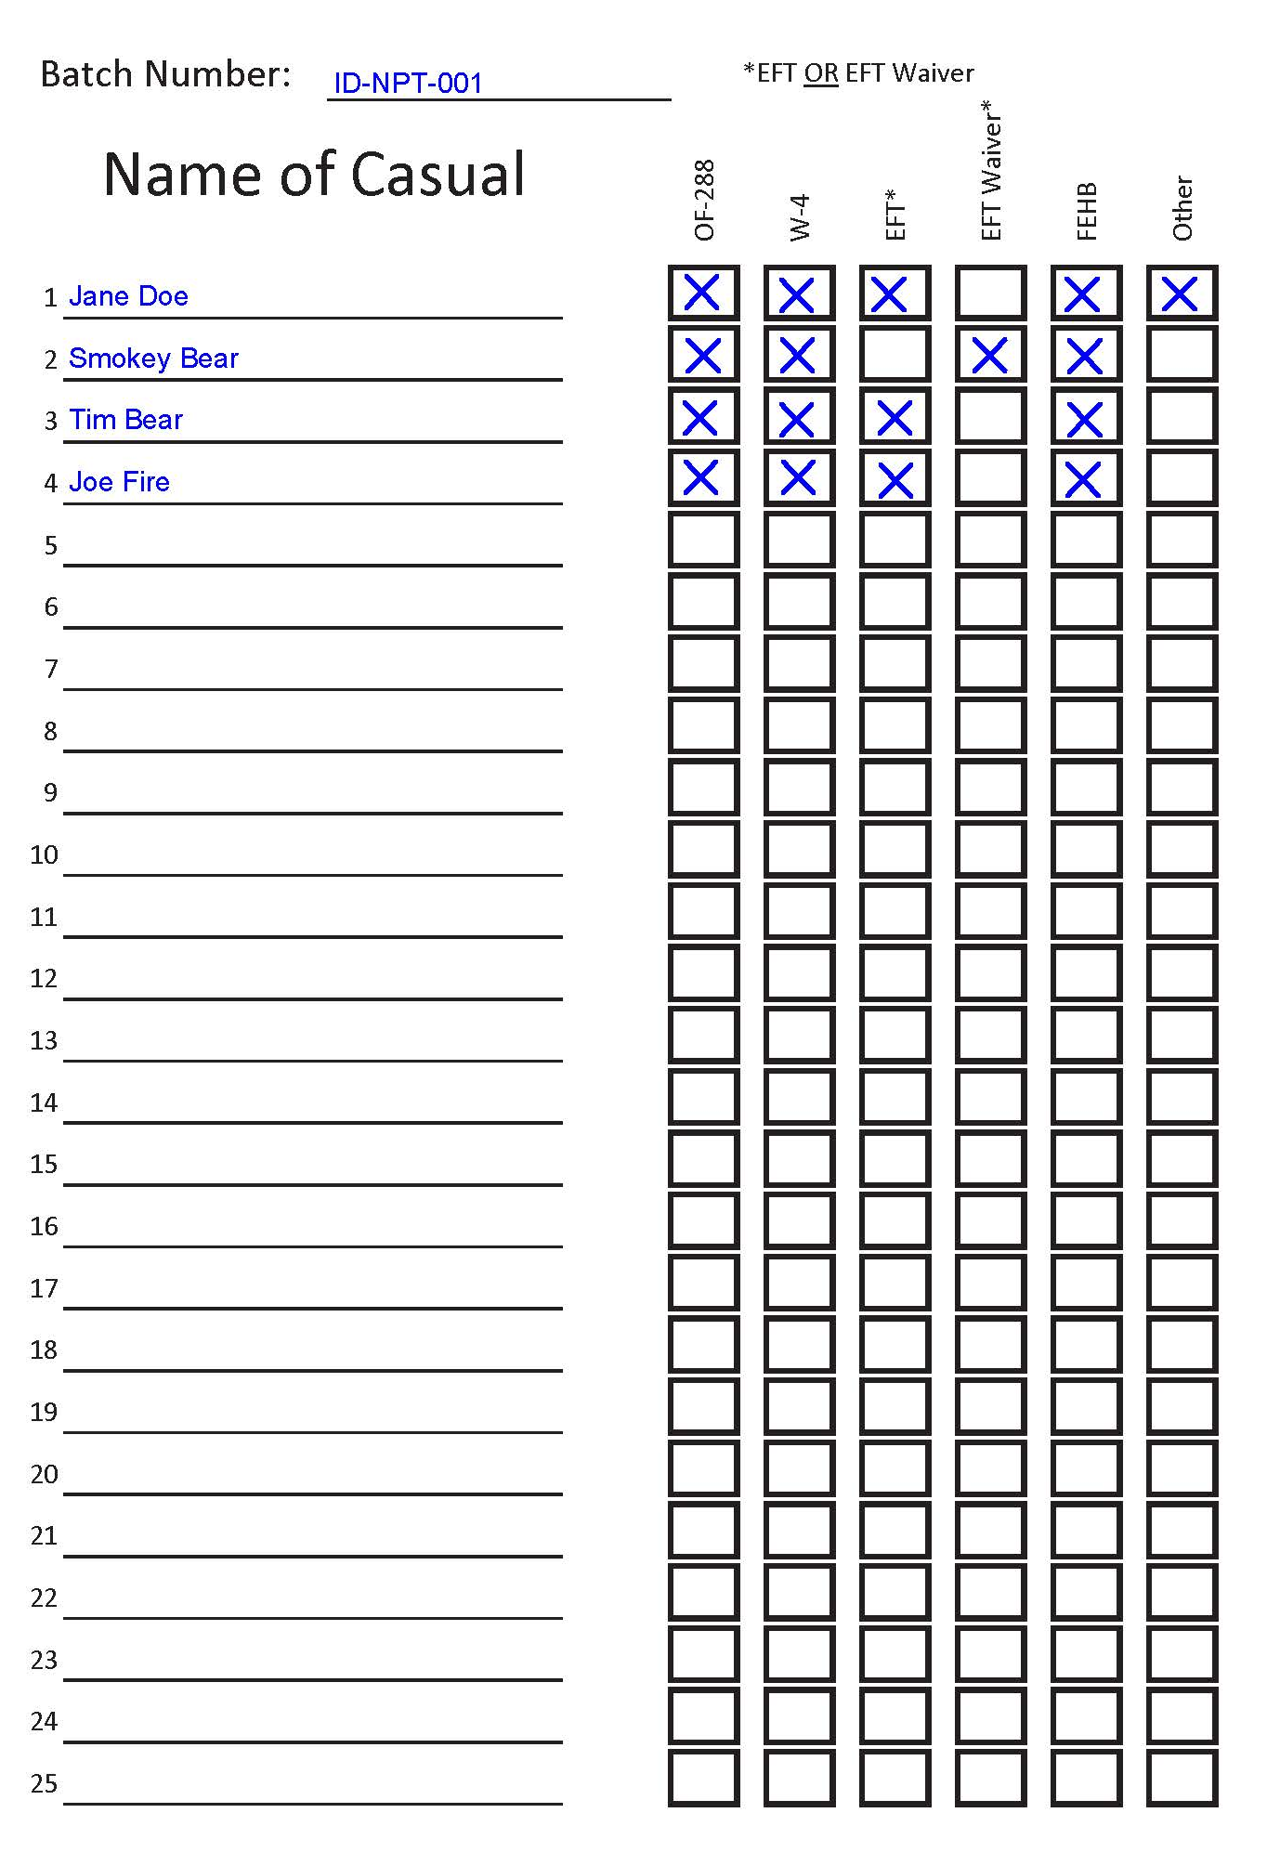
Batch Memo Manifest
Agency Batch Number
List of casual names
Account for additional documents being sent

Slide 25
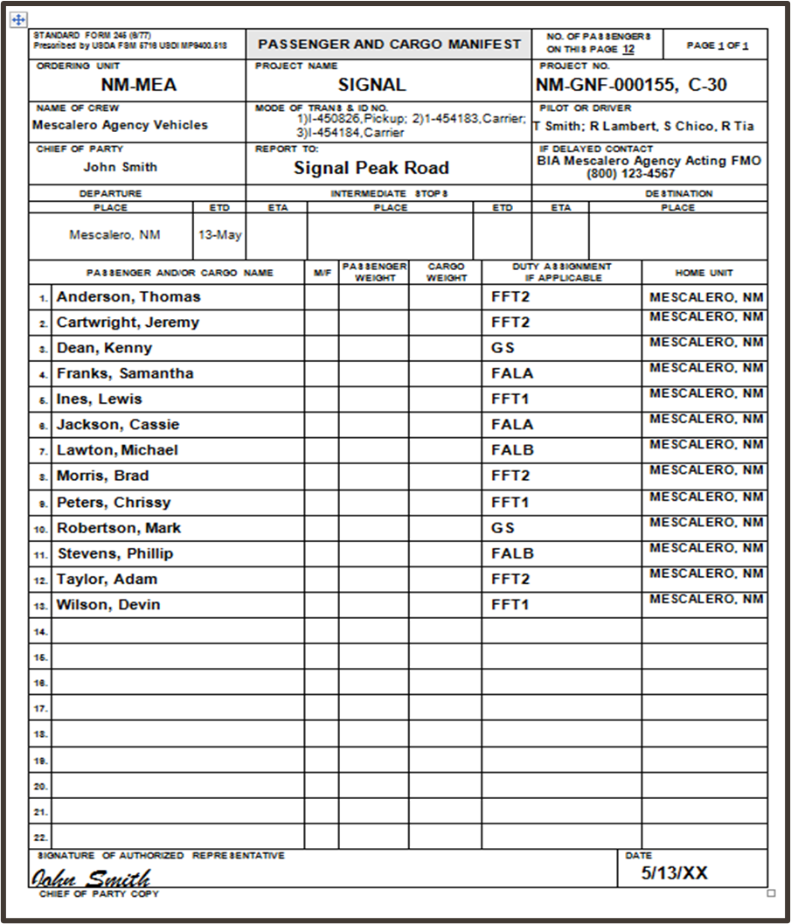
Passenger/Cargo Manifest
If list is long, instead of initiating a new manifest, attach the Passenger/Cargo Manifest with the list of Casual/ADs to the Approving Official Batch Memo.
Cross off names of Casual/ADs or GS employees who do not have OF-288s included in the batch.

Slide 26
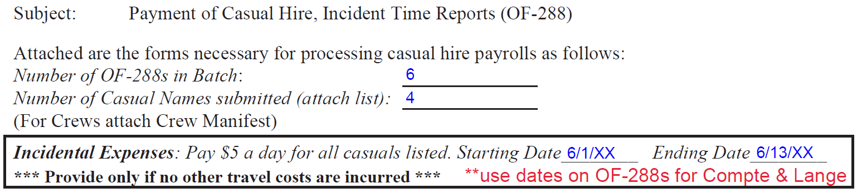

Travel Reimbursement Options on the
Batch Memo
1
Batch Memo: as part of the batch approval process, the AO will certify that the OF-288s are accurate, appropriate, and legal for payment.
2
Starting & Ending Dates for reimbursement should be completed by AO. The CPC will add dates & totals to each OF-288 based on the fire codes used for specific dates.
3
If there are casuals who joined the crew late or departed early, indicate those individuals and instruct to use dates on their OF-288s
4
Travel reimbursement is not for planned events, (e.g., Training or Rx).
If there are receipts, (e.g., lodging, baggage) it must go through ETS or Manual process (BIA).

Slide 27
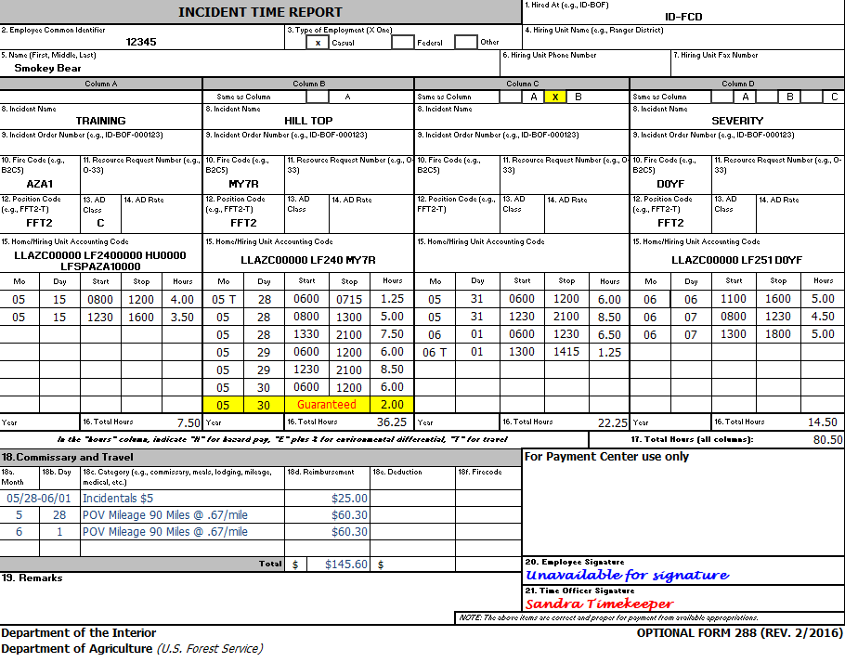
OF-288 Timesheet
BLM
Ensure the HA is indicated (box 1)
Verify the correct casual ECI and name is indicated (box 2 & 5).
Indicate Position Code. AD Class does not have to be listed, but if it is, it must not conflict with the PC (box 12 & 13).
Indicate cost code: Use approved abbreviated cost codes if preferred (box 15 or can be indicated in remarks, box 19).
Use military time in 15-minute increments. Indicate Guarantee time (month, day, and # of hours).
Travel comments can be made on the OF-288 (box 18).
Time Officer Signature must be present (box 21).
Note: $167 Boot Stipend will be applied automatically once casual qualifies.

Slide 28

OF-288 Timesheet
BIA
Ensure the HA is indicated (box 1)
Verify the correct casual ECI and name is indicated (box 2 & 5).
Indicate Position Code. AD Class does not have to be listed, but if it is, it must not conflict with the PC (box 12 & 13).
Indicate cost code: Use approved abbreviated cost codes if preferred (box 15 or can be indicated in remarks, box 19).
Use military time in 15-minute increments. Indicate Guarantee time (month, day, and # of hours).
Travel comments can be made on the OF-288 (box 18).
Time Officer Signature must be present (box 21).
Note: $167 Boot Stipend will be applied automatically once casual qualifies.

Slide 29
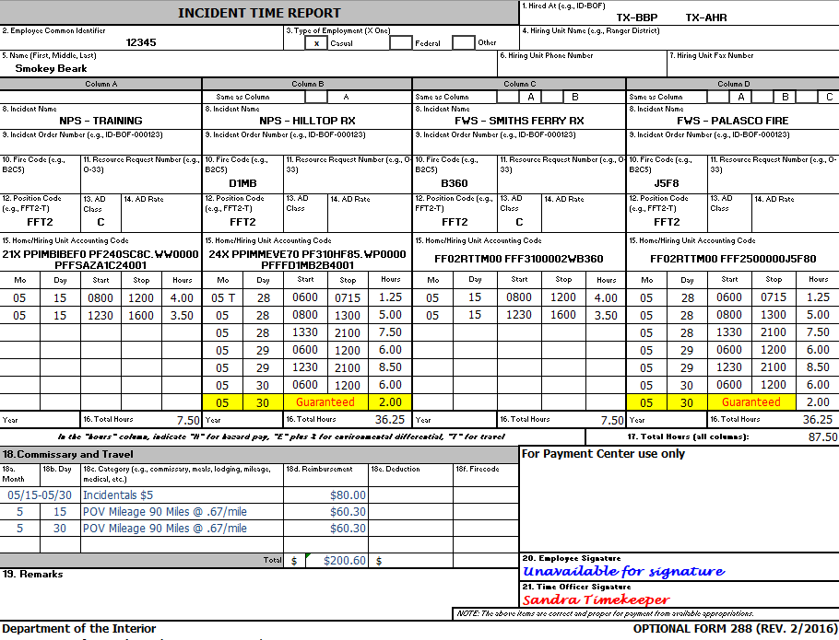
OF-288 Timesheet
NPS & FWS
Ensure the HA is indicated (box 1)
Verify the correct casual ECI and name is indicated (box 2 & 5).
Indicate Position Code. AD Class does not have to be listed, but if it is, it must not conflict with the PC (box 12 & 13).
Indicate cost code: Use approved abbreviated cost codes if preferred (box 15 or can be indicated in remarks, box 19).
Use military time in15-minute increments. Indicate Guarantee time (month, day, and # of hours).
Travel comments can be made on the OF-288 (box 18).
Time Officer Signature must be present (box 21).
Note: $167 Boot Stipend will be applied automatically once casual qualifies.

Slide 30
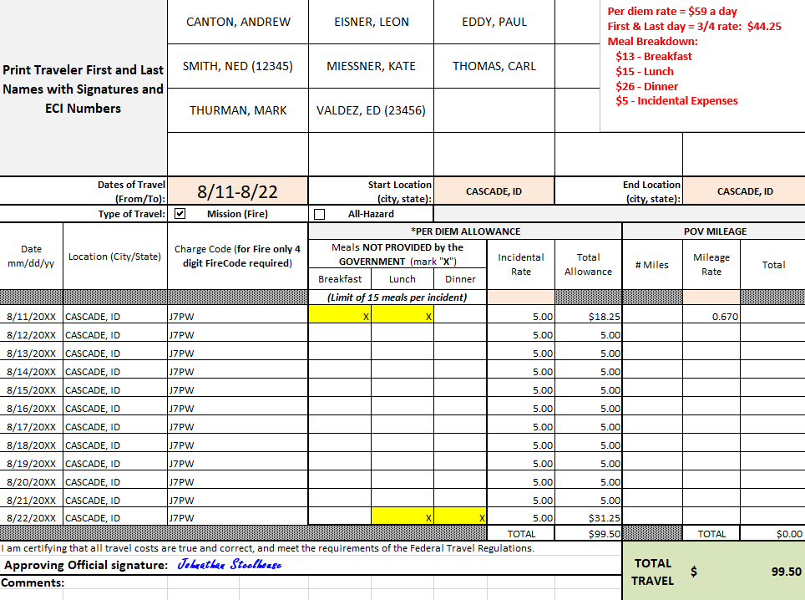
Travel Worksheet for a Crew
List casual names: add ECI if common or similar last name
Indicate dates and Type of Travel
List dates to be reimbursed for M&IE, city/state of where the night was spent, and 4-digit fire code
Ensure POV mileage is indicated at reimbursement rate of $0.67 per mile
Approving Official signature
The first & last day of travel are always calculated at ¾ rate (includes $5 incidental expenses) minus the cost of any meals provided: $44.25 - $26 = $18.25 (total allowance for 1st day)
8/12-8/21 - All meals provided at incident; only Incidental Expenses of $5 reimbursed

Slide 31
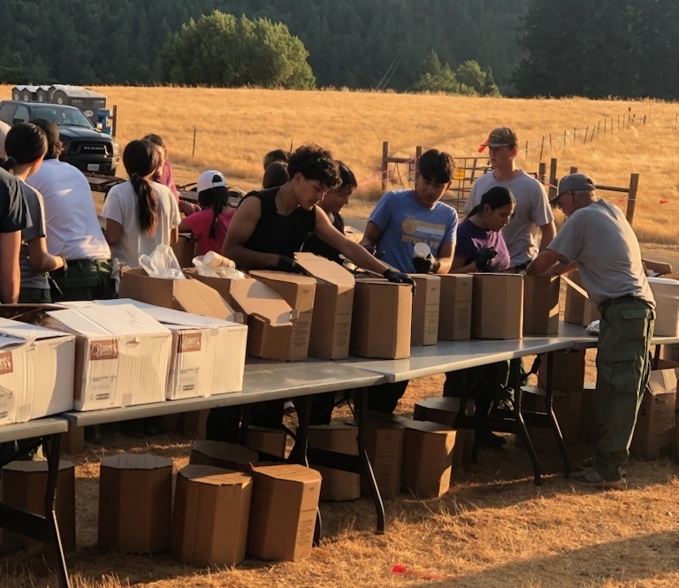
Meal Equation
1st day of travel reimbursement is $44.25 (3/4 rate – full rate is $59).
The government DID NOT provide Breakfast or Lunch ($13 for Breakfast and $15 for Lunch).
The casual is entitled to reimbursement for those meals not provided.
Because the government provided Dinner, the casual is NOT entitled to that amount, therefore $26 must be deducted from the total amount.
$44.25 - $26.00 (dinner provided) = $18.25
Although the 1st and last day are prorated at ¾ rate, the amount of each meal is not prorated, therefore the entire amount of that meal must be deducted.

Slide 32
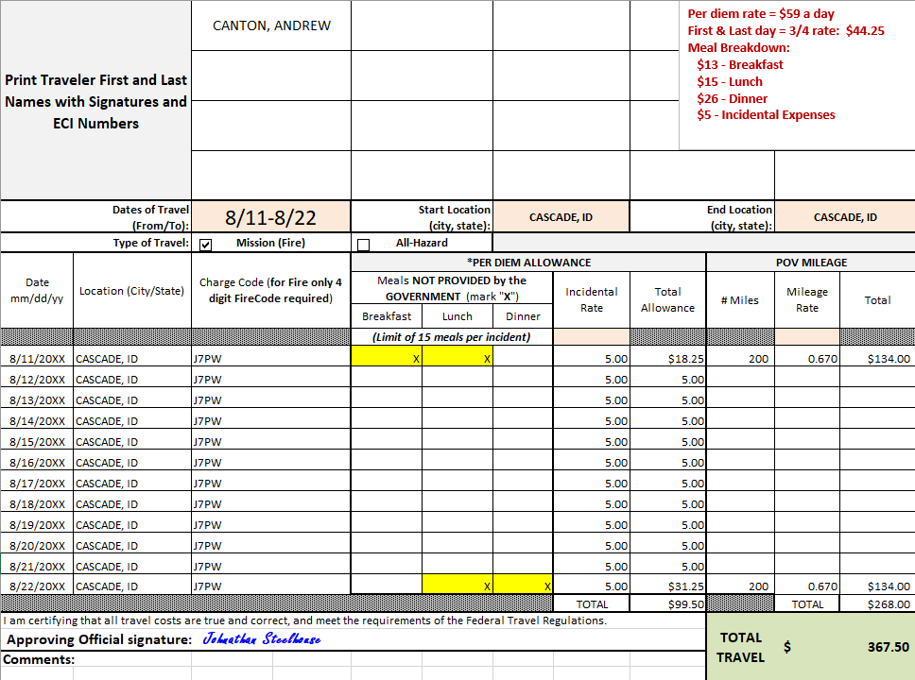
Travel Worksheet for a Single Casual
Casual name: add ECI if common last name
Indicate dates and Type of Travel
List dates to be reimbursed for M&IE, city/state of where the night was spent, and 4-digit fire code
Ensure POV mileage is indicated at reimbursement rate of $0.67 per mile
Approving Official signature
The first & last day of travel are always calculated at ¾ rate (includes $5 incidental expenses) minus the cost of any meals provided: $44.25 - $26 = $18.25 (total allowance for 1st day)
8/12-8/21 - All meals provided at incident; only Incidental Expenses of $5 reimbursed

Slide 33

Payroll Records
Calendar Year
PAYROLL RECORDS – Maintained on a calendar year basis as opposed to a fiscal year basis.
CASUAL FILES – Records are stored on a calendar year basis. Current and previous year’s records are available by request.
DATAMART REPORTS – Most reports are created on a calendar year basis.

Slide 34
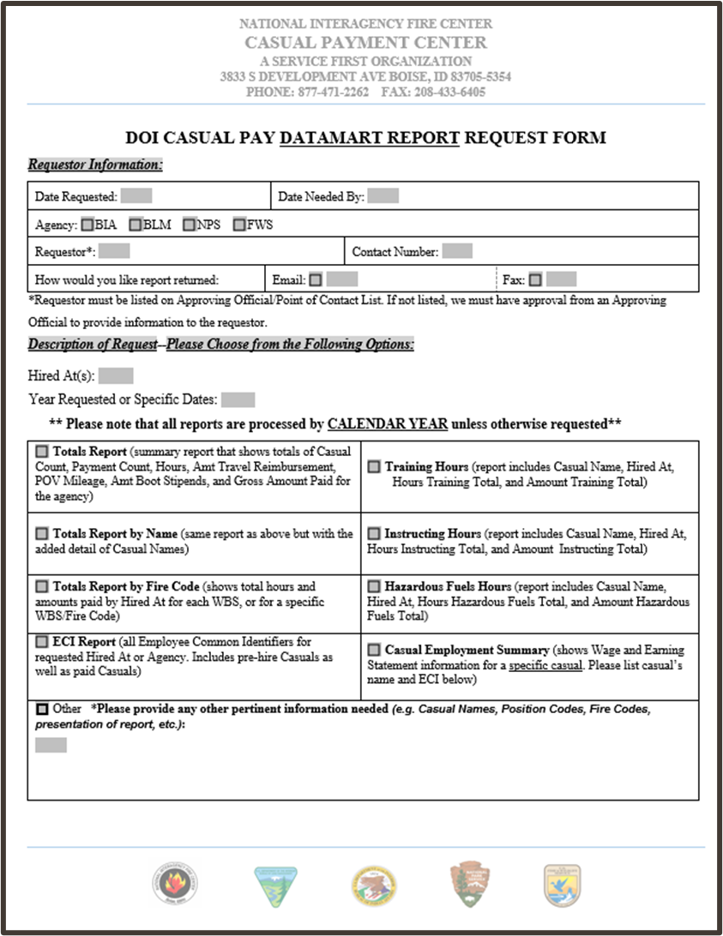
Casual Pay Datamart
Report Request Form
Include Date Needed By and how report should be sent, Email or Fax.
Clearly indicate which agency or Hired At(s) you would like reported and dates being requested.
Check report(s) being requested.
Email or fax request to the CPC.

Slide 35
Datamart Report Request Examples

Slide 36

THANK YOU!
Please visit our website to help with your payment needs.
https://www.nifc.gov/programs/casual-payment-center

