Slide 1
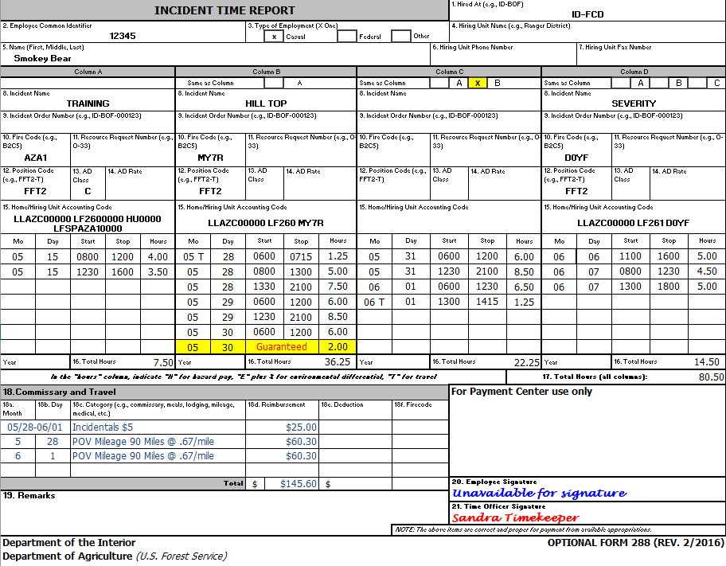
BLM OF-288 Sample
Ensure the HA is indicated (box 1)
Verify the correct casual ECI and name is indicated (box 2 & 5).
Indicate Position Code (PC). AD Class does NOT have to be listed, but if it is, must not conflict with the PC (box 12 & 13).
Indicate cost code: Use approved abbreviated cost codes if preferred (box 15 or can be indicated in remarks, box 19).
Use military time in 15-minute increments. Indicate Guarantee time (month, day, and # of hours).
Travel comments can be made on the OF-288 (box 18).
Time Officer Signature must be present (box 21).
Employee signature is not required.
DO NOT ENTER ANYTHING IN THIS BOX

Slide 2
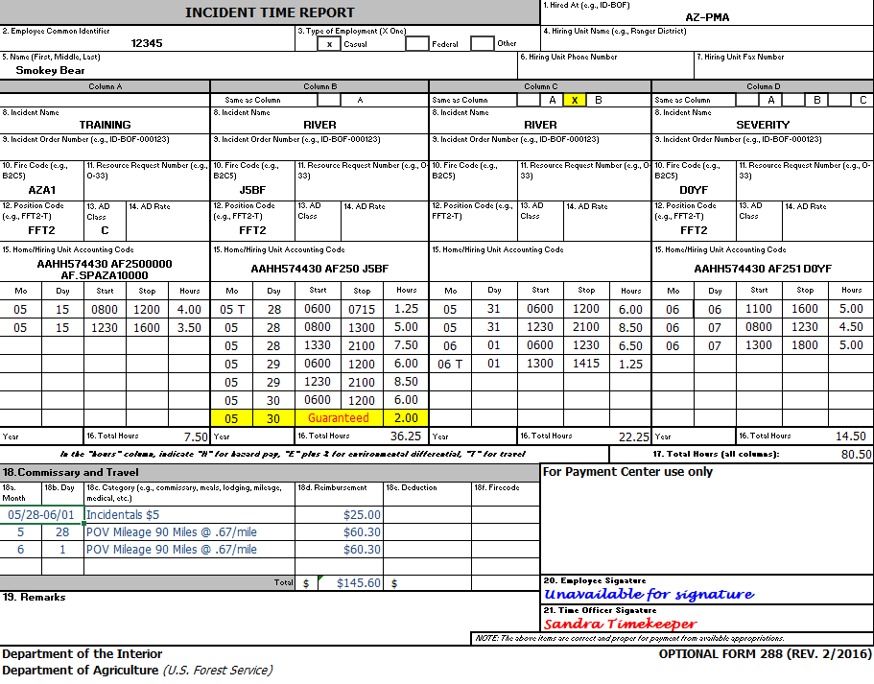
BIA OF-288 Sample
Ensure the HA is indicated (box 1)
Verify the correct casual ECI and name is indicated (box 2 & 5).
Indicate Position Code (PC). AD Class does NOT have to be listed, but if it is, must not conflict with the PC (box 12 & 13).
Indicate cost code: Use approved abbreviated cost codes if preferred (box 15 or can be indicated in remarks, box 19).
Use military time in 15-minute increments. Indicate Guarantee time (month, day, and # of hours).
Travel comments can be made on the OF-288 (box 18).
Time Officer Signature must be present (box 21).
Employee signature is not required.
DO NOT ENTER ANYTHING IN THIS BOX

Slide 3
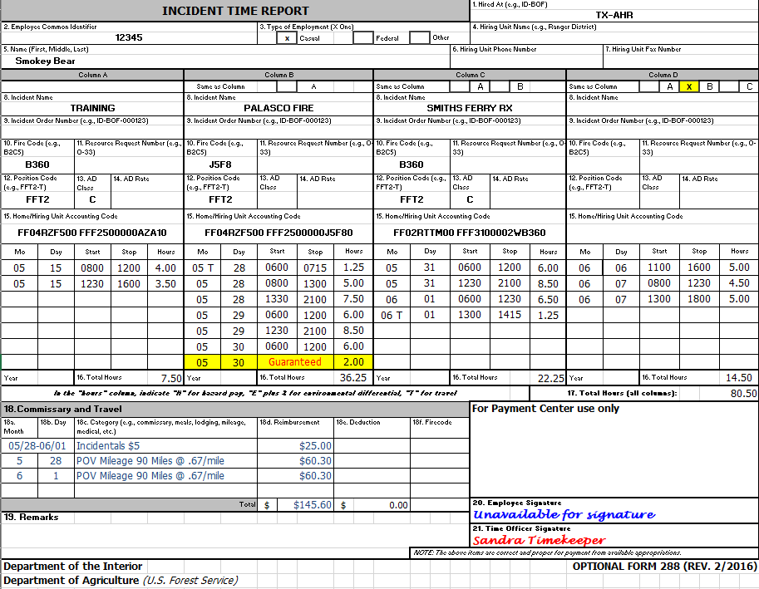
FWS OF-288 Sample
Ensure the HA is indicated (box 1)
Verify the correct casual ECI and name is indicated (box 2 & 5).
Indicate Position Code (PC). AD Class does NOT have to be listed, but if it is, must not conflict with the PC (box 12 & 13).
Indicate cost code: (box 15 or can be indicated in remarks, box 19).
Use military time in 15-minute increments. Indicate Guarantee time (month, day, and # of hours).
Travel comments can be made on the OF-288 (box 18).
Time Officer Signature must be present (box 21).
Employee signature is not required.
DO NOT ENTER ANYTHING IN THIS BOX

Slide 4
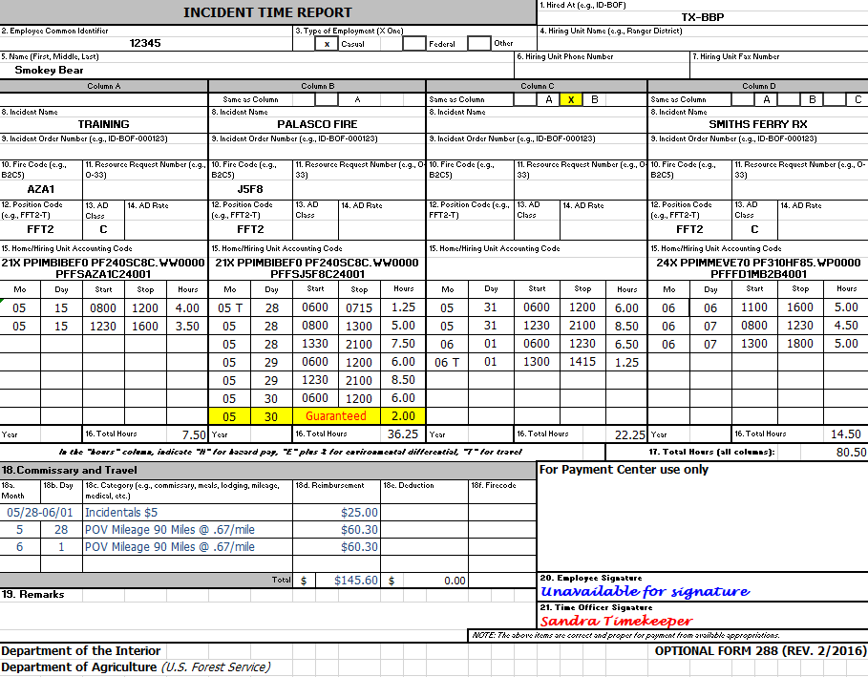
NPS OF-288 Sample
Ensure the HA is indicated (box 1)
Verify the correct casual ECI and name is indicated (box 2 & 5).
Indicate Position Code (PC). AD Class does NOT have to be listed, but if it is, must not conflict with the PC (box 12 & 13).
Indicate cost code: (box 15 or can be indicated in remarks, box 19).
Use military time in 15-minute increments. Indicate Guarantee time (month, day, and # of hours).
Travel comments can be made on the OF-288 (box 18).
Time Officer Signature must be present (box 21).
Employee signature is not required.
DO NOT ENTER ANYTHING IN THIS BOX

