Slide 1
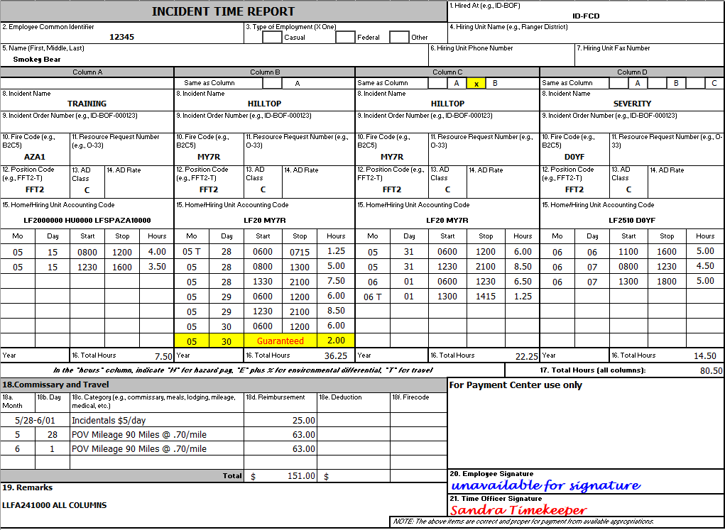
BLM OF-288 TIMESHEET
Ensure the HA is indicated (box 1).
Verify the correct casual ECI and name is indicated (box 2 and 5).
Indicate Position Code. AD Class does not have to be listed, but if it is, it must not conflict with the PC (box 12 and 13).
Indicate cost code: Use approved abbreviated cost codes if preferred (box 15 or can be indicated in remarks, box 19).
Use military time in 15-minute increments. Indicate Guarantee time (month, day, and # of hours).
Travel comments can be made on the OF-288 (box 18).
Time Officer Signature must be present (box 21).
NOTE: $167 Boot Stipend will be applied automatically once casual qualifies.
DO NOT ENTER ANYTHING IN THIS BOX

Slide 2
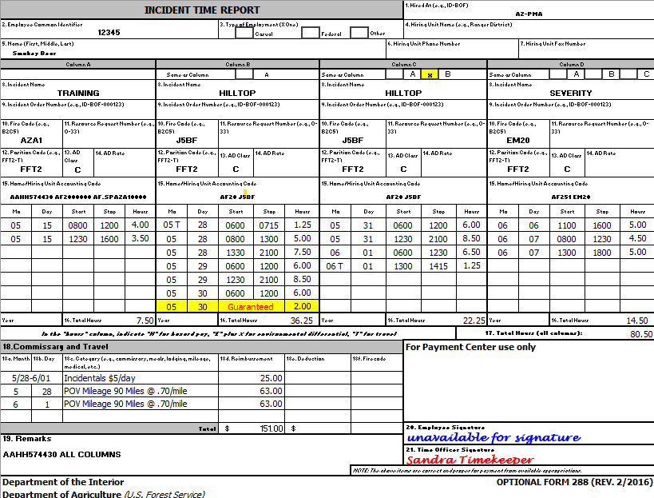
BIA OF-288 TIMESHEET
Ensure the HA is indicated (box 1).
Verify the correct casual ECI and name is indicated (box 2 and 5).
Indicate Position Code. AD Class does not have to be listed, but if it is, it must not conflict with the PC (box 12 and 13).
Indicate cost code: Use approved abbreviated cost codes if preferred (box 15 or can be indicated in remarks, box 19).
Use military time in 15-minute increments. Indicate Guarantee time (month, day, and # of hours).
Travel comments can be made on the OF-288 (box 18).
Time Officer Signature must be present (box 21).
NOTE: $167 Boot Stipend will be applied automatically once casual qualifies.
DO NOT ENTER ANYTHING IN THIS BOX

Slide 3
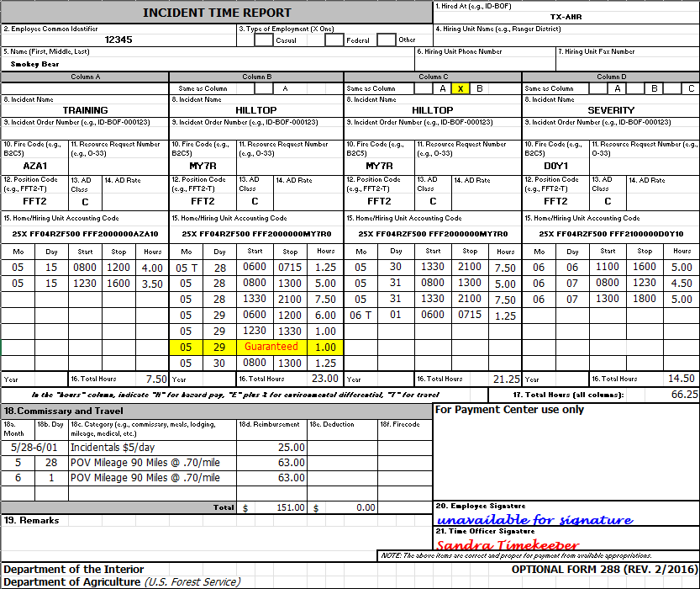
FWS OF-288 TIMESHEET
Ensure the HA is indicated (box 1).
Verify the correct casual ECI and name is indicated (box 2 and 5).
Indicate Position Code. AD Class does not have to be listed, but if it is, it must not conflict with the PC (box 12 and 13).
Indicate cost code (box 15 or can be indicated in remarks, box 19).
Use military time in 15-minute increments. Indicate Guarantee time (month, day, and # of hours).
Travel comments can be made on the OF-288 (box 18).
Time Officer Signature must be present (box 21).
NOTE: $167 Boot Stipend will be applied automatically once casual qualifies.
DO NOT ENTER ANYTHING IN THIS BOX

Slide 4
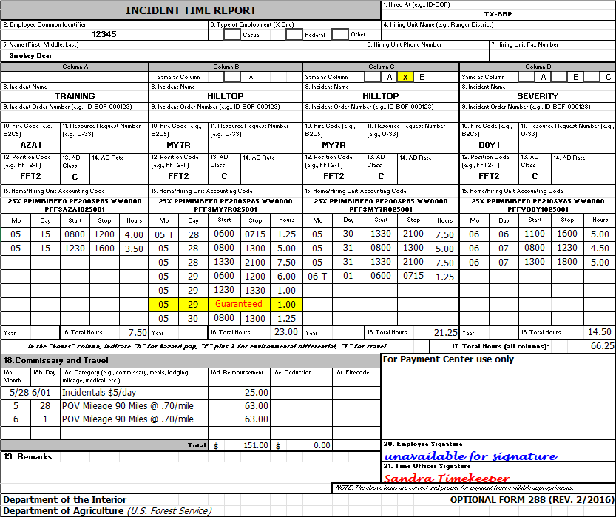
NPS OF-288 TIMESHEET
Ensure the HA is indicated (box 1).
Verify the correct casual ECI and name is indicated (box 2 and 5).
Indicate Position Code. AD Class does not have to be listed, but if it is, it must not conflict with the PC (box 12 and 13).
Indicate cost code (box 15 or can be indicated in remarks, box 19).
Use military time in 15-minute increments. Indicate Guarantee time (month, day, and # of hours).
Travel comments can be made on the OF-288 (box 18).
Time Officer Signature must be present (box 21).
NOTE: $167 Boot Stipend will be applied automatically once casual qualifies.
DO NOT ENTER ANYTHING IN THIS BOX

